Slide 1

STOP BED BUGS!
Bed Bug Prevention & Management for Residents
The Northeastern IPM Center receives support from the U.S. Department of Housing and Urban Development's Office of Healthy Homes and Lead Hazard Control through USDA-NIFA to facilitate this program.
Susannah Reese
The Northeastern IPM Center
Cornell University

Slide 2
What we’ll talk about today:
How do we get bed bugs?
What do they look like?
Inspecting and monitoring can prevent infestations!
Got bed bugs? Now what?

Slide 3
Myth or Truth?
Bed bugs carry disease
I need to throw out my mattress if I see bed bugs
Putting my mattress in cold or sun will kill bed bugs
Bed bugs are too small to see
Bed bugs eat left over food
Bed bugs can fly
Boric acid kills bed bugs
Turning up my thermostat to super heat my apartment will kill bed bugs
I can handle bed bugs on my own, and buy pesticides or use products that work

Slide 4
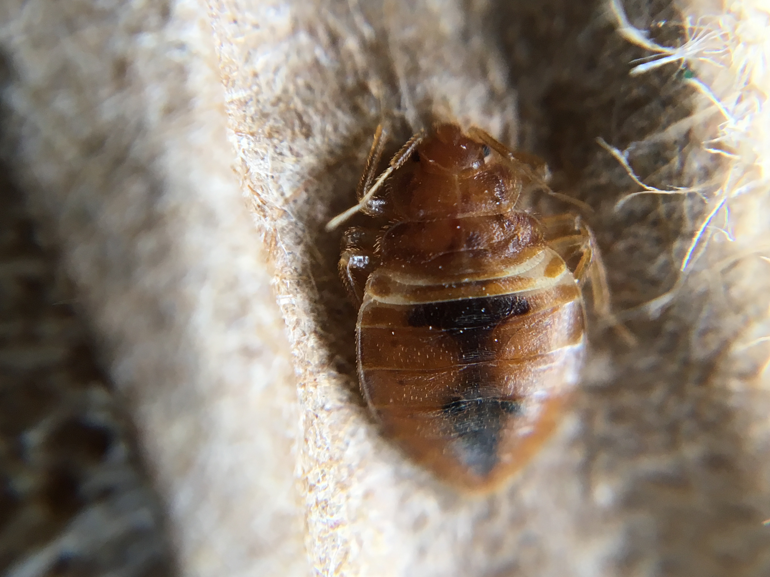

Bed bugs are a pest of public health significance
Result in stress, loss of work, loss of productivity, loss of sleep, and financial burden
Cause secondary infections after people scratch their bed bug bites
Are unwelcome in our homes and workplaces
Bed bugs do not transmit disease under normal living conditions.
Notes:
4
Although bed bugs have not been shown to transmit disease, they do have an effect on physical and mental health. In 2010 EPA and CDC issued a joint statement, classifying bed bugs as a "pest of significant public health importance.”
Dr. Dawn Gouge clarifies: Bed bugs do not transmit disease under normal living conditions
They can vector a number of bacterial pathogens e.g., Q fever and trench fever pathogens.
Physical effects could result from scratching the welts that show up on some people from the bed bug bite. The elderly and children may not have the self control to stop scratching and infection can result.
Many people with bed bugs cannot sleep and suffer negative effects. The stress from having bed bugs, having to treat them, and having to pay for it can take a significant toll.

Slide 5
How do we get bed bugs?
ANYONE can get bed bugs. Here’s how:
Hitchhikers
Bringing used furniture into a home w/o inspecting first
Bringing home used clothing w/o washing first
Through cracks and crevices in walls between apartments

Slide 6
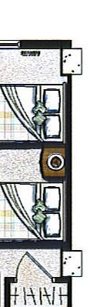
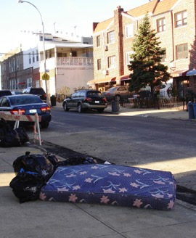
How do bed bugs spread?
Actively crawl along wires, pipes, and under doors
Passively on anything coming from an infested unit (furniture, backpacks, laundry…)
What’s on the other side of the wall?
Notes:
6
Prevention is key.
Since bed bugs are so reliant on humans, they have become very good at staying close to them. In public housing, one infestation can quickly spread throughout the development. The spread usually occurs when:
-residents in adjacent units do not inspect regularly, Bed bugs will travel along pipes or on wires if their food source is removed, or if the infestation gets too crowded. If a unit has bed bugs, all adjacent units should be inspected.
-management does not have the PMP inspect and possibly treat adjacent units,
-infested items are moved through the building without being wrapped in plastic,
-infested items intended for the trash are picked up and brought home,
-staff visits multiple units per day with bags or equipment
-residents visit each other carrying backpacks,
-or bed bugs are brought to the laundry room on bedding and people bring them home from this location.
If infested items are to be brought to the trash: 1. Cover the infested item with plastic for transport through the building. 2. Once outside, make the item unusable by breaking or cutting it open. 3. Put the broken item inside a covered trash receptacle. All these steps help ensure that bed bugs are not spread into uninfested areas within the PHA.

Slide 7
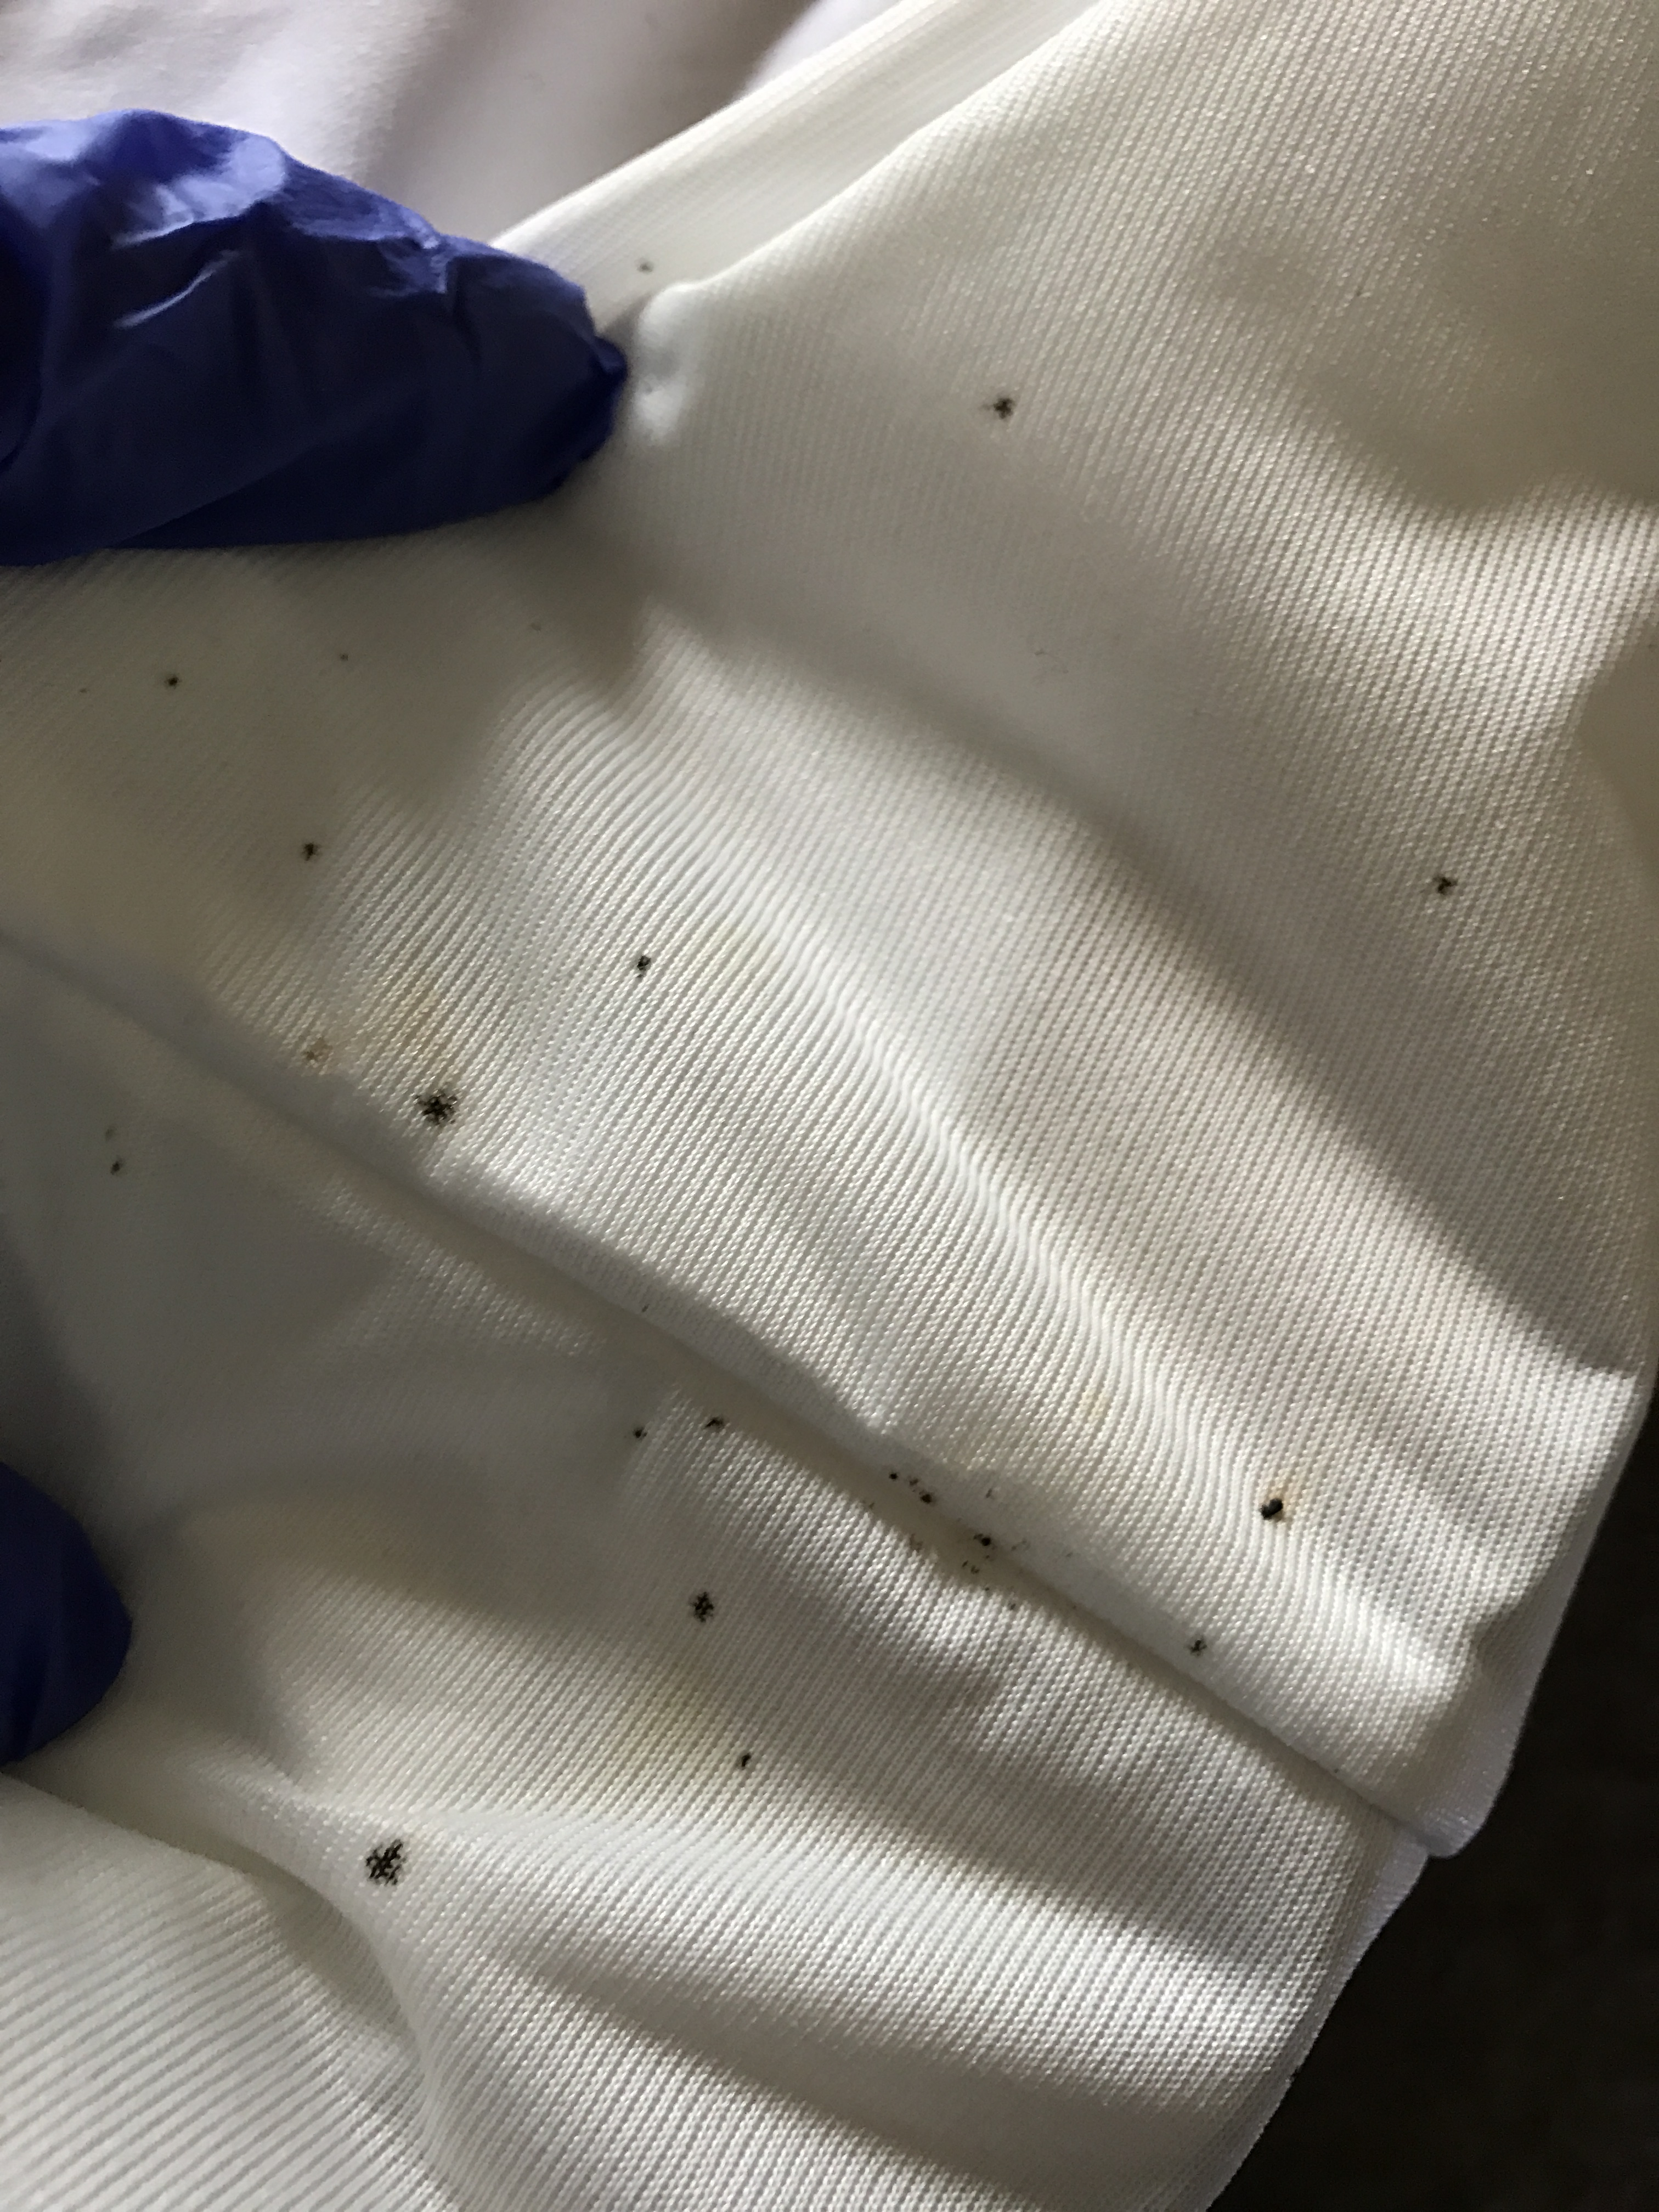
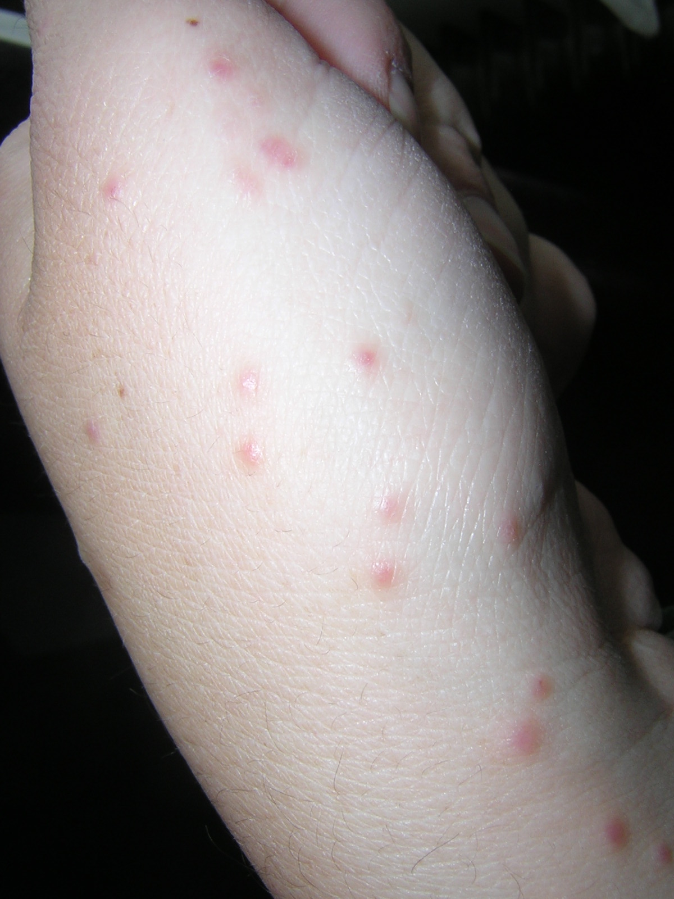
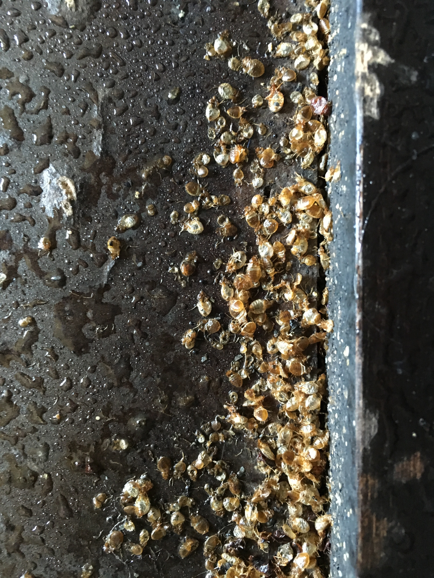
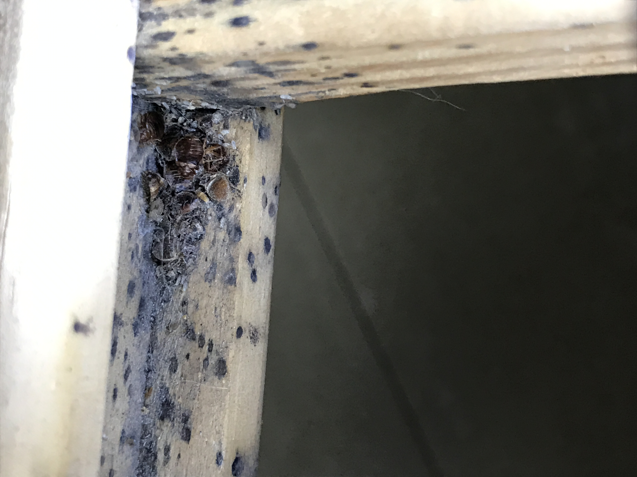
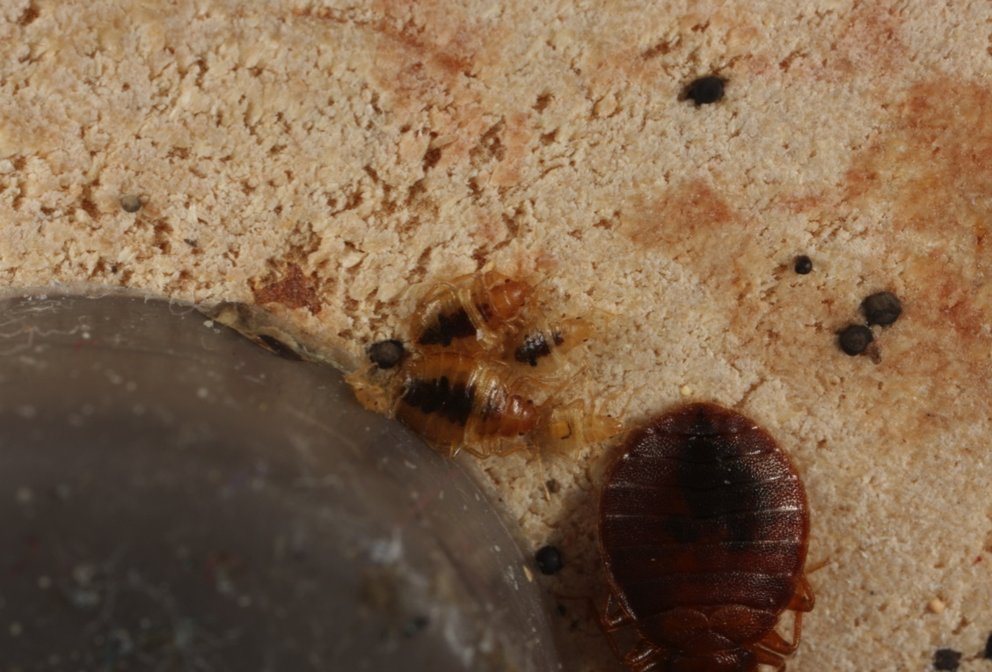
Signs of bed bugs
Bites
Fecal spots
Shed skins
Dead bed bugs
Live bed bugs
Photo: Susannah Reese
Photo: Susannah Reese
Photo: Susannah Reese
Photo: Alex Yelich
Notes:
7
Bed bugs are small and very good at hiding, so a flashlight is needed to see them (or evidence of them).
Keep looking until either a live bed bug is found or all involved feel satisfied that there are no bed bugs.
If bed bugs are found, a few should be put on tape or in a re-sealable plastic bag for identification.
The photo shows bed bugs that were snuggled next to the screw-in foot of a recliner. It took flipping the recliner over to find them. When the foot was unscrewed, more were found.

Slide 8
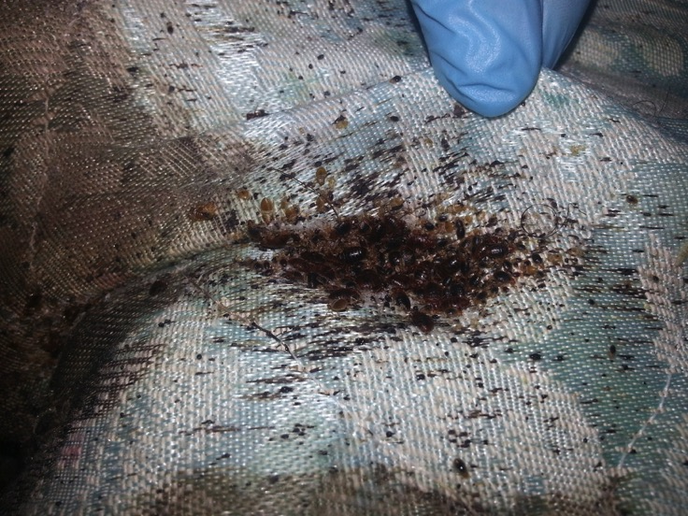
What do bed bugs look like?

Slide 9
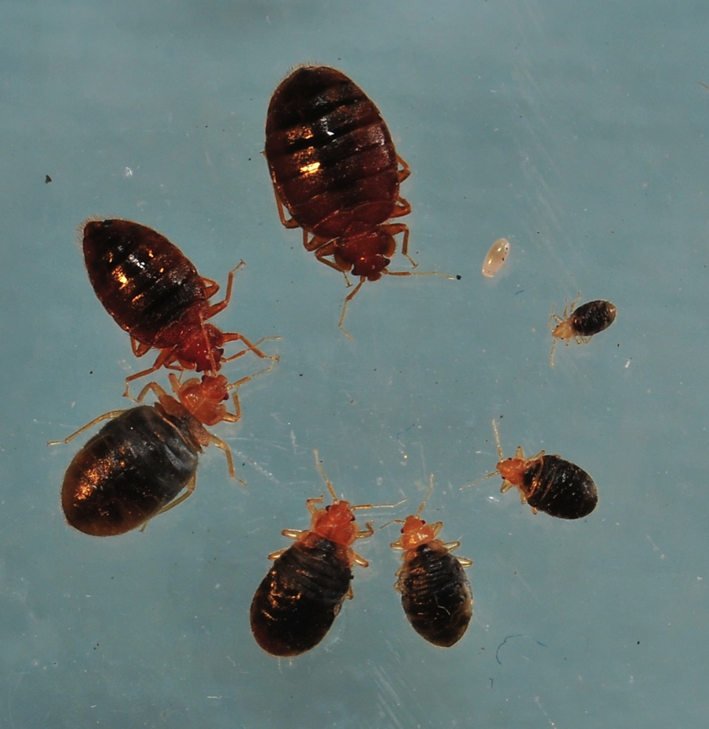
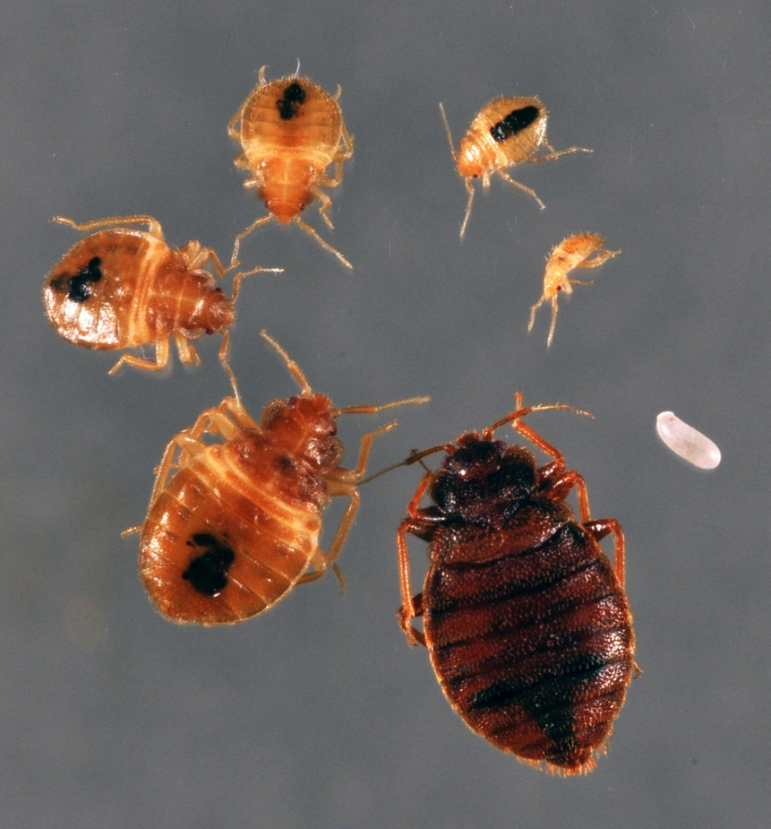
Bed bug life cycle
Fed
Not recently fed
Notes:
Bed bugs can be two different shapes, depending on when they last fed. They expand when full of blood and quickly (within a few hours) digest the blood and poop out the excess so that they are flat again. A recently fed bed bug will be plump, but after it digests it is back to being flat.
Like cockroaches, baby bed bugs look like the adults, only smaller.

Slide 10
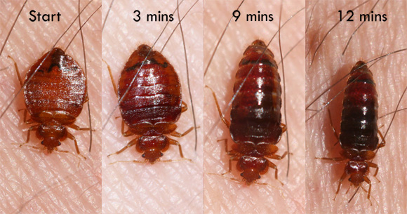
The feeding process
Start 3 min 9 min 12 min
Photo: Whitney Cranshaw
Notes:
Mike Merchant’s slide
Note that during feeding the adult bed bug’s body becomes distended with blood. This is normal. Not all bed bugs will look exactly alike.

Slide 11
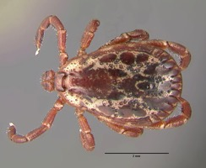
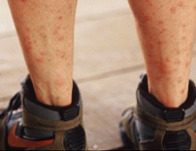
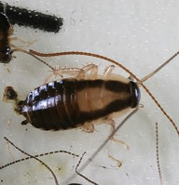
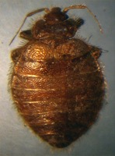
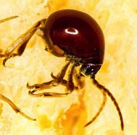
Can be confused with…
Ticks
Cockroach nymphs
Other kinds of bug bites
Allergic reactions to chemicals
Tick
Mosquito Bites
Cockroach Nymph
Bat Bug
Spider Beetle
Notes:
The photos are of a tick, mosquito bites, a cockroach nymph, a bat bug, and a spider beetle a few of the insects that have been found in the homes of people who thought they had bed bugs. Proper identification can save time, anxiety, and money. The only way to confirm bed bugs is to find live bed bugs, collect a few, and have a professional identify them.

Slide 12
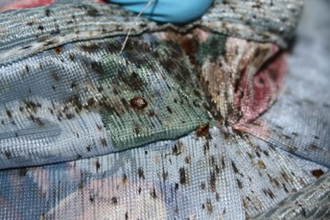
Fecal spots
Fecal spots are bed bug droppings
Different from frass—frass is gritty, fecal spots are smooth.
A current bed bug infestation cannot be confirmed by fecal spots
alone
Live bed bugs
must be found
A bad infestation
Notes:
Fecal spots are bed bug poop. Some people may have heard them called "blood spots." You may find blood spots on sheets where someone squished a recently fed bed bug, but fecal spots are small dark dots, like the dot a fine tipped sharpie would make. Fecal spots will be found on sheets, pillow cases, mattresses, and around the spot where they are returning to hide. Bed bugs often hide together (as evidenced in the picture above) but not always. Careful inspection with a flashlight must be done to find the spots where they are hiding…especially the loners. One pregnant female could restart an infestation.
You can distinguish fecal spots from cockroach frass. Frass is gritty, like pepper. Fecal spots are smooth.

Slide 13
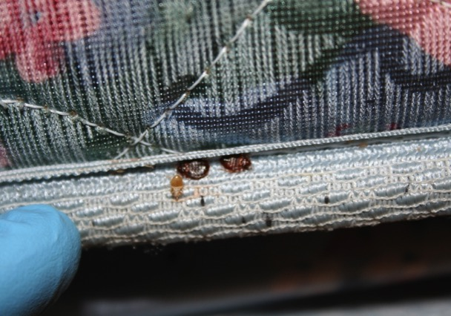
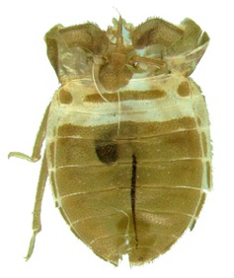
Shed skins
Bed bug signs on a mattress seam
Notes:
Bed bugs don’t have stretchy skin. When they need to grow up, they shed their outer layer—emerging as a larger version. They do this five times, going from the size of a poppy seed to the size of an apple seed. Shed skins look like hollow bed bugs and are the evidence of this growing process.

Slide 14
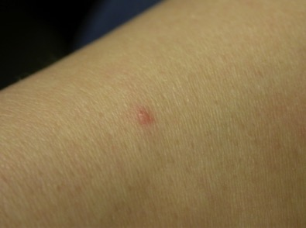
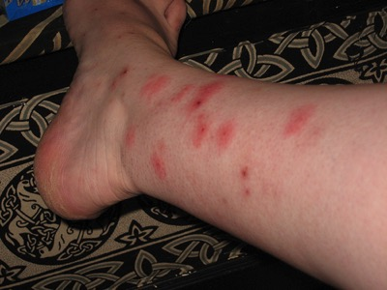
Bites
Bed bugs cannot be confirmed by bites alone—bites do not show up on everyone
Live bed bugs must be found
Notes:
There is a myth of bed bug bites always showing up in sets of three in a row: “breakfast, lunch, and dinner.” This is untrue. Bed bugs will come out of hiding to feed when they are hungry (usually once a week), feed until they are full, and then return to their hiding spots, leaving blood spots (bed bug poop) along their route. The bites in a row happen if there are any feeding along the sheet-human intersection or if one is disturbed mid-meal and has to reinsert its mouthpart.
Not everyone reacts to the bites, and a person’s reaction to bed bugs may change over time (not reacting at first, but then reacting after being bitten a number of times).

Slide 15
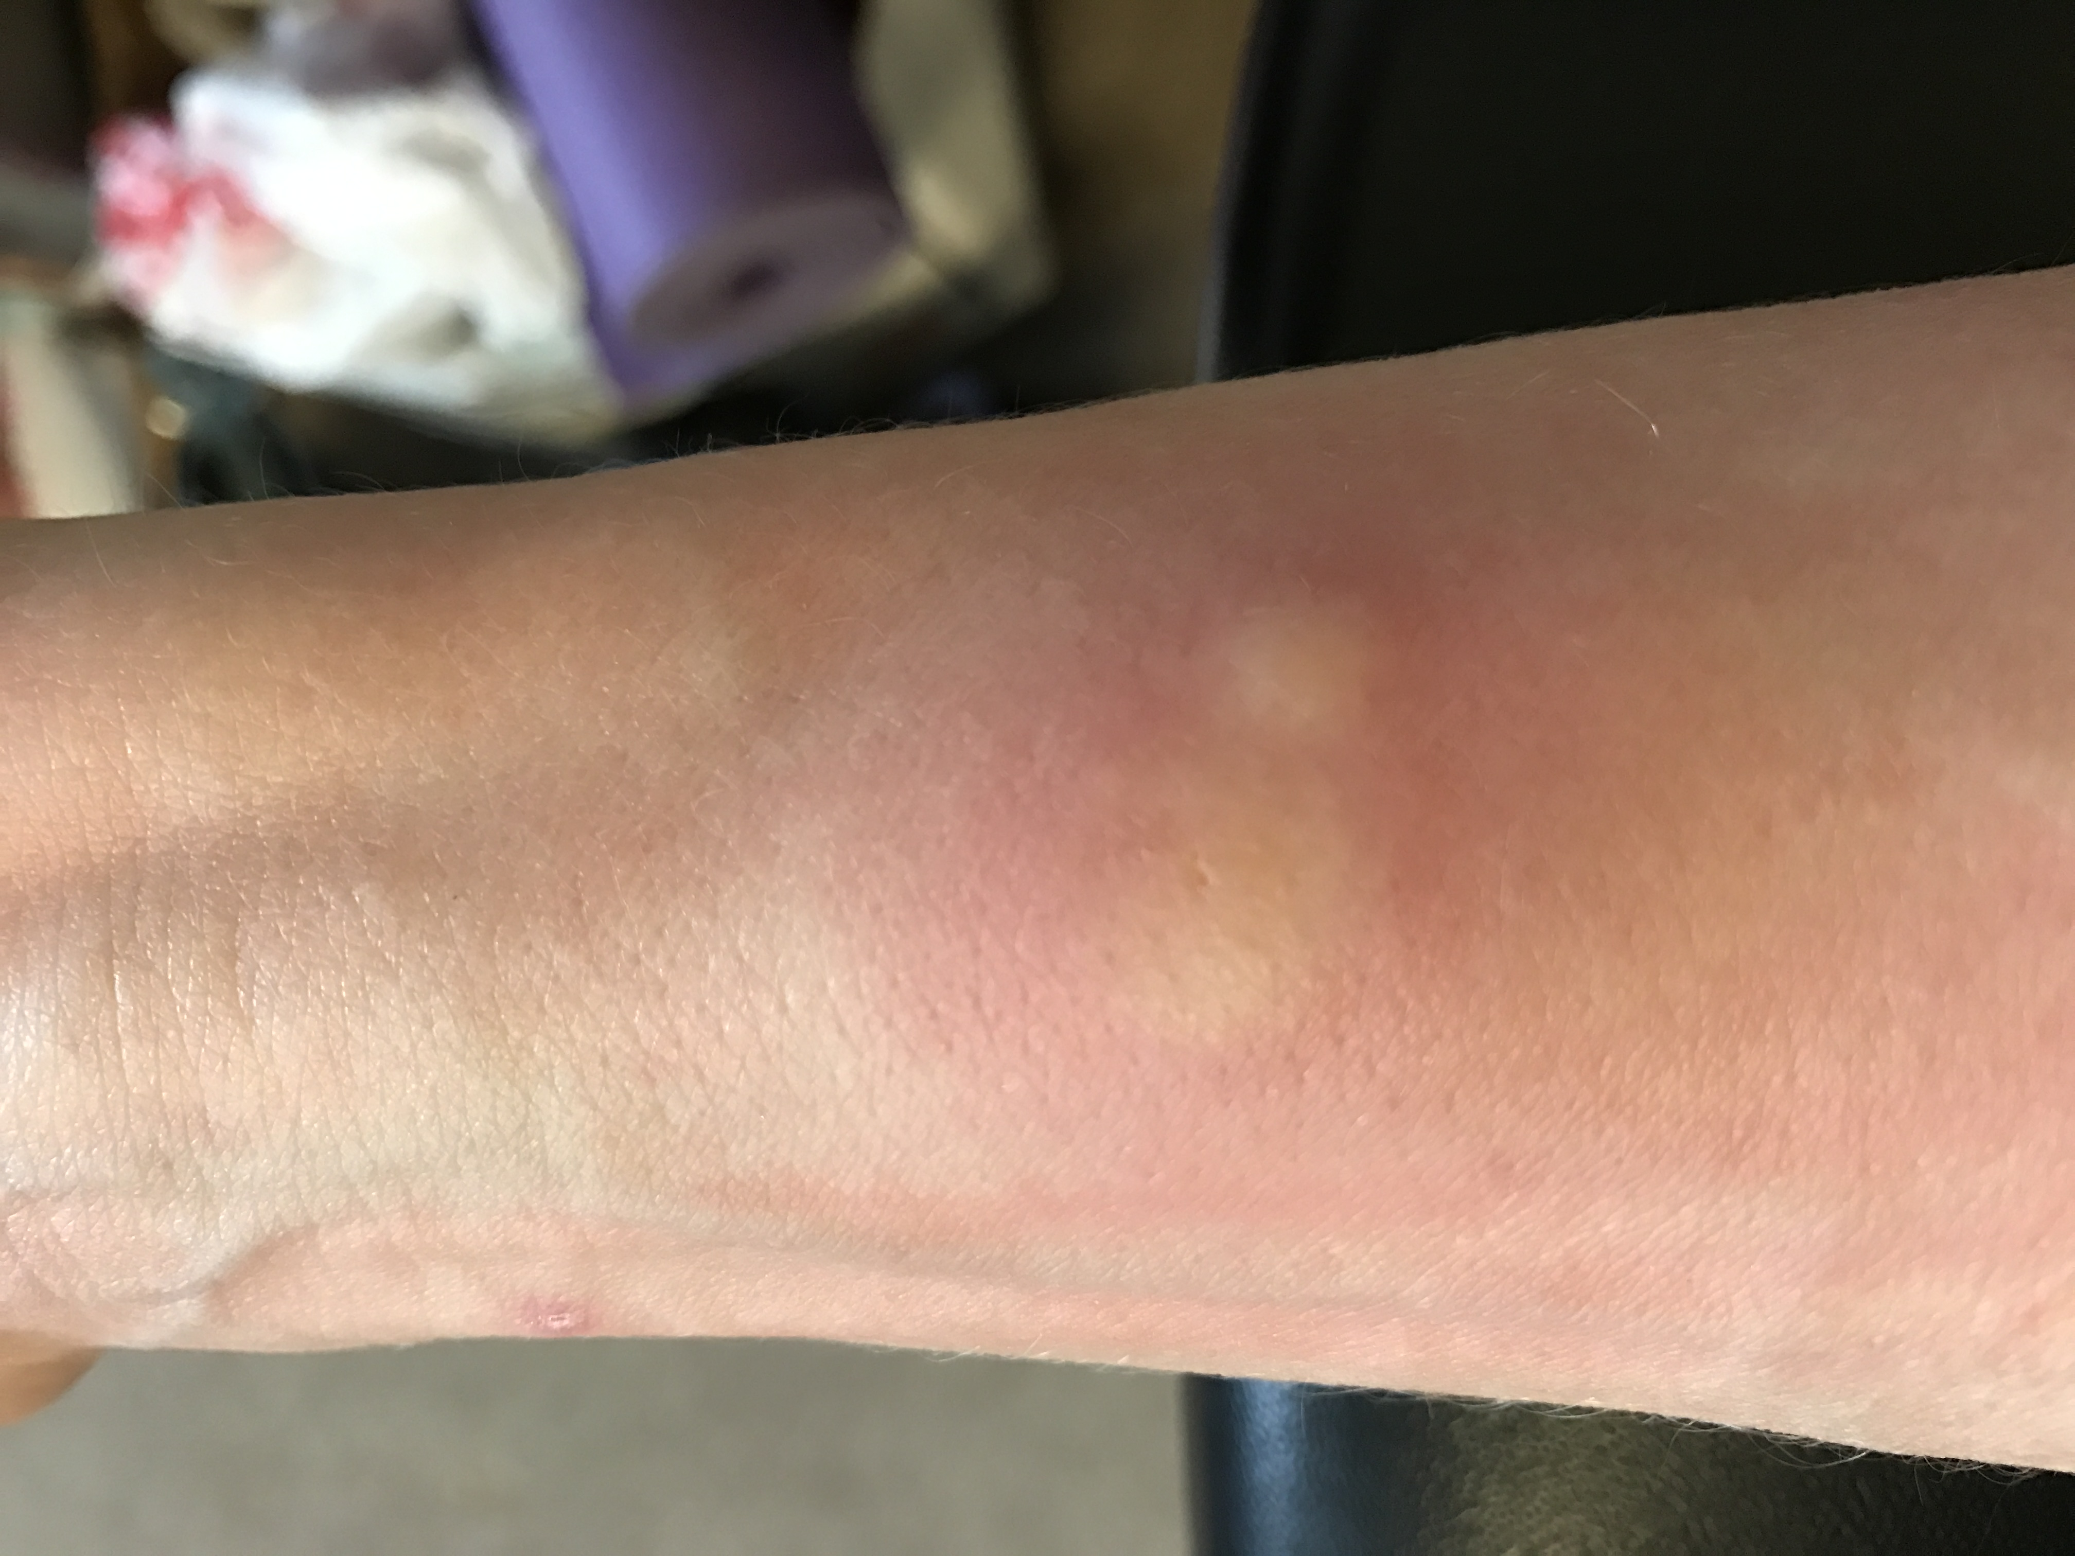
People and bed bug bites
Prefer feeding during darkness
Bites often painless
Many people don’t exhibit an obvious reaction to bed bug bites and may not know they have an infestation
Photo: Susannah Reese
Photo: Susannah Reese
Notes:
Mike Merchant’s slide add changlu’s stats on
The one in 20 stat comes from a study done by Ron Harrison at the Orkin National office. He enlisted hundreds of volunteer Orkin employees over several years to be bitten by a bed bug. Only about 5% complained of any skin reaction to a single bite.
Will feed in daytime if necessary
May travel 20 feet from hiding place to feed…even farther if necessary
Seem to prefer humans over pets
Attracted to humans by body odor, body heat, carbon dioxide

Slide 16
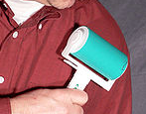
Inspection
Always use a flashlight
If bed bugs are found, neighbors should be inspected
Two types
  Visual
  Scent detecting canine
Lint roller are a great inspection tool!
Notes:
Inspections using a bed bug detection canine are especially useful in two scenarios. 1. When a person reports bed bugs but the PMP can’t find any with visual inspection. 2. When a PMP wants to confirm that the area is bed bug-free, for example post- treatment. Canine inspections for bed bugs may identify emerging infestations in their earliest stages, helping property managers gain building-wide control before an infestation spreads to other units, saving considerable time and money.
Inspection with canines is useful for detection, but as with inspection by humans, there is potential for error. You should be able to verify the presence of bed bugs where the dog "alerts" the majority of the time. The dog’s effectiveness depends upon the quality of its training, the ability and consistency of its trainer, and the conditions in the area of inspection. If trained and handled properly, bed bug-sniffing dogs can inspect much more effectively and in a much shorter time than a human. Contact the National Entomology Scent Detection Canine Association (NESDCA) for more information.

Slide 17

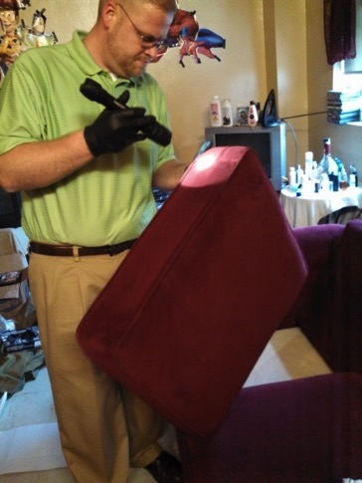
Inspect with a flashlight and lint roller
Inspect yourself – shoes, laces, socks, arms of jackets most common spots

Slide 18
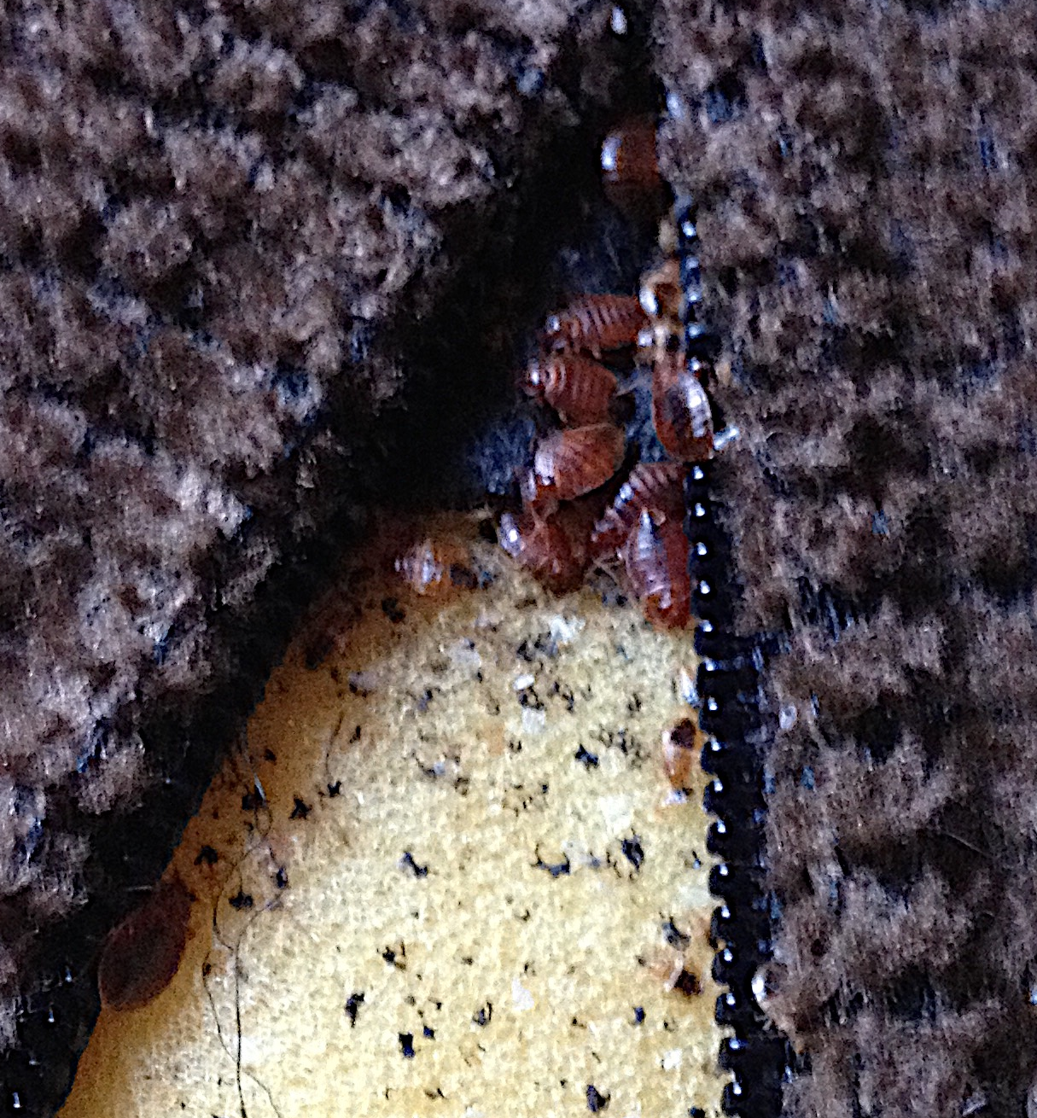
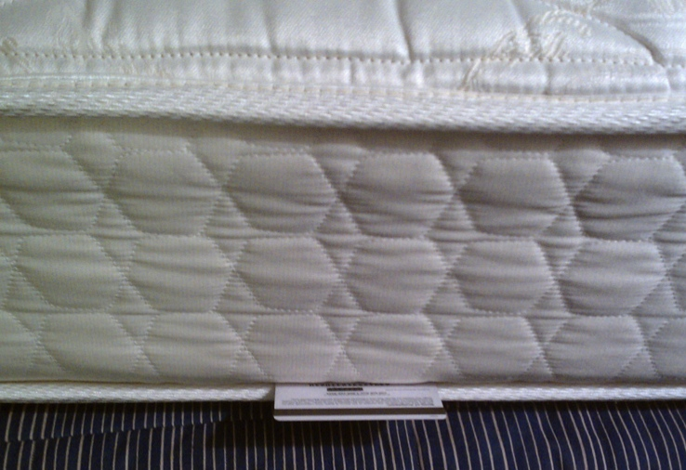
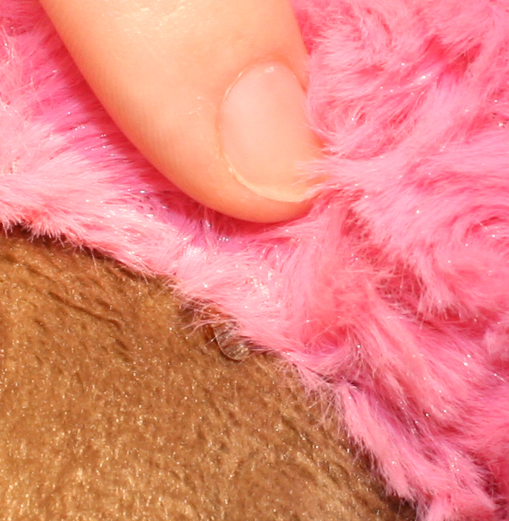
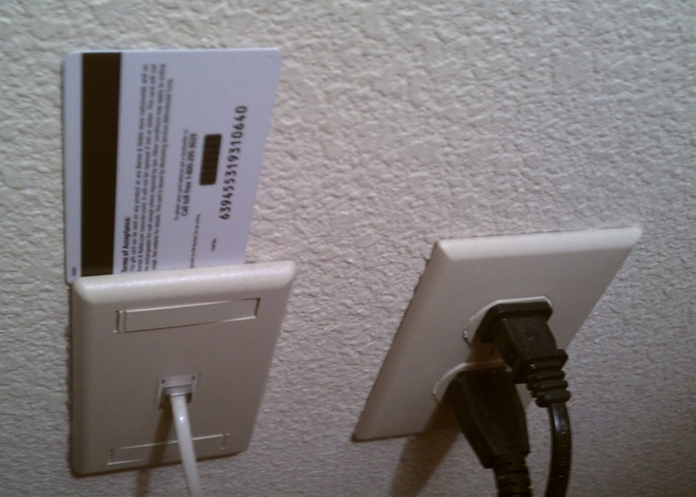
Where bed bugs live
Only inside homes and buildings
In any crack or crevice where a credit card edge could fit
On any item near where people rest
Photo: S. Reese
Couch cushion zippers
Photo: Dr Dawn Gouge
Mattress piping
Stuffed animals
Switch plates
Notes:
Sanitation plays a role in bed bug control because a cluttered apartment will be nearly impossible to treat. Bed bugs can hide anywhere, and cleaning will unearth them. Vacuuming and washing bed linens often will help keep populations from growing.

Slide 19
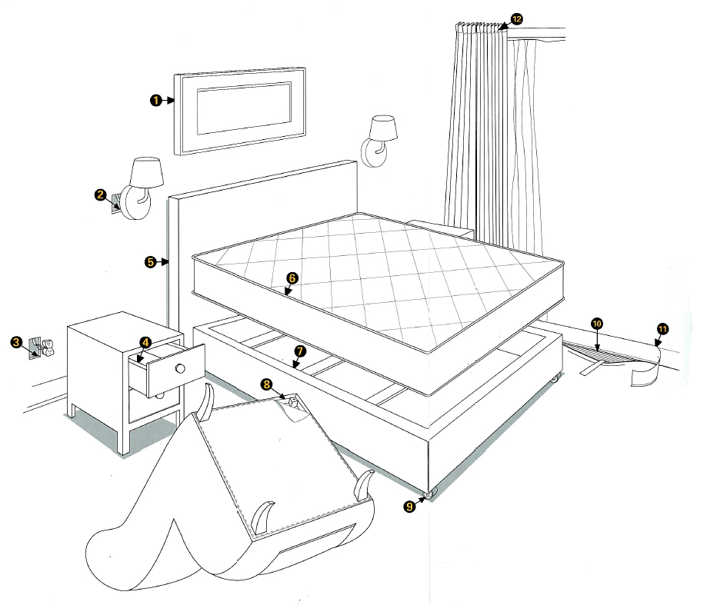
Early detection is key
Early infestations of bed bugs usually are confined to bed or within 5 feet of bed
Advanced infestations spread away from bed, spreading problem
Advanced infestations will cost more to control
56% - 70% on
Bed and sofa
23% within 5 ft
Picture: BASF Corporation
7% Other harborages
Notes:
Changlu’s input
Mike’s Slide
This slide shows common inspection points for bed bug control companies. Throwing away mattresses doesn’t work because 30% of the bed bugs in a sleeping area aren’t on the bed. The only time bed removal is recommended is for old, heavily infested beds that should be thrown out for other reasons.

Slide 20
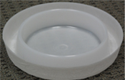
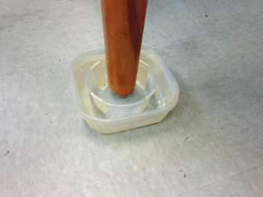
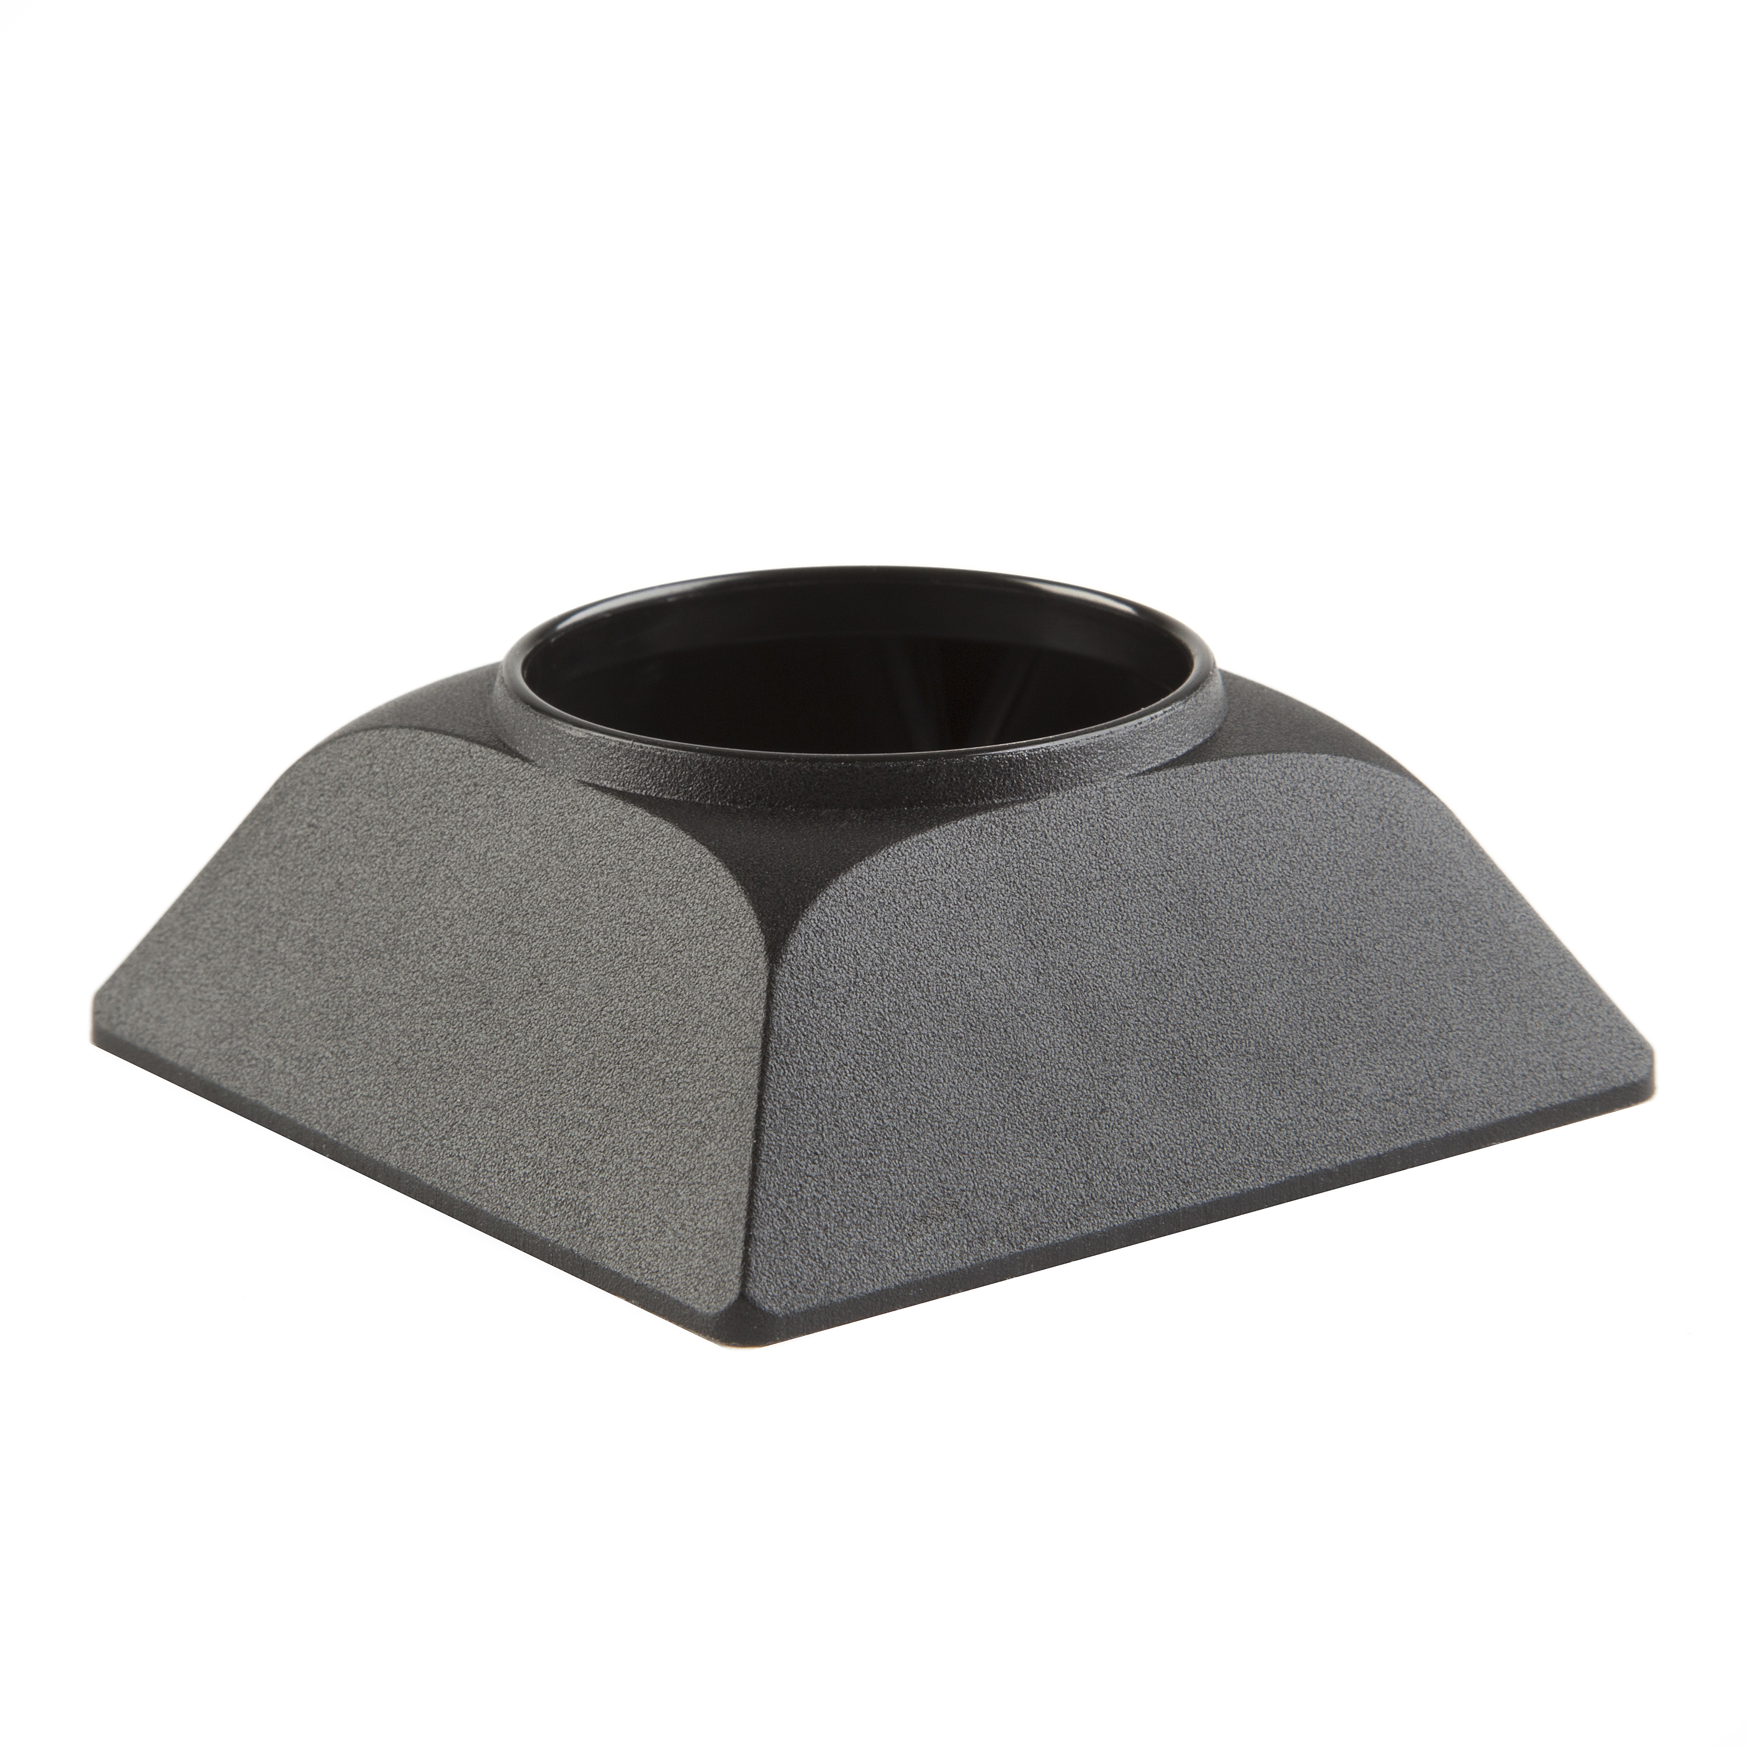
Bed bug monitors
Interceptors can detect up to 95% of infestations
Trap and kill bed bugs
Determine how bad the infestation is
Two types
  Passive
  Active
Passive, moat-style DIY interceptor from University of Florida/ IFAS Extension
Passive, moat-style interceptor
Active monitor, Includes lure
Notes:
Add citation
Edited 8/1/17 removed active monitor and replaced w volcano. Also added DIY
Monitors will not control a bed bug infestation, but they will trap and kill some. More importantly, they help find bed bugs or confirm their presence so that management can take further action. There are two types of monitors for bed bugs: passive monitors do not have an attractant and must be placed where the bugs will walk over them; active monitors have an attractant —a combination of heat, carbon dioxide, and an attractive chemical.
Often bed bugs avoid sticky surfaces so sticy trap monitors are not recommended.
Reference: Rutgers University evaluation of monitoring devices: http://www.rci.rutgers.edu/~insects/bedbuginterceptor.pdf

Slide 21
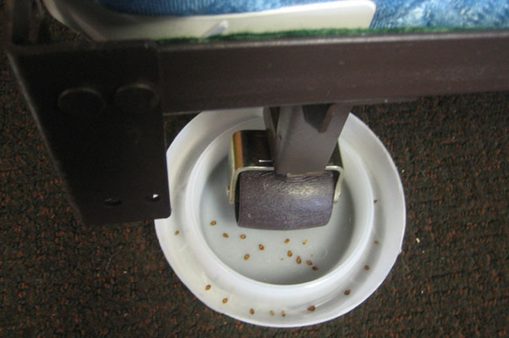
Passive monitor
Photo from bedbugcentral.com

Slide 22
Prepare before you have to
Once bed bugs are present, you don’t want to disturb the area
Ideally, residents routinely
  inspect with a flashlight
  launder bedding
  vacuum
  maintain their unit according to housekeeping standards

Slide 23
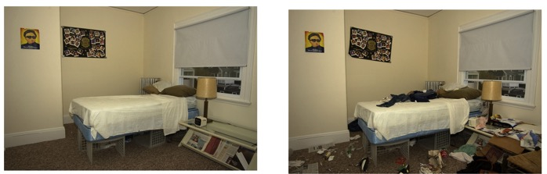
Preventing problems
The less stuff spread around, the fewer places for bed bugs to hide
  Don’t store stuff under bed. Easier to look for bugs and treat.
Good Too much stuff and hiding spots

Slide 24
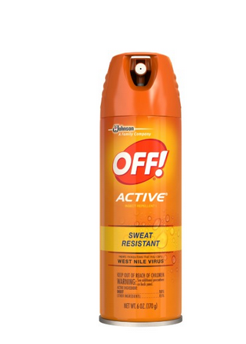
Prevent introduction and spread
Manage items that come or go from the home
  Keep coats, backpacks, purses, and bags off beds, recliners, and sofas at home and while out
  Inspect used furniture carefully before bringing it home—avoid it if possible
Look for signs when sleeping away from home
Bug spray
When visiting a home with bed bugs you can protect yourself with insect repellant
Notes:
Education throughout a development to help prevent bed bugs is worth the PHA‘s time.
Reference: Bed bug poster with a spot where contact info can be filled in.

Slide 25
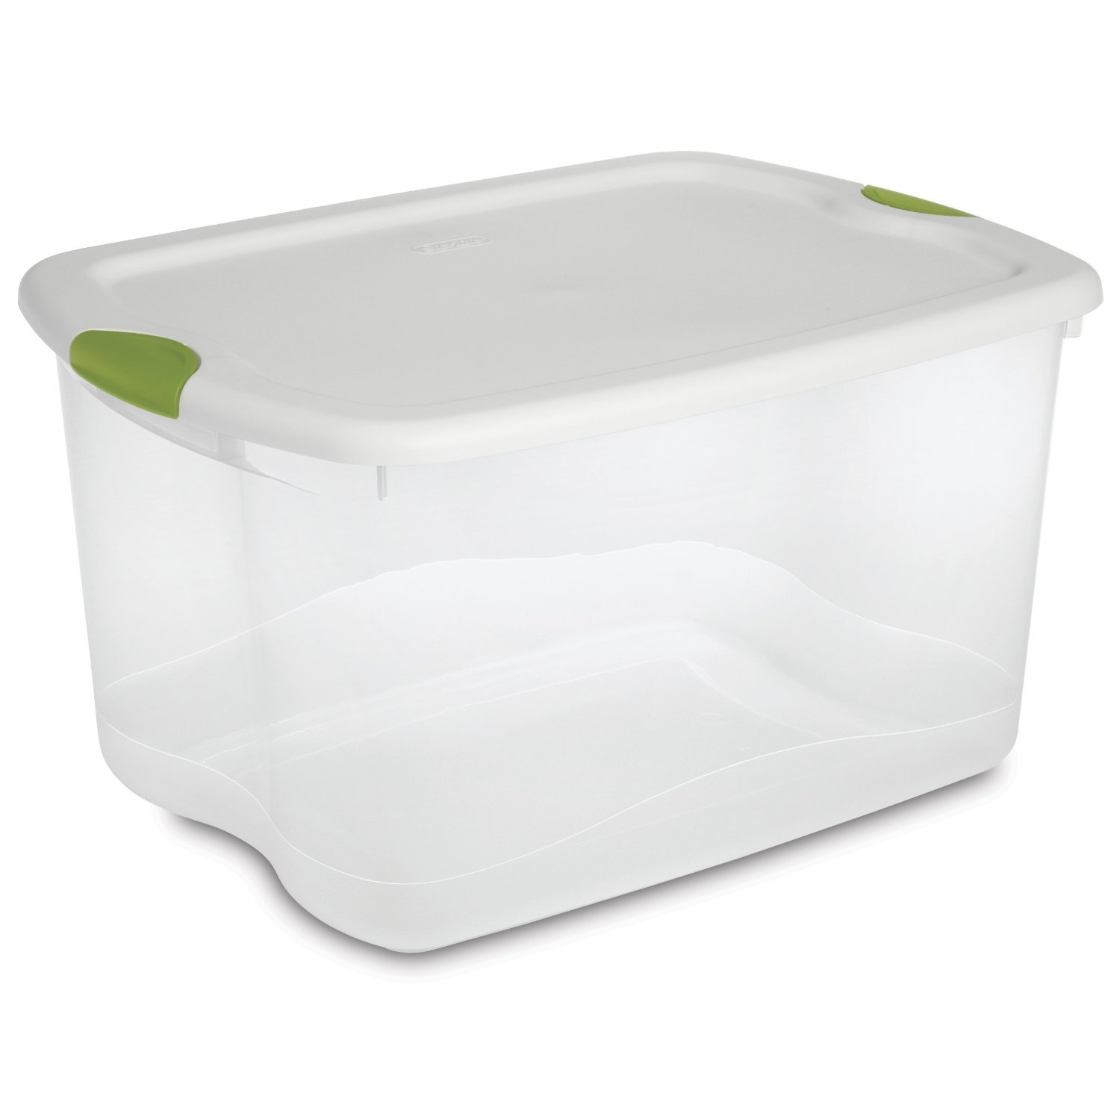
Prevent introductions and spread
Keep coats, backpacks, purses, and bags off beds, recliners, and sofas at home and while out
Inspect used furniture carefully before bringing it home - avoid it if possible
Look for signs when sleeping away from home
Smooth plastic totes can keep items bed bug free or contain items with bed bugs
Notes:
Education throughout a development to help prevent bed bugs is worth the PHA‘s time.
Reference: Bed bug poster with a spot where contact info can be filled in.

Slide 26
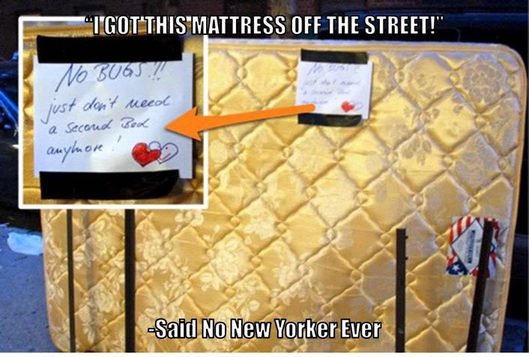
Prevention

Slide 27
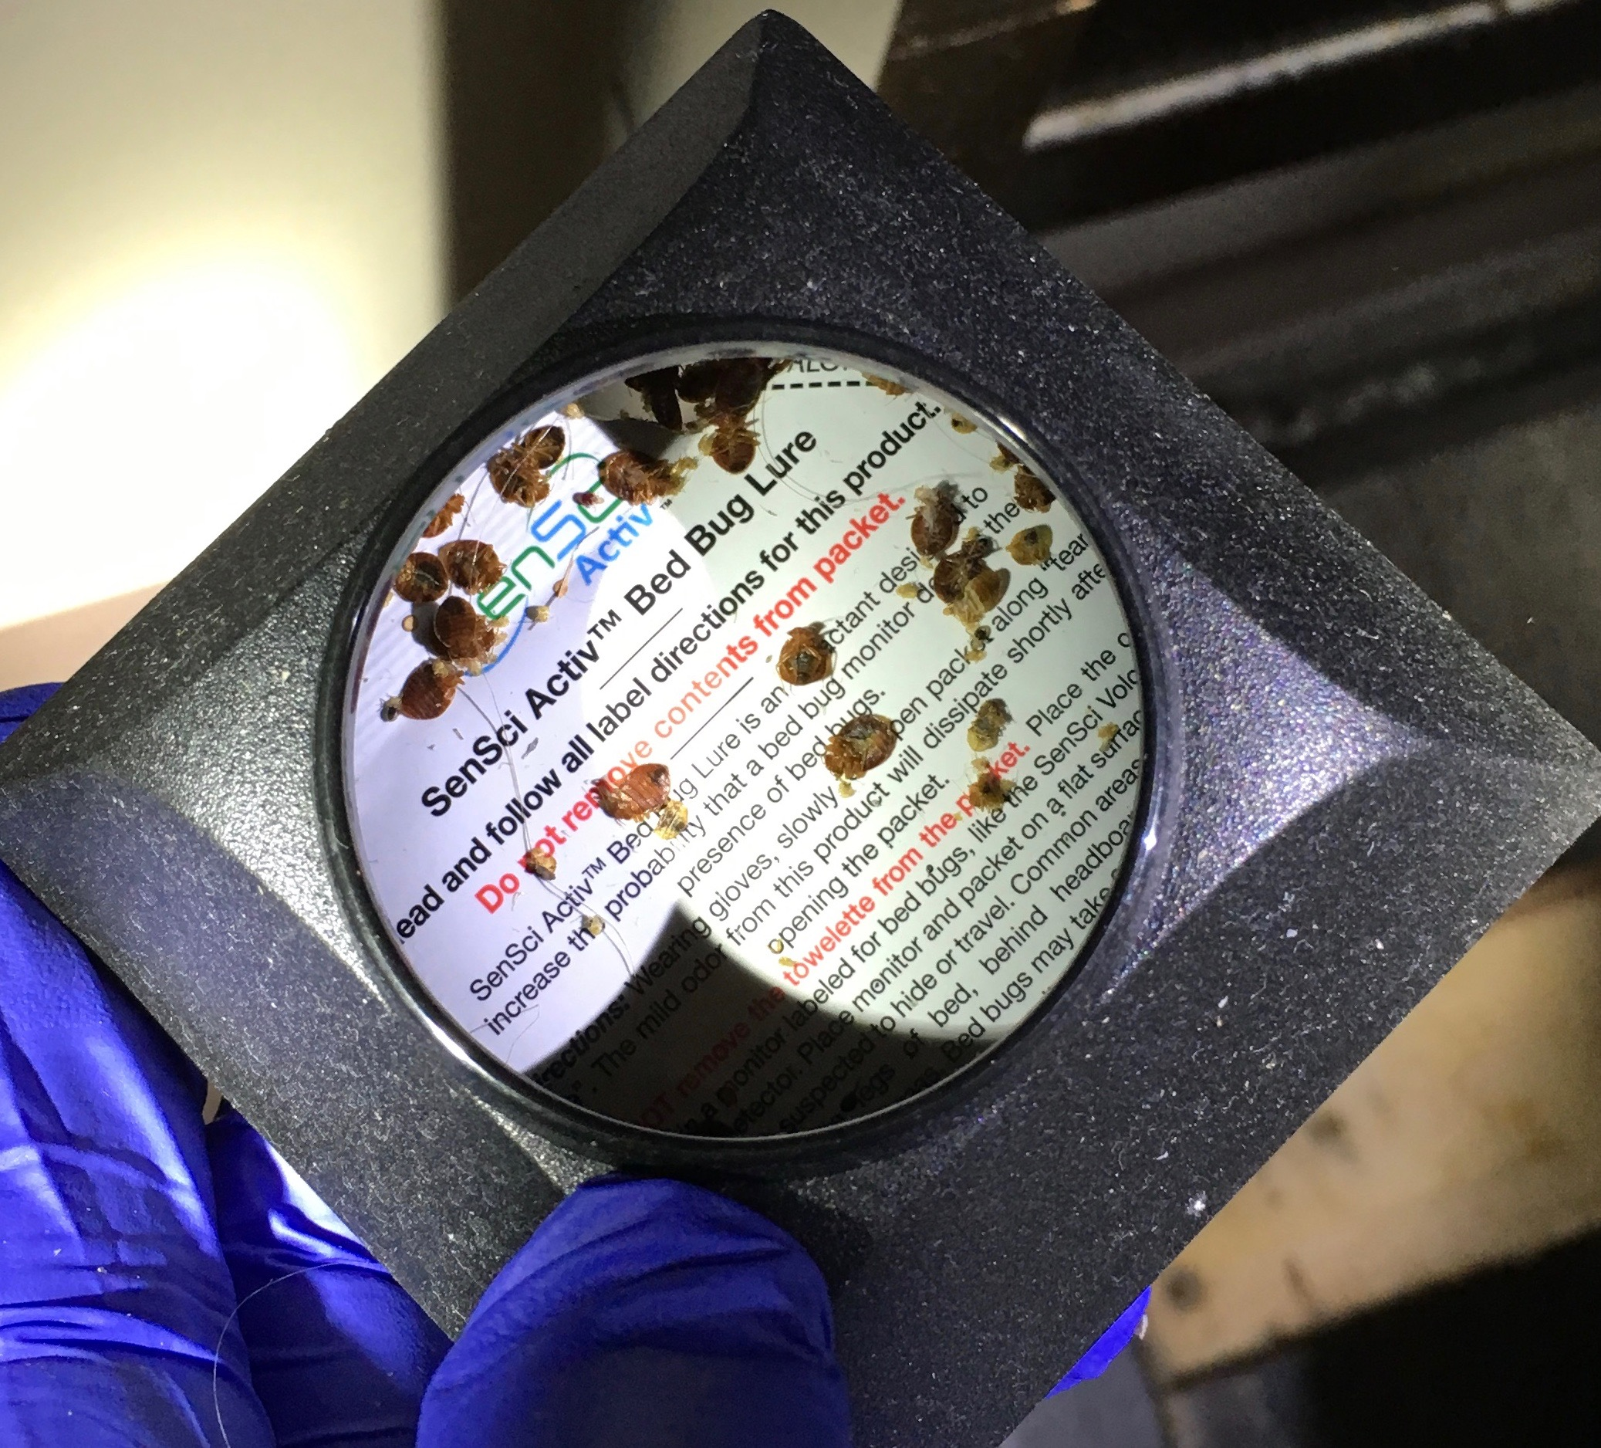
Importance of early detection
If found and controlled early in the infestation, the spread of bed bugs can be stopped
Early detection and rapid response are critical to building-wide bed bug management
Photo: Susannah Reese
Monitors like the SenSci Activ Volcano pictured here can help with early detection
Notes:
27
From HUD's Notice PIH 2012-17: "The PHA should respond with urgency to any tenant report of bedbugs. Within 24 hours of the tenant report, the PHA should make contact with the tenant, provide the
tenant with information about control and prevention of bedbugs and discuss measures the tenant may be able to take in the unit before the inspection is performed. However, a bedbug inspection and, if necessary, treatment, may take time to schedule. The PHA should endeavor to take appropriate action within a reasonable time period using the guidelines provided below [in the Notice].

Slide 28

If someone finds a bed bug
Document all observations
Rapid response plan:
  Save the insect
  Report the problem
  Don't apply pesticides or move things around
  Prevent carrying the bed bugs to other places
  Have professional inspect the unit and adjacent units
Notes:
If a tenant applies pesticides they are not as strong and effective as the ones a licensed person uses. They will scatter the BB further into hiding, making the bed bugs harder to treat
Collect a specimen on a piece of tape or in a jar with a splash of isopropyl (rubbing) alcohol in it.

Slide 29

Treatment options
Vacuuming
Isolation
  Encasements
  Clear bags
  Closed plastic containers
  Make the bed an island
Freezing
  Liquid CO₂
  Chest freezer
Heat
  Clothes dryer
  Steam
  Container
  Whole unit
Pesticides*^{ONLY PROFESSIONALS}
Spray
  Dust
  Fumigation
Notes:
Since bed bugs feed only on blood, control is different.
Although there are many things that a homeowner or resident can do to help treat bed bugs, this training encourages getting a PMP involved ASAP rather than taking time to treat the problem without one. Each pest management company should have instructions for residents on how to prepare the unit for a treatment.
Vacuuming
Every bed bug treatment will likely involve some vacuuming—even if it’s just the floors to make the PMP’s job easier. Vacuums are useful in medium and high infestations for getting rid of a lot of bed bugs relatively quickly without using pesticides. The same goes for cockroaches. We recommend using a bag vacuum with a HEPA filter and having a spatula or other tool available for dislodging bed bugs as you vacuum. As soon as you’re done using the vacuum, take the bag out seal it in a plastic bag, and throw it out. If all you have is a canister vacuum, you can use that too. After every use empty the canister into a bag, tie it off, throw it away, and wash out the canister. Either way, if you have to shut off the vacuum mid-job, plug up the hose with a paper towel. This will prevent bed bugs from crawling back out the hose and will wipe the inside of the hose when you turn the vacuum back on. If a vacuum will be used in many different areas, inspect it to make sure you don’t carry any hitchhikers.
If you don't want to deal with changing the bag, get one knee-high pantyhose and stuff the toe down the vacuum hose at the sucking end. Keep pushing it down the hose until about 8 inches are sticking out. Fold the open end of the pantyhose over the vacuum nozzle (like you fold a trash bag over the edge of a trash can) and secure it with a rubber band. Put the crevice tool on the vacuum hose over the pantyhose. The bugs will get trapped in the pantyhose and when you are done you can remove the rubber band, tie off the pantyhose, and pull it out for disposal.
Isolation
Encasements are discussed on the next slide.
Bed bugs can’t claw or chew through plastic. They’re also not great at climbing up smooth metal, plastic, or glass. Adding a light dusting of baby powder to the sides of a container makes it nearly impossible for them to climb up and out. You can take advantage of this in your management plan by using plastic totes, sealed bags, and encasements. Pulling the bed frame away from the wall and any surrounding furniture and putting insect interceptors under bed frame legs also isolates the bed.
Freezing
Two types of equipment will freeze bed bugs. Freezers that reach 0°F or colder can work for bed bugs. Although research is ongoing, it seems an object must reach 0°F for 3 days to kill all life stages of bed bugs. If it’s not that cold, it will take longer. Household freezer temperatures vary too much to depend on.
PMPs may offer a freezing treatment that uses dry ice. The equipment is designed to spray the dry ice snow over objects—flash freezing the bed bugs and their eggs. Only a professional should use this method. This system isn’t used exclusively, it’s usually a good option for sensitive objects like fine art.
Heat
Bed bugs and their eggs die when exposed to anything that is 120°F for about 30 minutes. Some companies have equipment—including heaters, fans, monitors, and computer programs for tracking temperatures—to heat up an entire area. Not every large area can be brought to a high enough temperature for a long enough time. The key to any heat treatment is to get every inch of every object at least 120°F. Paper, clothes, and carpet are all insulators that may block the heat. The PMP will have to move objects around and use fans to get the heat everywhere. Bed bugs that hide behind switch plates or baseboards may crawl into the wall void and escape. To get those bugs, the PMP will treat the voids with a pesticide dust. You will have to prepare for a heat treatment because some common items can’t take the heat.
Heat treatments are also available on a smaller scale. The same target temperatures and concerns apply. For luggage and other small items there are portable heat chamber options that anyone can purchase and use. Larger objects can be isolated in a chamber and heated up.
The hot setting on a dryer is one of the best options for bed bug management programs because of accessibility and ease of use. Dry fabric will be de-infested after 30 minutes on the hottest setting in a dryer. Even dry-clean-only items can go in a dryer—it’s water that these fabrics can’t stand. If the fabric is wet, run the dryer for the full cycle.
Steam is another heat option. You can use a commercial-grade steamer to kill bed bugs and their eggs. The target temperature is still at least 120°F, but steamers get much hotter than that—around 200°F. That’s hot. Be careful when using steam, both heat and water can damage objects and steam will conduct electricity. To ensure the killing temperature gets into every crack and crevice, move the nozzle head very slowly. To keep moisture down and reduce the likelihood of blowing bed bugs away without killing then, cover the nozzle head with a towel.
Pesticides that are legal for use against bed bugs will list bed bugs on the label. Most are sprays or dusts. EPA’s bed bug website has a bed bug pesticide search tool. The label is the law—follow it closely. Even botanical products and other least toxic pesticides pose risks. If you have pesticide questions, call or visit the National Pesticide Information Center. Many pesticide products don’t keep killing once they’re dry (no residual). You may have to do some preparation in the area so that the PMP can access all areas for treatment.
For an in-depth discussion see What's Working for Bed Bug Control in Multifamily Housing at http://www.nchh.org/Portals/0/Contents/bedbug_report.pdf
Suggestion: if the PHA’s PMP is present at the training, ask him or her what residents are instructed to do and have a discussion about who would help do this preparation for an elderly or disabled resident.

Slide 30
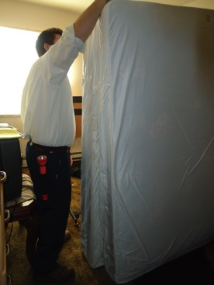
Use a mattress encasement
Cover mattresses and box springs
Ensure a snug fit, zip, seal,
and check for rips
Leave it on for a full year!
Cover any sharp points on the bed frame with tape or felt
Mattresses and furniture
don’t have to be thrown out!
Notes:
30
Use fabric encasements designed for bed bugs. The encasement drastically simplifies inspection, making early detection easier especially on the box spring which has lots of spots where bed bugs can hide. The most common site of escape is through the zipper and bed bug encasements have special zippers. Most bed bugs will die within 5 months, but leave the encasement on and sealed just in case.

Slide 31

The clothes dryer
Heat on High for 30 minutes.
Don’t over stuff
Even items that are “dry-clean only” can be put in the dryer
Dryer alone works. Not necessary to wash first

Slide 32
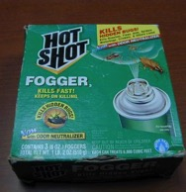
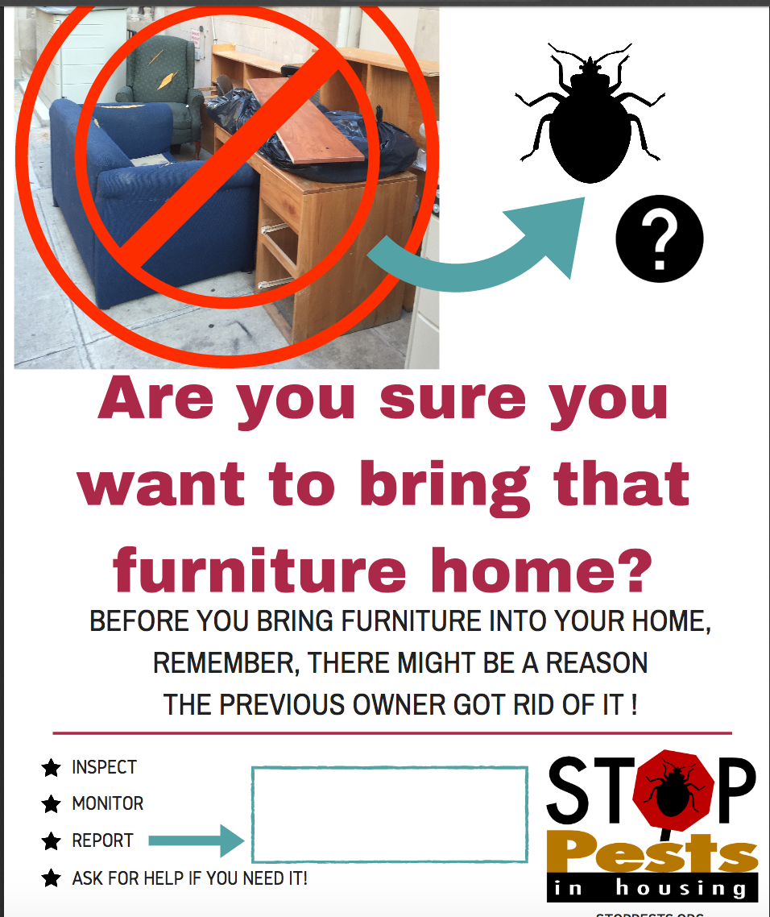
What NOT To Do
Don’t panic
Don’t try to use outdoor garden or agricultural pesticides indoors
Don’t use “homemade” insecticides
Only use products with instructions on the label in English
Don’t apply pesticides directly to your body
Rubbing alcohol, gasoline and kerosene are all flammable and not safe
Don’t throw treatable items out (furniture)
Placing items in black plastic in the sun will not work
Notes:
Many people use rubbing alcohol. It does kill the bed bugs with a direct hit but will not provide any lasting protection (no residula) and gives people a false sense of security

Slide 33
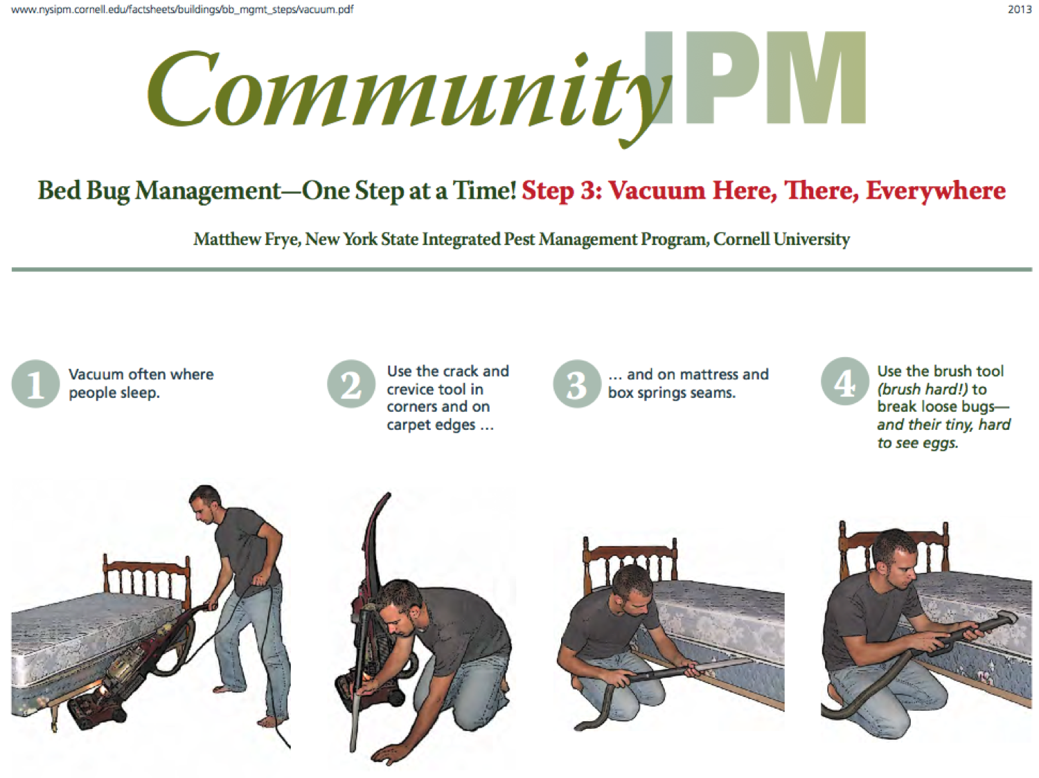
Internet and “Green” Bed Bug Products
Ultrasonic devices do not work on any pest ever!
Almost any liquid will kill bed bugs with a direct hit (dish washing liquid, alcohol, hair spray) but so will a hammer.
If any product was were as great as it sounds we would all be using it. We would not be talking about bed bugs today!
A vacuum is the best “green” pest control tool. New York State IPM Program created picture-based, step-by-step bed bug management instructions in English and Spanish for residents. www.nysipm.cornell.edu

Slide 34
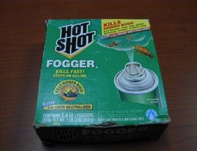
Only licensed pest control technicians use sprays
Sprays are not effective when used by homeowners for bed bug control
Over-the-counter-sprays and foggers cause the bugs to scatter so the problem becomes harder to deal with
Notes:
34
Sprays should not have to be used by the PMP for cockroaches and rodents, but since there are few other options for bed bug management, sprays may need to be used.
“Do It Yourself” sprays may be repellent, causing bed bugs to move away from the treated area. Their use can spread the problem, making the bed bugs harder to deal with and MORE expensive for a professional to treat (because of a larger treatment area). PMPs have the expertise and products to treat bed bugs. Residents should focus their efforts on nonchemical control practices.
A 2013 study by Dr. Susan Jones at Ohio State University showed that total release foggers do not work for bed bugs.
Sprays should not be used in the units occupied by people with chemical sensitivities, or in adjacent or neighboring units, common areas (such as the halls, lobby, laundry room, elevator, or stairs), or along paths of travel. Infants and children, the elderly, and pregnant women are at greater risk for adverse health effects associated with exposure to pesticides and thus it makes sense to use reduced risk practices, follow label instructions, and practice prevention-based approaches that reduce reliance on chemical control measures.
Reference: Jones, S. and Bryant, J. 2012 "Ineffectiveness of Over-the-Counter Total-Release Foggers Against the Bed Bug (Heteroptera: Cimicidae)." Journal of Economic Entomology, 105(3):957.

Slide 35
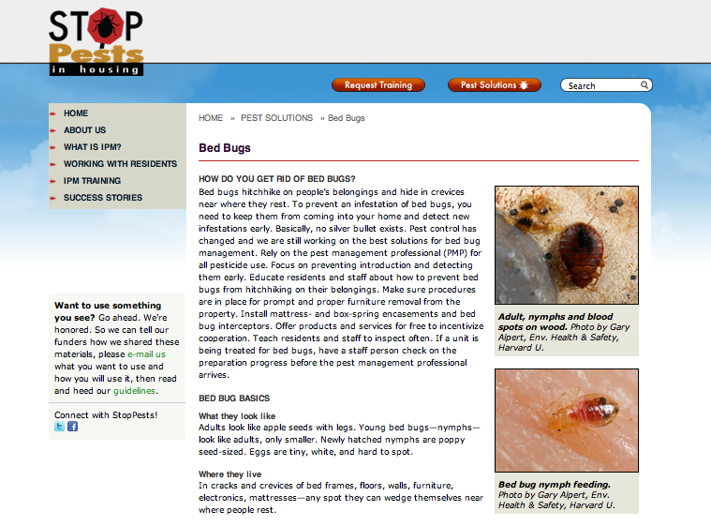
StopPests.org

Slide 36
Questions?
Susannah Reese
The Northeastern IPM Center
Cornell University
stoppests@cornell.edu

Slide 37
Questions?
Notes:
37

