Slide 1
Keeping your Home Clean and Pest-free
Image credit: Jayne Windham
Notes:
This is embroidery from the 1890’s.
A lot of ideas about housekeeping have changed since then.
Housekeeping is not always exclusively “women’s work” now.
Everyone in the household can contribute to keeping it clean.

Slide 2
Why clean?
Control Pests
Food, water, hiding place
Allergies & Asthma
Save food, save money
Protect your stuff
Save money & time
Lease & landlord requirements
Notes:
A clean home can be healthier.
Why control pests? They are a nuisance, but also unhealthy.
They carry allergens & asthma triggers
Cleaning removes these: dead & live bugs, their skins, droppings
Pests need many of the same things we need.
We want to make them UNCOMFORTABLE in our homes
Pests can ruin our food.
Storing food properly keeps pests out and saves money on groceries
Protect your belongings: When you take care of them, they last longer.
When you can find things, you don’t spend extra money buying more
Save time looking for missing items
What are the lease requirements relative to housekeeping standards? This may be a good time to remind tenants of landlord responsibilities and tenant responsibilities

Slide 3
Where does the mess come from?
Food: cooking and eating
Pets: food & hair
Pests
Dust from outside
People!
How do people add to this?
Notes:
Ask participants to think of messes in their homes.
People: food, clothes, track in dirt, Shed skin and hair

Slide 4
Think about your home…
What are your messy areas?
Why is it so hard to keep clean?
Time
Energy
Storage space
Other people
Don’t know where to start
Hard-to-clean surfaces: Clean AND Cleanable
Kitchen
Living room
Bedrooms
Bathroom
Notes:
Have participants make a list in the booklets of the messiest or “problem” areas in their home.
Ask them to be specific: What is messy in the kitchen?
What is going on in the kid’s rooms?
Depending on how many people are there, give them a chance to share aloud with the group or the facilitator
Then ask them to write down why they think it’s so hard to keep those specific areas clean.
Again, give them some time to share aloud with the group or the facilitator
Surfaces must be smooth & cleanable: The HA may have some responsibility here
We will revisit this at the end of the class

Slide 5
Where to Start: Remove Clutter First
Put things back where they belong
Clothes in bedrooms
Dishes in kitchen
Wash what’s dirty
Fold, bag, hang, store
Get rid of what you don’t use or need!
Sell
Donate
Give away
Notes:
Going back to cross stitch at the beginning, “ a place for everything and everything in its place.”
Putting things away is a habit.
Good habits can be developed in 30 days.
So first, we need place to put things, then we need to remember to put them there.
Have too many things? Keep only what you use or love.
Sell, give or donate, and Let somebody else love the rest.
There are many resources to learn more about de-cluttering.
General neatness will:
Keep pests away
Protect your belongings
Save time- Know what you have, find what you have

Slide 6
Clutter Image Rating
Notes:
Ask participants to think of their kitchen. What number would they rate it?
Discuss image scale for other rooms as well.
Give resources for hoarding if needed
Be aware of and sensitive to cultural differences in standards and the meaning of having a lot of possessions.
To some cultures, a lot of “stuff” is a sign of success & prosperity (even if we see it as “junk”)
Tell Franklin story

Slide 7
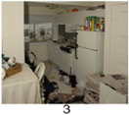
Notes:
We all strive for a “1” but maybe can’t do it every day.
Reducing the amount to put away means it takes less time to tidy up.
It’s easier to restore order to a 2 or 3 than a 6 or 7.
Decide where you need to draw the line.
Maybe when you see things get to a 3, take 10 minutes, stop & straighten up before it gets too big.

Slide 8
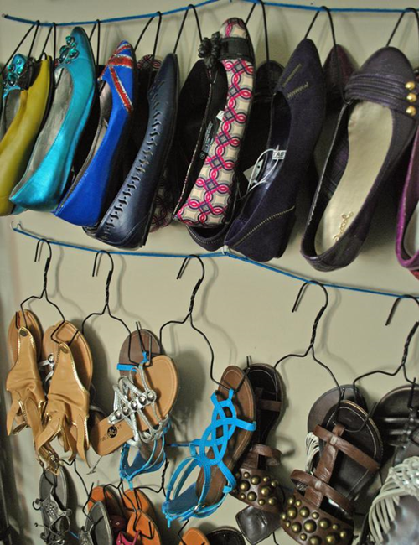
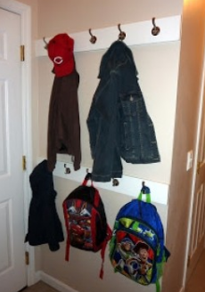
You need help. Make it easy for everyone to pitch in!
Organize
Hooks
Hangers
Vacuum bags
Storage boxes
Give away what you don’t use
Keep dirt out
Keep pests out
Notes:
Hooks by the door are helpful for jackets, backpacks, totes, etc.
If landlord won’t allow hooks on walls, you can get over-door hangers (dollar store) that won’t damage walls.
A bench or chair to remove shoes before entering the house helps to keep dirt from entering.
And a shoe rack or storage spot keeps shoes neat. Photo is shoe rack of metal clothes hangers & string
If you must store off-season items, try the vacuum bags that reduce volume.
When storing items, be sure to put them away clean – stains and perspiration will set in during storage and become visible when you take items out of the bags or boxes later on.
Keep pests out by closing doors, using window screens. Making pests “unwelcome” by removing food, water, shelter. Reporting pest problems to management EARLY.

Slide 9
Let’s start in the kitchen
Begin up high, work your way down
Walls & windows
Stove, sink, fridge
Countertop, tables & chairs
Inside cabinets & drawers
Floor
Notes:
Beginning at the top means that you’ll only have to clean things once, avoiding crumbs or drips falling into clean areas.

Slide 10
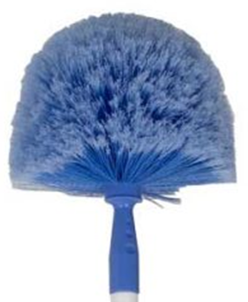
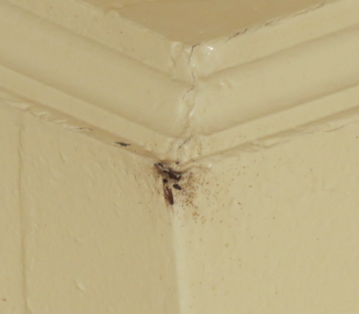
Take it from the Top
Cobwebs & Dust
Corners
Lights
Cabinet tops
Range hoods
Shelves
Picture frames
Curtains, blinds
Notes:
Show cobweb duster, dustcloth or swiffer
Over-Range vent: use when cooking
Curtains: vacuum, wash or eliminate
Blinds: dust regularly, soak in sink or tub as needed
The picture on the bottom is of roaches in an upper corner of a kitchen wall.
There was so much grease on these walls that the roaches were congregating there in the open in mid-day.

Slide 11
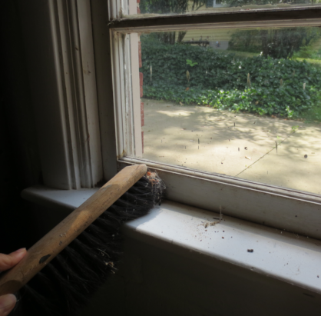
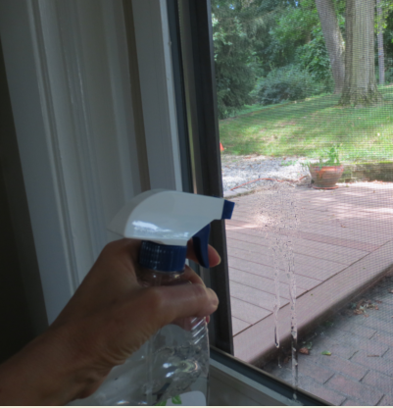
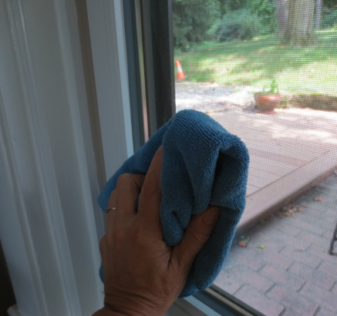
Cleaning Windows
Move aside any clutter or window covers
Wipe down sill & frame to remove dust
Spray 1 window at a time with cleaner, wipe with soft cloth
Dry with micro-fiber cloth
Notes:
Wipe or dust (or vacuum) sills & frames (wood part) of windows before cleaning. This keeps the dirt from getting onto your cleaning cloth.

Slide 12
Range hood & filters
Use the fan every time you cook
Wipe the hood with soap & water, dry after each meal
Remove & clean filters monthly, or more often if you cook with lots of oils
Image credit: Jayne Windham
Notes:
Using the fan reduces the buildup of:
Moisture
Grease
Odors
Combustion by-products from gas stove.
To clean filters, remove the filter.
How to remove & wash filters
Add ½ cup Baking soda to hot water in sink, let soak 30 minutes.
Rinse in hot water, re-install
Or, run through dishwasher if you have one.

Slide 13
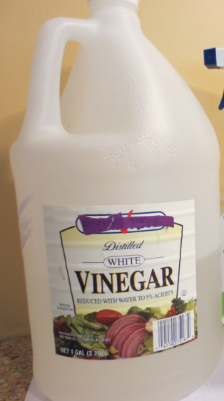
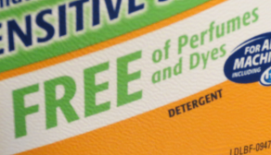
What to use? Almost anything is better then nothing, but…
Unscented soap or detergent is best:
Scents can interfere with pest control
If you cover odors, how will you know when it’s clean?
Mix your own: Combine equal parts water & white vinegar in a spray bottle
Image credits: Jayne Windham
Notes:
We can recommend cleaners & methods, but any cleaning product the attendees are accustomed to is better than not cleaning at all.
Some will feel that mixing their own “green” vinegar cleaning solutions is too daunting.
Or they may dislike the smell.
Unscented or naturally-scented products are available commercially.
Unscented is best: artificial scents (that “clean smell”) just mask odors.
Clean shouldn’t smell like anything.
Avoid bleach! It can burn your eyes & lungs. There are safer alternatives that work just as well.
Never mix bleach with other cleaners, especially ammonia.

Slide 14
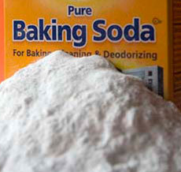
Image credits: Jayne Windham
Notes:
Some examples, from left to right:
Vinegar, costs less than $2.00 per gallon ($1.67 in 2016 at Target, WalMart)
Commercial glass cleaner, ammonia-free
Natural dish detergent, unscented laundry detergent: Great for cleaning refrigerator, stove, even floors: anything you don’t want to scratch.
Baking soda can be used on a sponge as a gentle abrasive cleaner when you need to scrub
Powdered baking soda can clean sinks, bathtubs, shower tiles, kitchen counters and metal surfaces. Just sprinkle 2 teaspoons onto a damp, clean sponge or rag, and scrub away. Rinse the area well once clean, to avoid a white residue. Because baking soda is non-toxic, this makes an excellent replacement for harsh chemicals in houses with young children. For stubborn stains, make a paste with water and baking soda. Apply to the stain, leave on for thirty minutes, and wipe away with a damp sponge. Rinse well.
All of these products are free from artificial scents and dyes
Sponges should be disinfected with vinegar or by placing a wet sponge in microwave for 2 minutes.
Dishtowels and cleaning rags should be washed regularly

Slide 15
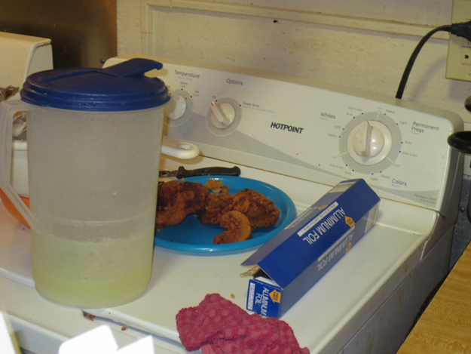
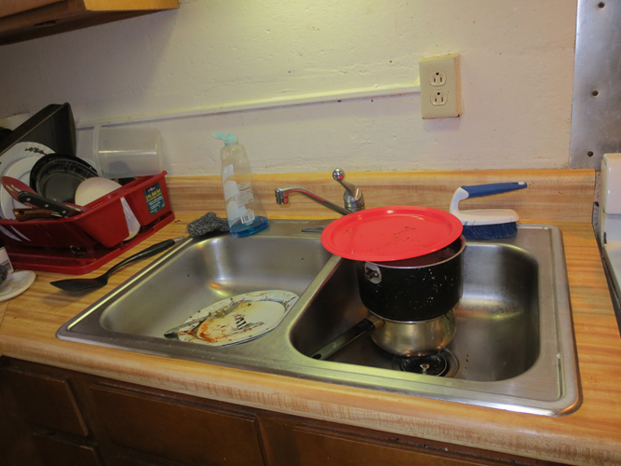
Dishes, Pots & Utensils:
Clear food
Store leftovers in covered containers
Scrape garbage
Rinse
Wash immediately or put in dishwasher
Image credits: Jayne Windham

Slide 16
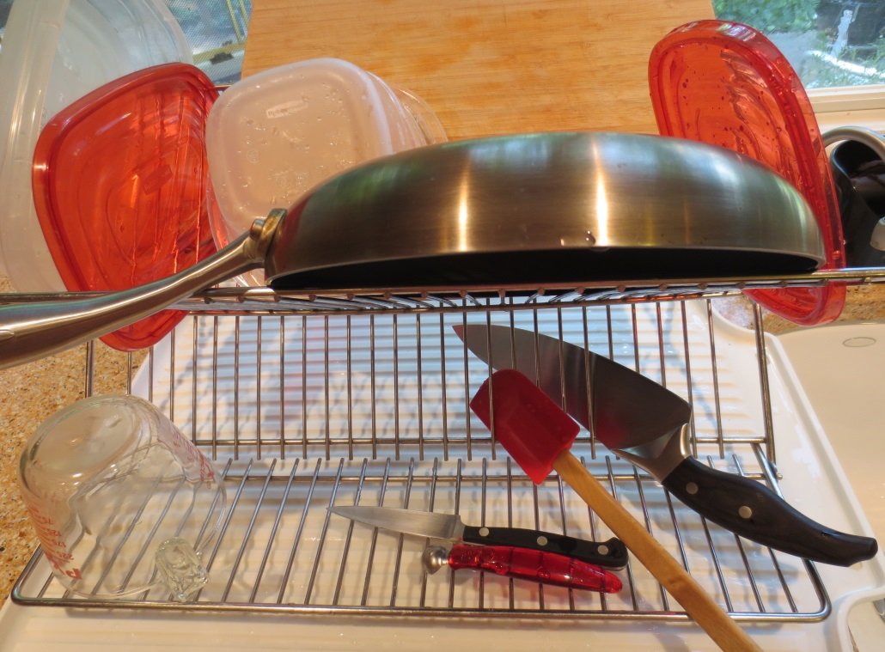
Sinks & Drain boards:
Don’t let food or dish water sit
Wash with soap & hot water
Dry items completely and put away promptly
Scrub sink with baking soda
Image credit: Jayne Windham

Slide 17
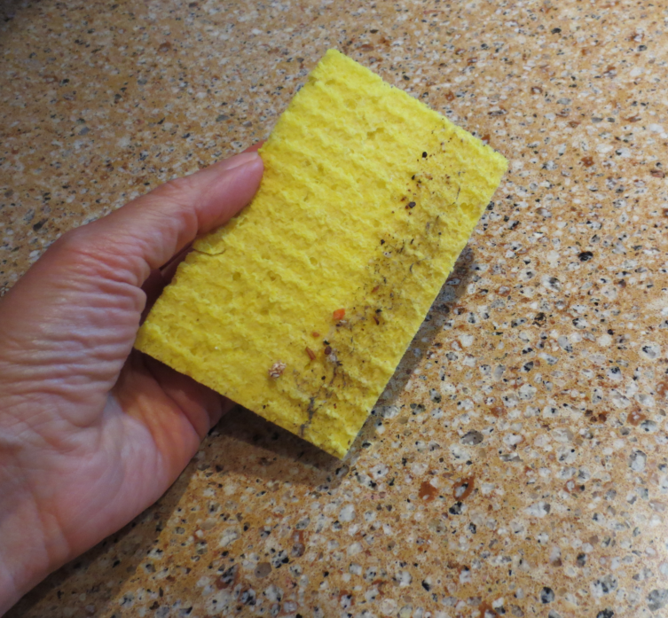
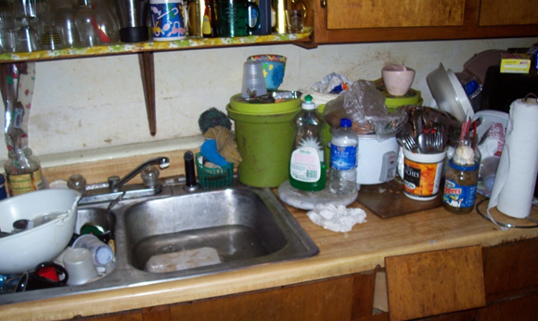
Countertops:
Move everything aside or put it away!
Wipe up spills, crumbs & dust
Dry
Image credit: Healthy Housing Solutions, Inc.
Notes:
Move everything off or all to one side
In the top photo, see the countertop looks clean. Some countertop designs “hide” crumbs, but still need regular cleaning
If you have a hand-held vac, vacuum crumbs
If very dusty, vacuum
Then dust, wipe clean

Slide 18
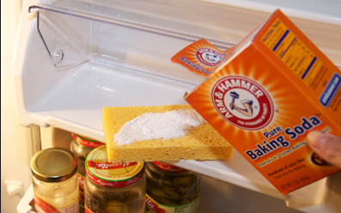
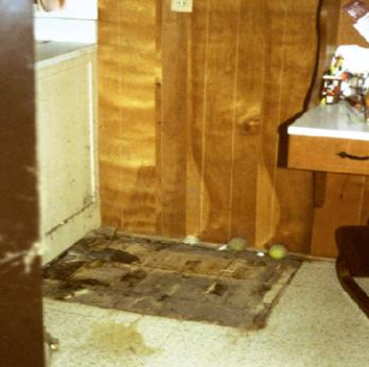
Appliances: Refrigerator
Put contents in a cooler
Remove drawers
Wipe interior: Use dish soap or baking soda
Clean behind it
Do you need help to move the refrigerator?
Image credit: Healthy Housing Solutions, Inc.
Notes:
Lots of dust accumulates under & behind the fridge.
It’s especially important to clean behind appliances if you have had pests.
Dust on the coils can cause a refrigerator to run inefficiently.

Slide 19
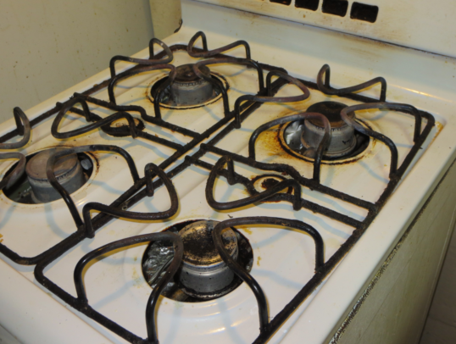
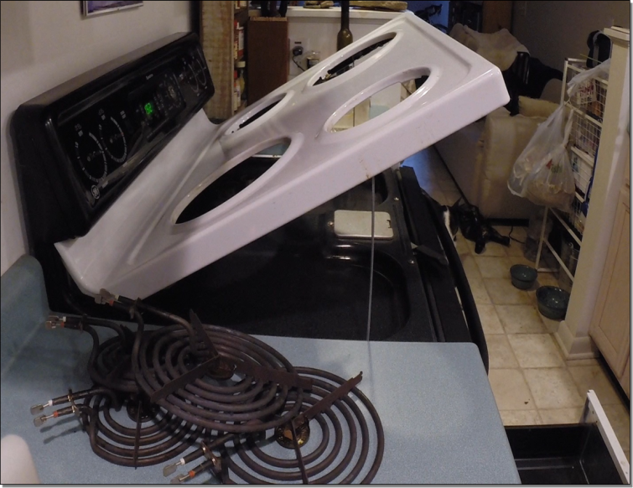
Appliances: Stove & Oven
Stove Top & Oven
Wipe after each use
Avoid harsh cleaners
See manufacturer instructions for detailed cleaning
Ask building maintenance for help
Notes:
One drop of grease can feed a cockroach for 20 days…
That doesn’t mean we have to be spotless.
But it means for every grease spot we remove or avoid, we help eliminate the all-you-can-eat cockroach buffet.
The neater we are, the fewer roaches & pests we support.
Harsh abrasive “scratchy” cleaners (Comet, etc) can scratch stove top, making it harder to clean.
Smooth surfaces are easiest to clean.
Oven cleaners can be caustic, and burn our hands, eyes, throats & lungs.
Wipe spills promptly use baking soda for tough spots.

Slide 20
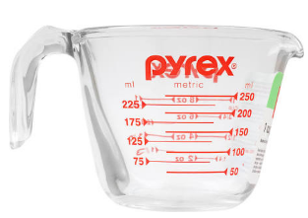
Appliances: Microwave
Mix equal parts of vinegar/water in a measuring cup
Turn on high for 5 minutes
Let sit with door closed for 5 more minutes. The steam will loosen the grime.
Wipe interior clean

Slide 21
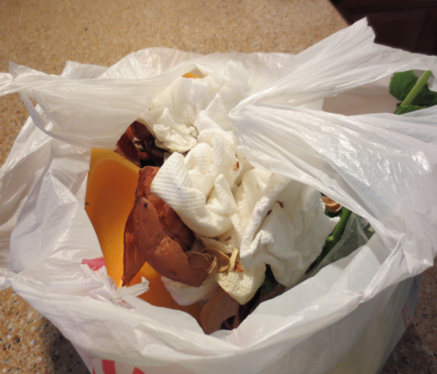
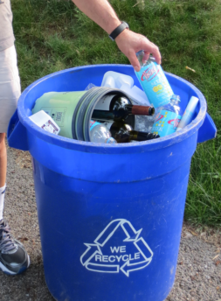
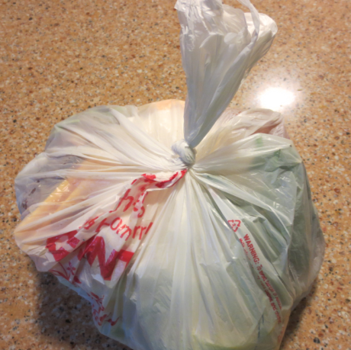
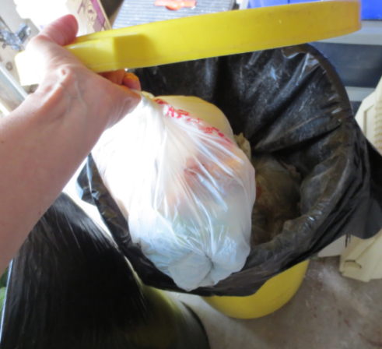
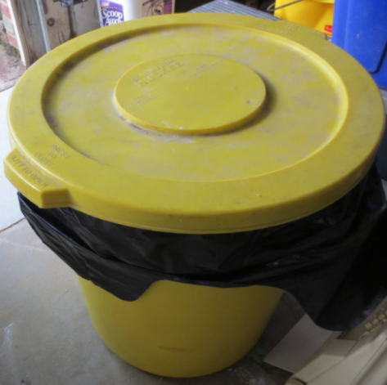
Recycling & Trash
Don’t keep cardboard or paper bags
Rinse & recycle food & drink containers
Garbage in separate bag – empty daily
Trash in covered container (tight lid)
Remember to wash inside the trash can
Image credits: Jayne Windham
Notes:
Cardboard & paper bags are harborage for pests.
Pests (especially roaches) can live in cardboard boxes.
Rinse recyclables, take out ASAP
Put “food-based” garbage (meal prep, meat trays, plate scrapings) in separate bag – Good re-use of plastic food bags.
Tie tightly and remove to covered trash bin nightly.
Tight trash lids keep pests out of trash containers.
Smooth sides keep pests from climbing in.
Or use facility dumpsters if available.
Washing inside the can is important. Sometimes things fall between the liner & the can, we miss the can, or the bag tears and we have a stick mess underneath.

Slide 22
Tables & Chairs
Move everything!
Catch crumbs
Wash sticky spills
Look under the table - Vacuum or dust the floor
Notes:
Just dust or wipe
Don’t always need cleaners

Slide 23
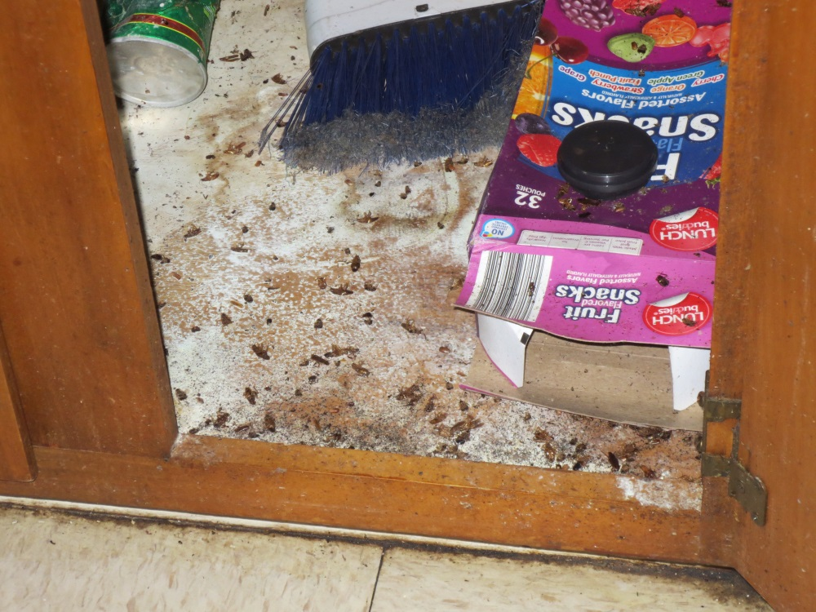
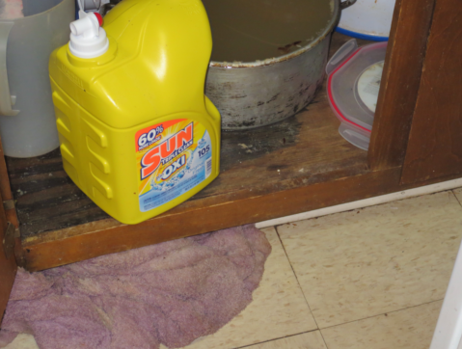
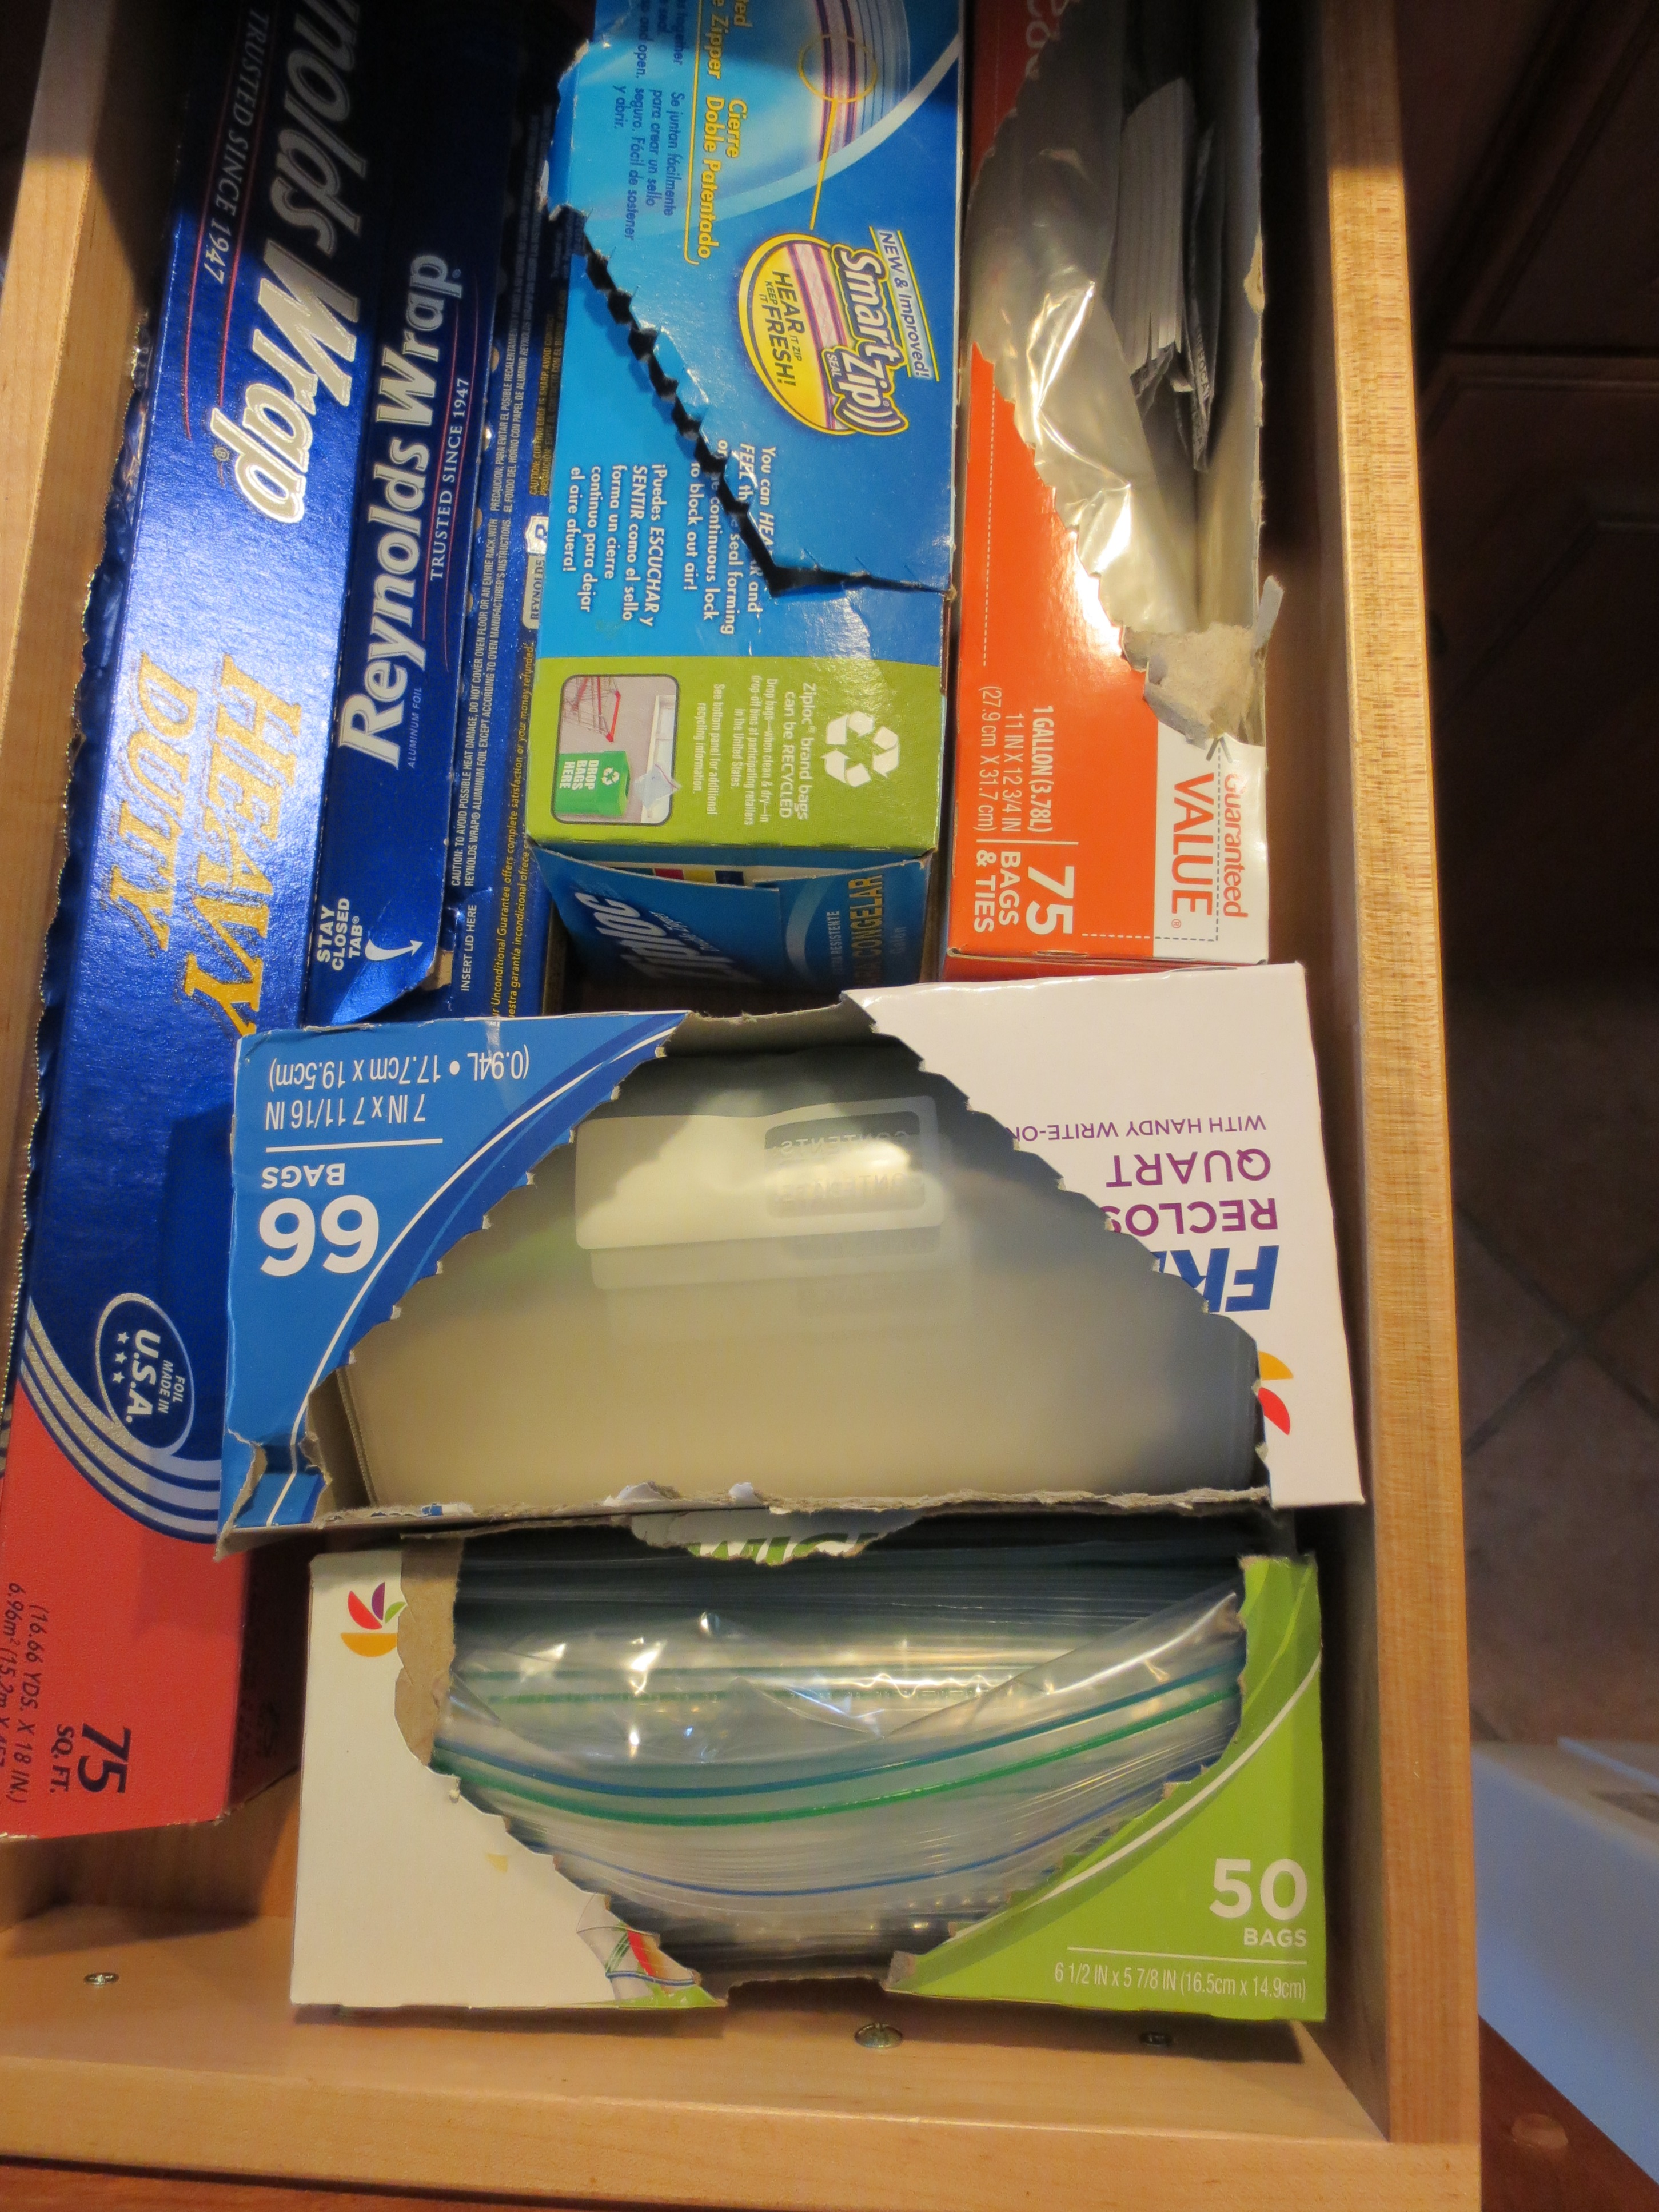
Cabinets & Pantry
Move everything!
Look under the sink
Vacuum or dust
Organize contents
Food in covered containers
Zipper bags
Snap covers
Image credits: Jayne Windham
Notes:
These are 2 extreme examples of inside a sink base cabinet.
Top photo, See live & dead roaches, food, Spilled cleanser & broom.
Lower photo, pan was placed under leak to catch water is overflowing. Leaks should be reported to management.
Pests can get into cardboard (box of pancake mix, cereal) or paper bags (flour, sugar)
Clean inside ALL cabinets 2x yearly – a good “spring” and “fall” cleaning.
You don’t have to do them all on the same day
Use new containers from dollar store
Re-use Empty, clean food containers
Zipper plastic bags

Slide 24
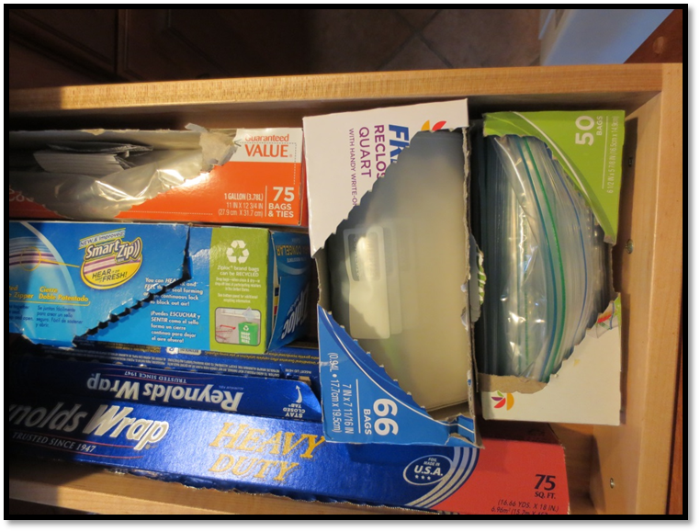
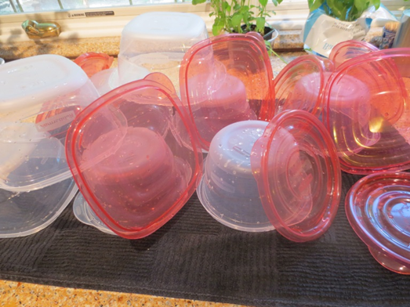
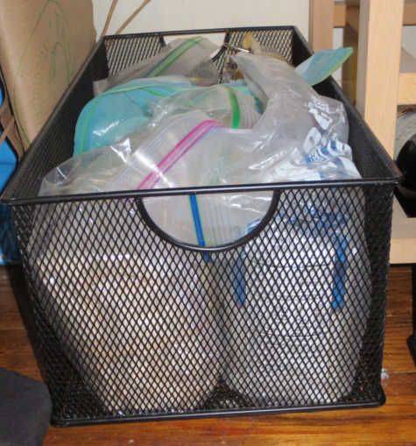
Storage Containers
Images credit: Jayne Windham
Notes:
Dry goods (flour, sugar, rice) stored in original containers but clipped into zipper storage bags or sealed with a clip. Baskets make it easy to keep products organized
Dried fruit, nuts stored in “free” containers (re-used olive containers from store) with clear sides and tight lids.
The white bag is powdered oatmeal, in case anyone asks!
Plastic storage containers from dollar store. Always wash before use. Stores can have pests, too!

Slide 25
Furniture
Move everything!
Clutter from tops
Dust with soft cloth
Microfiber, old T-shirt, microfiber cloth or paper towel
Damp dust when possible
Fold contents of drawers
Image credit: Jayne Windham
Notes:
Moving everything will disturb pest hiding spots
Just dust or wipe - Don’t always need cleaners
Damp dusting is best, keeps from spreading dust or allergens in the air.
Microfiber holds dust, does not spread it around

Slide 26
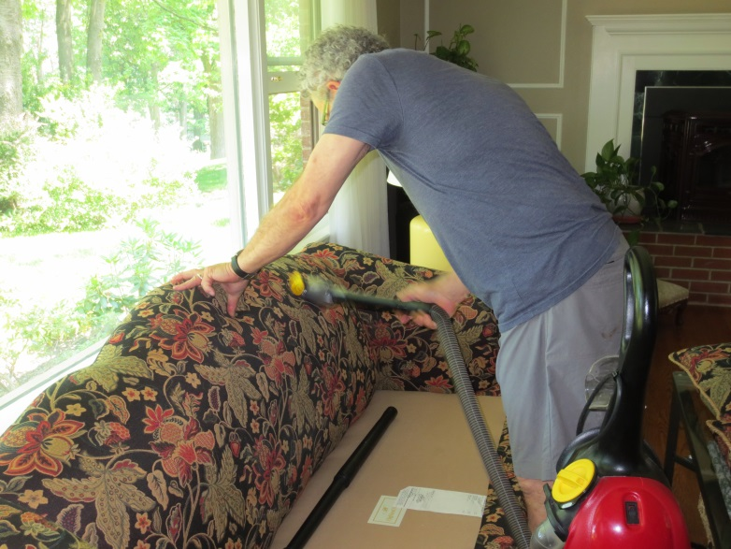
Soft Furniture
Move everything!
Blankets, pillows
Vacuum
Even under cushions
Fold and store blankets
Cover sofa with washable sheet if pets sleep here
Image credit: Jayne Windham
Notes:
Moving cushions disturbs pest hiding spots
Vacuum dust, crumbs, pests
You may even find money in the cushions!
An old sheet can be easily removed & washed if it gets covered in pet hair

Slide 27
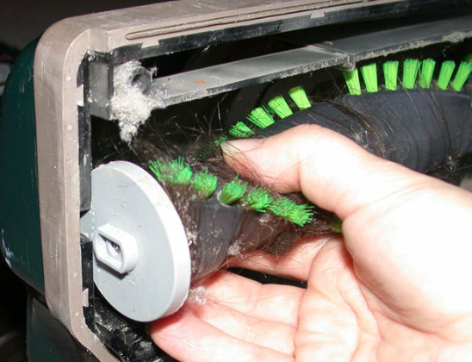
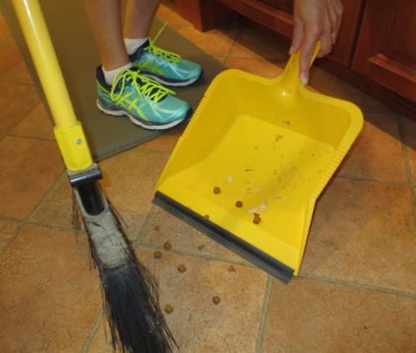
Floors
Vacuum: If carpet, use beater bar
HEPA filtration is best
Sweep
Mop
Dry
Report rips or tears
Image credit: Wikihow.com
Image credit: Jayne Windham
Notes:
Carpet traps dirt and allergens. Even with thorough vacuuming it is difficult to keep clean.
Hard surface floors are easier to clean
Carpet should be professionally cleaned twice per year
The beater bar is the brush under the vacuum that fluffs up the carpet fibers as you vacuum. This helps to lift out the dirt trapped inside.
HEPA (High Efficiency Particulate Air) is high efficiency filtration that works really well, especially for people with asthma and allergies.
Many vacuum cleaners now have HEPA filtration, and hepa bags are available for most vacuums.
Be careful of dry-sweeping as it can stir up dust. Misting dust with water first can help.

Slide 28
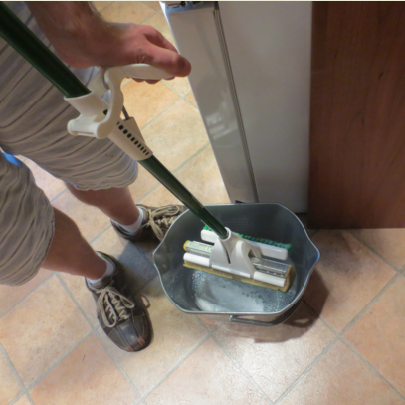
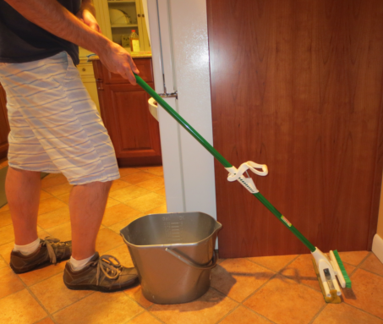
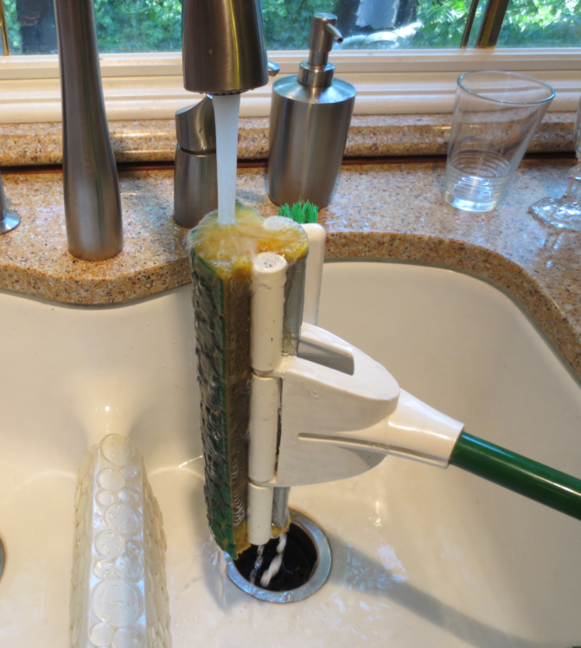
Mop & Rinse
Images credit: Jayne Windham
Notes:
Clear the area. Remove whatever tables, chairs, throw rugs and other obstacles are on the floor.
If you're cleaning any of those things, too, clean them first. That way, if any debris falls on the floor, it'll fall before you clean.
If you'll be cleaning counters, tabletops, or other surfaces, clean those first.
Send anyone likely to walk over the floor out of the area. That includes children, spouses, housemates, pets, and guests.
Sweep the floor or vacuum the floor first. It may seem redundant to clean something you're about to clean, but mops generally do a terrible job of picking up crumbs, dust, hair, and other solid debris. If you mop an unswept floor, you'll just end up pushing this stuff around. Moreover, dust and dirt can leave scratches on the floor if not removed first.
Place the cleaner of your choice into the bucket and fill with enough warm water to cover the head of the mop completely. Leave enough of the bucket empty to allow yourself to add the mop and to keep the wringer up out of the water, if it is built into the bucket. An alternate method bypasses use of a bucket by using a wringer that attaches to your sink and you rinse your mop under running water instead of the water in a bucket. In this case make your choice of any cleaners directly to the mop or the floor. Use the cleaner according to the instructions on the package or bottle. Usually, that means just enough to make it suds up a bit. Don't use more cleaner than you need. It will not add much benefit and it could leave a residue or damage the floor.
It is possible to use ordinary dish-washing detergent. Just a squirt added to the water or a few drops directly on your mop is adequate.
Dip the mop in the cleaning solution and let it absorb the cleaner thoroughly or hold in running water. Sometimes a stiff, dried-out mop will need to soak for a little while to loosen up.
Wring the excess solution out of the mop. You want it damp, not soggy. However, for really dirty floors you will get better dissolving of dried grime with a wetter condition of your mop, t
then come back after with a drier wrung-out mop to pick up the dissolved grimy water.
Start in one corner of the room. Move the mop around over the area you want cleaned with some pressure to pick up the dirt. When you have covered a small area, or when the mop looks dirty, dip and wring the mop again and move on to the next area. For polyurethaned hardwood floors, run the mop with the grain of the wood.^{[1]}
For textured floors, move the mop in small figure eight circles.^{[2]}
For persistent dirt, you may want to visit an area twice. The first time, leave the mop a bit wetter than usual and use it to dampen the area thoroughly. Let that sit for a few moments while you dampen the next area. The extra time gives the cleaning solution time to dissolve the soil. Then, dip the mop again and wring it out more thoroughly. Go back over the area to pick up the water and loosen any especially stubborn dirt.
Continue across the whole floor in this fashion.
Work back towards a door and avoid stepping on the areas you have just cleaned. Any fine dust clinging to the bottoms of your shoes will stick to the floor and become mud. If you do step on an area that is wet, run the mop back over it to clean up these tracks.
Let the mopped area dry thoroughly. Opening up doors or windows for circulation will speed the process. It's generally not necessary to dry a floor manually unless the surface shows streaks badly. Just let the air do the job.
Replace any furnishings you removed from the area.
Hang the mop up to dry out when you are finished. If you leave in the bucket, it will rot and start to smell bad. Hang it with the wet end down and hang it somewhere where a bit of water underneath won't hurt. Dispose of dirty mop water in a toilet. It's a better place to put something that might have solid sediments, and you won't have any dirty sinks.
While not strictly necessary, it's a good idea to rinse your mop and wring it thoroughly once more before hanging it up, so that the residues of dirt and cleaners don't sit in the mop all the time.

Slide 29
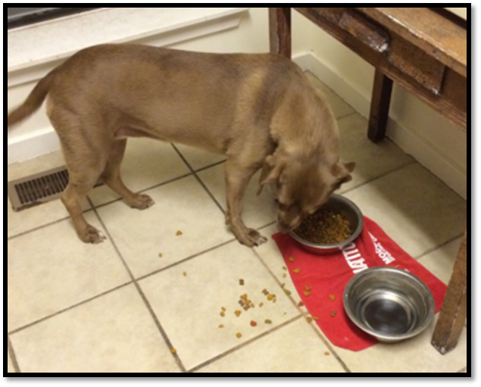
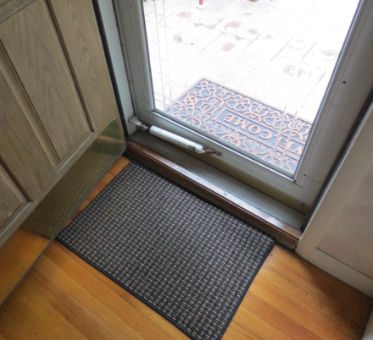
Keep dirt off of the floor
Tray under pet food makes cleanup easier
Entry mats keep dirt out
Notes:
Trays under pet food
Entry mats inside & out
Mat near cat box?
Shoes off before entering?

Slide 30
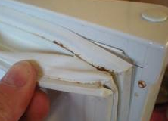
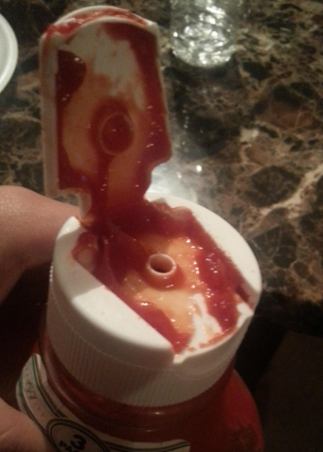
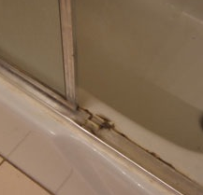
Small things, big messes:
Images credit: Jayne Windham
Notes:
Top left: This is the seal in your refrigerator, called a gasket. Mold and dirt can accumulate here. Clean with vinegar solution & brush. Tell your landlord if it is split.
Bottom left: Track for sliding shower door get full of soap scum and mold
Center: Wipe tops of bottles, jars & containers after use. Important to keeps pests off.
These are crumbs under toaster. There is a door underneath – open it over the trash and empty.
Ask attendees if they have any others?

Slide 31
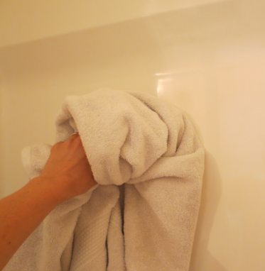
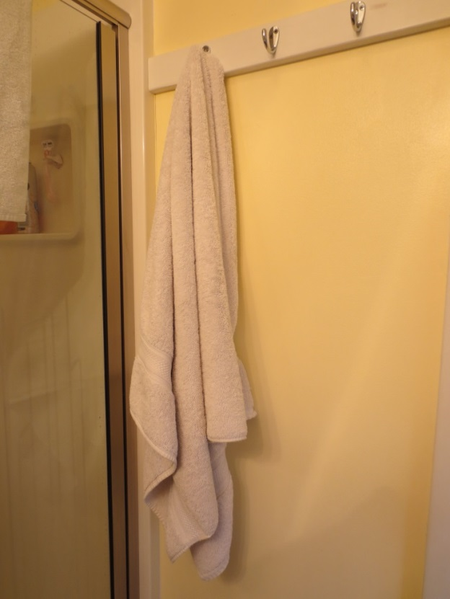
Bathrooms
Keep them dry
Clean
Mold-free
Pest-free
Use a squeegee, sponge or towel to wipe down walls
Images credit: Jayne Windham
Notes:
Keeping the bathroom dry actually helps to keep it clean, too.
Moisture (condensation) from showering or bathing forms & accumulates on cool surfaces in the bathroom.
Reducing moisture is a big part of keeping bathrooms clean. Reducing moisture keeps mold at bay
Run a bath fan during shower or bath and for at least 20 minutes after.
If no fan, open a window.
Use a squeegee to reduce moisture inside shower enclosure
Or wipe down with a towel.
Do not leave wet towels on floor or in the tub.
Hang towels to dry and use again or put in laundry.
Or, wash immediately.

Slide 32
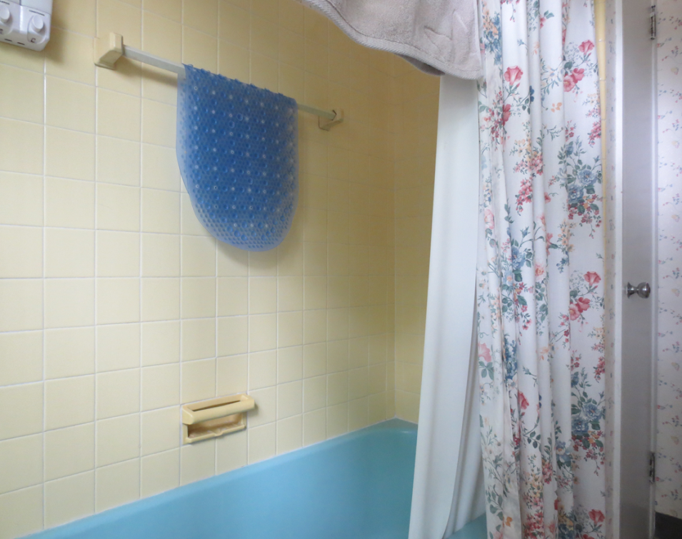
Bathrooms: Ventilated & Dry
Run the fan or open the window
Hang mats & towels to dry when done
Notes:
Hanging the mat and closing the shower curtain helps them to dry, and keeps mold from developing on them.
If there is no bath fan or air conditioning, open the window, even in winter. Excess moisture does more damage and costs more money to repair than the resultant heat loss will.

Slide 33
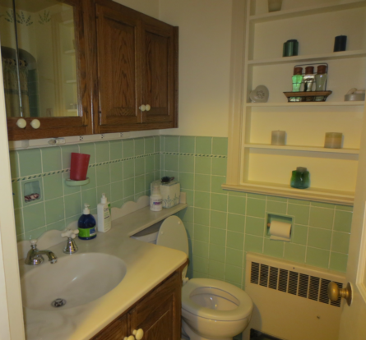
Bathroom (continued)
Spray sink, shower & toilet with cleaner
Make sure to clean under the seat!
Wipe with paper towel, rag or sponge
Brush inside toilet
Check under sink for leaks or spills
Report any leaks
Empty wastebaskets
Notes:
Emphasize that keeping things dry (as in previous slide) will keep the walls much cleaner.
Cleaners will not be necessary as often.
Often the toilet can be cleaned by brush only.
Avoid rough scouring cleaners that can scratch/mar surfaces & make them harder to clean in the future.
Vinegar mix, Sprays (unscented!) and soft cloths only
Avoid bleach or strong scents
Do not mix bleach with other cleaners

Slide 34
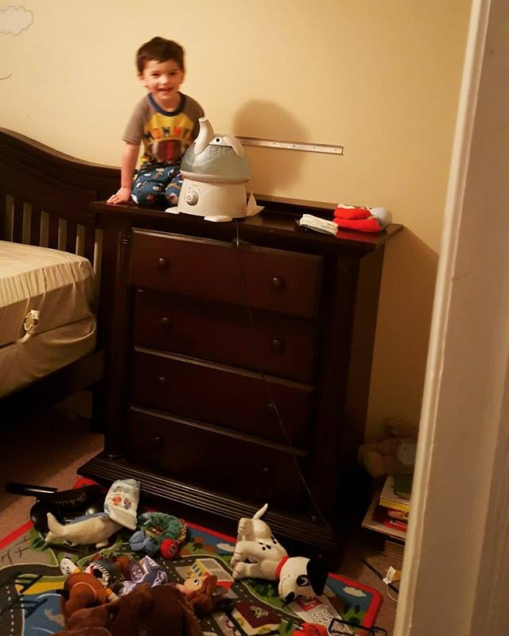
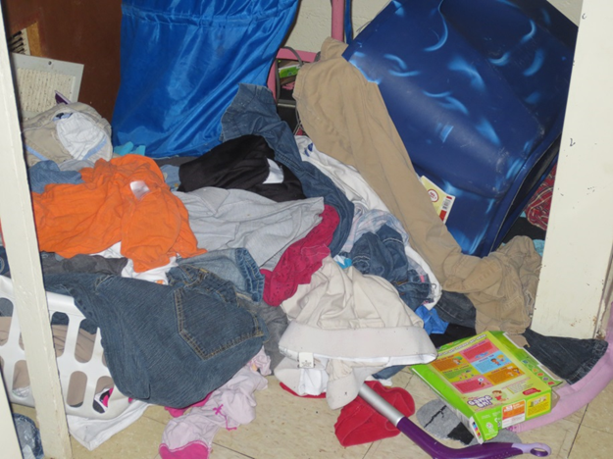
Bedrooms
Launder bedding weekly, use hot dryer
Keep closets organized, floors clear
Dust & vacuum weekly
Keep food & drink away from bedrooms
Image credit: Jayne Windham
Images credit: Jayne Windham
Notes:
Bedding should be laundered weekly to control dust mites (allergens & asthma triggers).
Also good way to inspect for bedbugs and catch the problem early.
It’s OK to wash in cold if you use a hot dryer cycle.
Keeping closets & drawers organized makes it easier to spot pests, eliminates their hiding spots.
And saves time in the long run because it is easier to find things
Keeping food & drink out of the bedroom makes it easier to clean. Eliminates food & drink for pests.

Slide 35
What do we need? It doesn’t have to cost a lot…
Sponge, dish towel, microfiber cloth
Zipper bags, food containers
Trash bag, plastic grocery bag,
Cleaners
Mop & bucket
Broom & dustpan
Vacuum
Cobweb duster
Toilet brush
Trash bin
Squeegee
Notes:
Most of the items on the right are purchased only once, and will last for several years
The items on the left are one-time or limited time use
Shopping list in participant’s booklet.
What do they already have?
What do they need?
How can they get what they need?
Borrow a vacuum?
Buy one used?

Slide 36
Revisit your lists (page#) Think about your home…
Messy areas?
Why is it so hard?
What are your top 3 difficulties?
List 3 things that would help to improve these
List people who can help or things you need
What are your top 2 messy rooms?
List 3 specific things you can do to improve each one
Notes:
Have participants go back to their lists they made earlier.
Ask them to be specific now with ideas of how to improve each messy area
It doesn’t mean make it perfect, just where will they start to make it better?
Depending on how many people are there, give them a chance to share aloud with the group or the facilitator
Then ask them to think about the impediments, or roadblocks - why they think it’s so hard to keep those specific areas clean.
What will help to remove those roadblocks?
Again, give them some time to share aloud with the group or the facilitator
We will revisit this at the end of the class

Slide 37
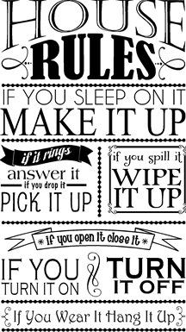
Now that you’re all cleaned up: Suggested “House Rules”
Food and drink at table only
Shoes off upon entering
Wet towels hung up to dry
Dirty clothes in laundry basket
What else will help you?

