Slide 1

Session Two of Integrated Pest Management for Multifamily Housing: Cockroaches
StopPests is a program of the Northeastern IPM Center of Cornell University, funded by HUD’s Office of Lead Hazard Control and Healthy Homes.
Training content is research-based.
Products, vendors or commercial services pictured or mentioned are illustrative, not endorsements.
Notes:
Welcome to Session two of Integrated Pest Management for Multifamily housing
<Click>The StopPests program at the Northeastern IPM center, at Cornell University, provides training and technical assistance for Federally-assisted housing sites. StopPests is funded by HUD’s Office of Lead Hazard Control and Healthy Homes.
<Click>This training content is research-based, and promotes an objective approach to pest management in affordable housing. The 4 session of the course are intended to be used in its entirety.
<Click>Products, vendors, or commercial services mentioned or pictured in these trainings are for illustrative purposes only and are not meant to be endorsements.

Slide 2
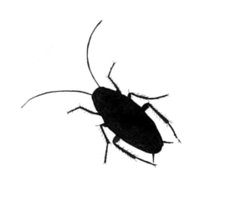
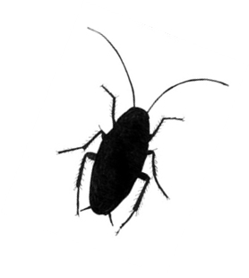
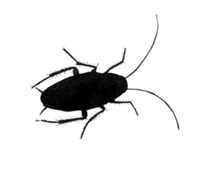
Session One Introduction
  Priority Pests
  Why IPM
  Pesticides & Health
Session Two Cockroaches
  What they are
  Associated Health Hazards
  What they eat & drink
  Where they live
  Prevention & Control
Notes:
This curriculum is a series of four, interrelated classes. In session one, we started with the connection between pests, pesticide use, and occupant health.
Today’s session two will focus on one of the three priority pests, Cockroaches. Here is an outline of this presentation. We’ll go into quite a bit of detail discussing cockroaches, as the strategies we learn for dealing with can transfer to the other pests as well.
Please be forewarned that many of the photos in today’s session are quite graphic, not intended to shock you; just to illustrate the conditions. And by no means represent the majority of homes in affordable housing. We sometimes tend to use pictures of the worst infestations to illustrate a point. But these are the minority, most infestations are low-level infestations you have to inspect to find signs of.

Slide 3
Know Your Priority Pests
Cockroaches cause asthma in infants, trigger asthma attacks, and contaminate food
Rodents such as mice and rats carry diseases, bite, destroy property, may cause fires, and may trigger asthma attacks
Bed Bugs and their bites are a nuisance and are expensive to eliminate
Notes:
3
Remember these are the top three pests in affordable housing.
Cockroaches are a health concern, as they can cause asthma in infants, trigger allergies and asthma attacks, and contaminate food. “According to the Asthma and Allergy Foundation of America, 63 percent of homes in the U.S. contain cockroaches and their particles, including saliva, droppings and decomposing body parts.“

Slide 4
On average, what level of infestation have you seen in units?
High (live cockroaches obvious in daytime)
Medium (evidence of roaches and frass)
Low (occasional resident reported sightings)
None
Don’t know
Notes:
Ask the audience

Slide 5
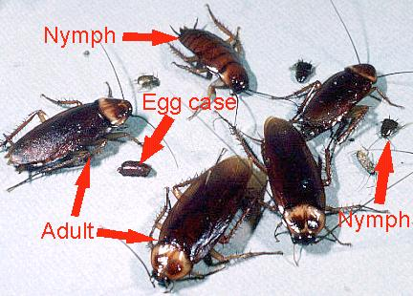
What is a Cockroach?
Live where humans provide food and water
Multiple eggs in each egg case means many nymphs (babies)
Mostly active at night, visible Cockroaches during the day indicate a serious infestation
Notes:
5
We don’t need to be experts on all pests, but we do need to know the basic biology and behavior of pests in our buildings.
So what is a cockroach?
<click>Cockroaches are found throughout the world many in association with humans and some just live out in nature. They are omnivorous, meaning they eat many foods, including table scraps, pet food, and even glue book bindings. Some species are unable to survive in locations away from humans or human activity.
<click>They have three life stages: the egg, nymph, and adult. Nymphs look like small versions of the adults.
They wear their skeletons on the outside, and must molt, or shed their skin, as they mature and grow. They breed continuously, with many overlapping generations present at any one time. Under ideal conditions, population growth explodes.
<click>Although infestations are often associated with poor sanitary conditions, populations can grow even in tidy homes. They tend to be more active at night time, so visible cockroaches during the day is a bad sign.

Slide 6
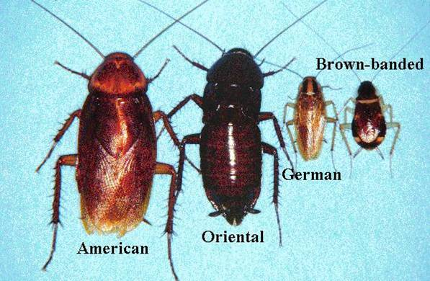
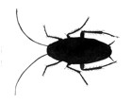
Common Cockroaches
hot
cool
high & dry
most common
sewers & basements
Notes:
There are actually many types of cockroaches. This photo shows four types that you may see in housing. Different kinds of cockroaches have diverse preferences for food and shelter, so it’s important for us to identify which one we’re dealing with.
Our primary focus will be on the most common species, the German cockroach.

Slide 7
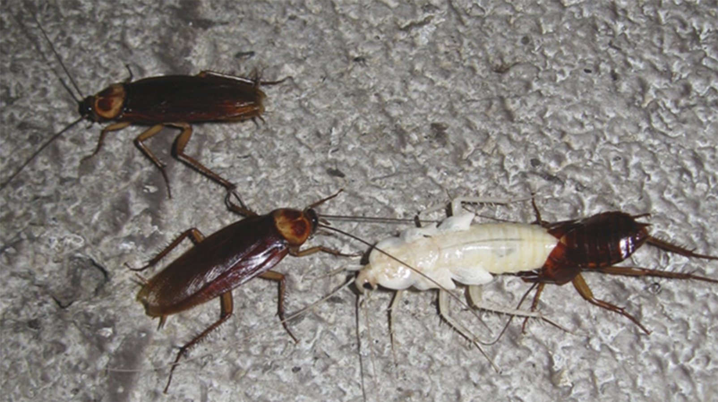
American Cockroach
Notes:
The American cockroach is the largest of the house-infesting roaches and a major pest in the United States. Commonly known as a water bug, or a palmetto bug, they are large, about 1 to 1.5 inches long. Egg capsules are sometimes glued to surfaces near a food sources, and can be found in warm, wet places like basements, laundry rooms and kitchens, as well as behind appliances or underneath cabinets. Although they primarily live outdoors, American cockroaches will move indoors when they experience a food shortage, or a significant change in climate. They often enter structures on things we bring into our homes, under doors, or from sewer systems through drains. They can fly only in warmer climates

Slide 8
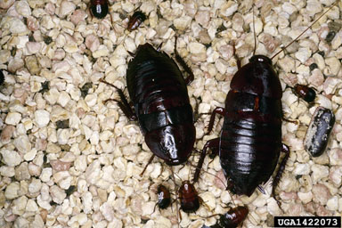
Oriental Cockroach
Image: Daniel R. Suiter, University of Georgia
Notes:
The Oriental cockroach is another large cockroach, sometimes also referred to as a “waterbug” because they congregate in damp areas. About an inch long, they are shiny black to a dark reddish-brown color. They cannot fly.
Oriental cockroaches tend to invade homes during the summer. They will enter structures under door gaps, along utility pipe penetrations, and through floor drains and sewer pipes. Oriental cockroaches make themselves at home in basements and crawl spaces as they prefer damp, cool locations. You can also find them in bathrooms, crawling around toilets, sinks, pipes and drains. The oriental cockroach feeds on all kinds of food, especially decaying organic matter, starchy foods and garbage. Heavily dependent on water, they tend to gather in large numbers near water sources.
Both American and Oriental cockroaches are invaders. So they typically enter the home seeking food or water,

Slide 9
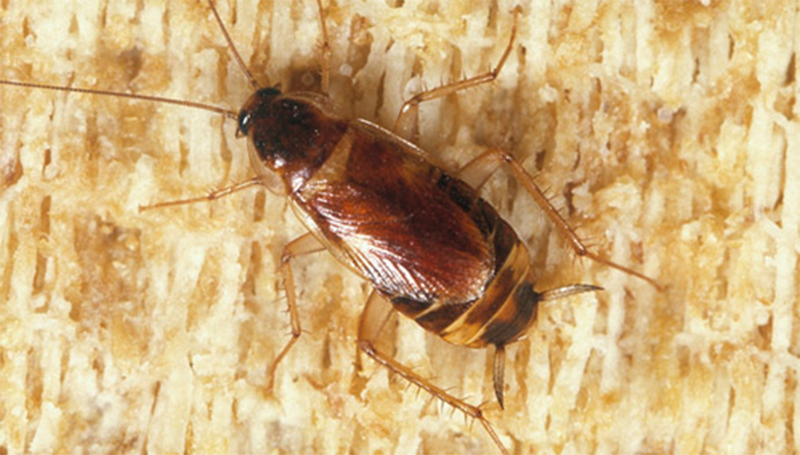
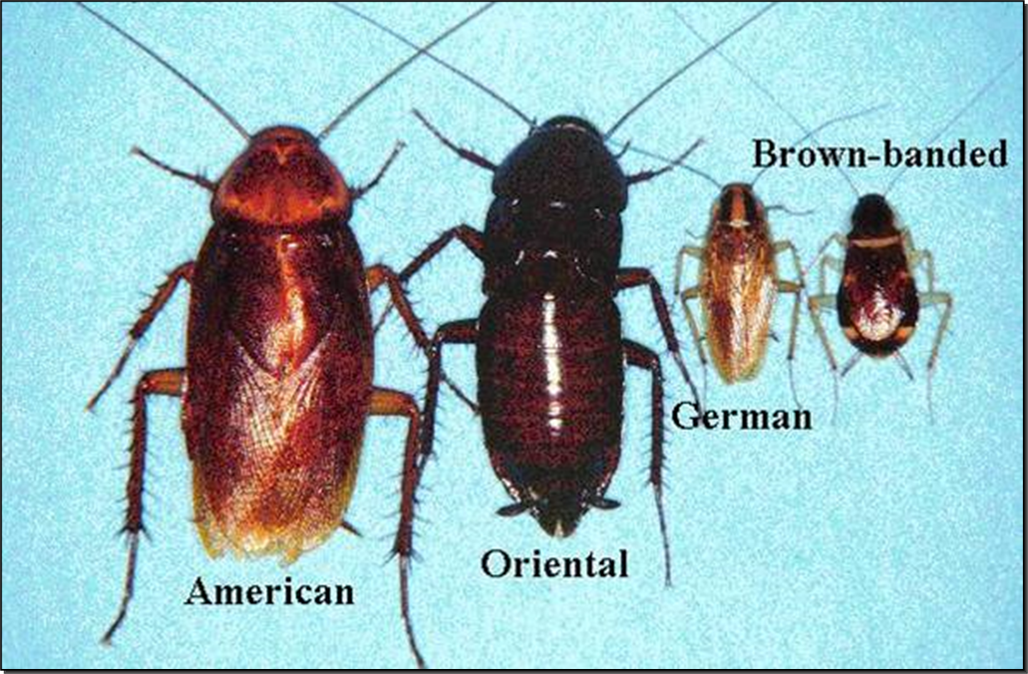
Brown-banded Cockroach
Notes:
Brown-banded cockroaches get their name from the two light brown bands they have across their dark brown bodies. They can take shelter throughout the household, but prefer to be high and dry, so you’ll often find them in cabinets, around door frames, or around ceiling light fixtures. Because they are nocturnal and small, the brown-banded cockroach can easily go undetected and infest a home.

Slide 10
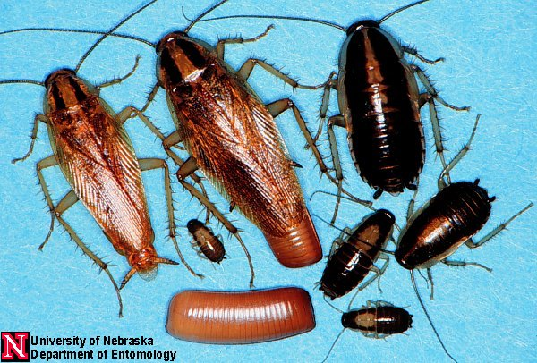
German Cockroaches
Medium size (3/4''), bronze, with “racing stripes” behind the head
Like warmth, moist and dark conditions
Notes:
10
The German Cockroach, or the common Kitchen cockroach, is the cockroach of concern, the species that gives all other cockroaches a bad name.
German cockroaches are infesters, which is part of what makes them so problematic.
They take up residence in the home where we provide adequate food, water, and harborage, and their populations may grow exponentially.
The German cockroach is about ¾ of an inch long, bronze in color, with “racing stripes” behind the head
They can be found anywhere indoors, but prefer warm, moist and dark conditions, like those in kitchens and bathrooms.

Slide 11
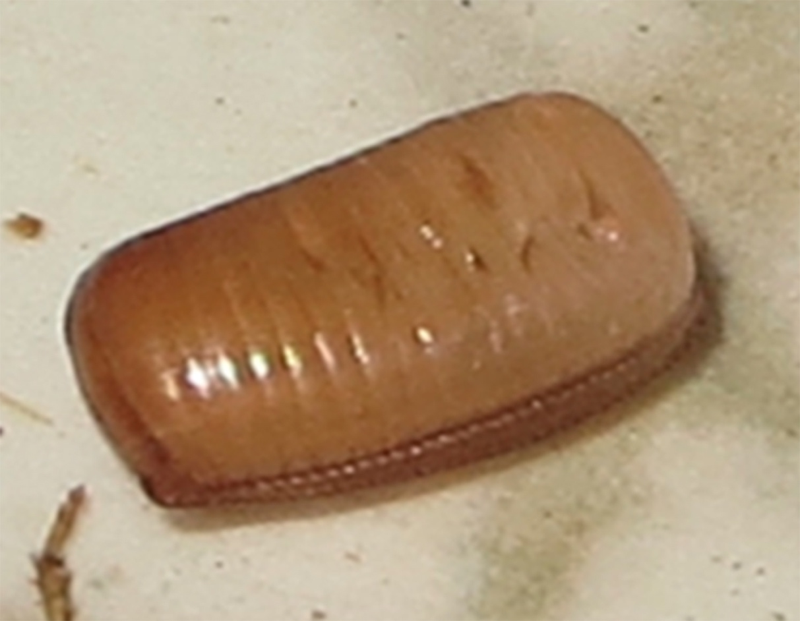
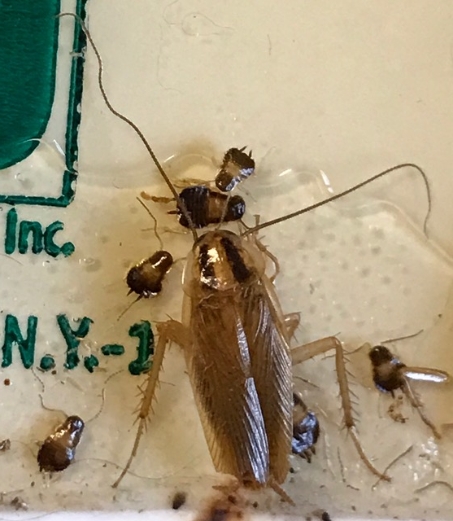
German Cockroaches
Medium size (3/4''), bronze, with “racing stripes” behind the head
Like warmth, moist and dark conditions
Reproduces quickly
Mother carries eggs to term even if she is dead
Notes:
11
German cockroach eggs are carried by the female in an egg case until just before hatch occurs. The egg case is a tiny, brown, purse-shaped capsule, which can be seen protruding from the back end of the female. A typical egg case contains 30 to 40 eggs.
German cockroaches are more effective reproducers than the other cockroaches in a variety of ways.
They are quicker to reproduce, the egg cases hold more cockroaches, and the eggs are more likely to survive because they are held by the mother until one day before they hatch.
If the mother dies from pesticides when the eggs are near full term, the eggs can still hatch. Just one more reason it’s so important to clean up dead cockroaches.

Slide 12
Cockroaches Are Health Hazards
Cockroaches, their shed skins, and their frass:
Make asthma worse
Cause asthma in children
Cause or aggravate allergies
Contaminate food, dishes, and counters
We must clean the dead roaches, skins & frass.
Notes:
12
Cockroaches Are Health Hazards. There is a connection between the German cockroach and asthma.
Cockroaches, their shed skins, and their frass:
Click>Make asthma worse in sensitive people
Click>Can Cause asthma in preschool-aged children
A cockroach allergy is a common trigger of asthma. Studies show children who are allergic to cockroaches, and are exposed to them, need to go to the hospital for asthma more often than other children with asthma.
Click>Cause or aggravate allergies
Click>Contaminate food, dishes, and counters
Cockroaches are known to spread bacteria, including E. coli and Salmonella, parasitic worms and other human pathogens.
Click>Think about all the areas where cockroach infestations could be health hazards, such as childcare facilities, recreation rooms and your workplaces…
It’s important that We clean up the dead roaches, skins & frass.

Slide 13
Cockroach Frass Math
For sensitive people with asthma:
8 units of cockroach allergen per gram of dust can trigger a reaction.
One female cockroach will produce
1,500 units per day
Notes:
Let’s talk for a moment about “frass,” which is the poop produced by insects.
Cockroaches leave frass wherever they go, and they communicate by smelling and tasting frass.
Click>For sensitive people with asthma, eight units of cockroach allergen per gram of dust can trigger a reaction.
Click> ONE female cockroach will produce 1500 units per day! One cockroach and its frass can be an asthma trigger.
. So killing cockroaches helps, but does not remove the allergens found in the remains. Cleaning, using simple soap, will remove the allergens, remove the cockroaches’ mode of communication, and allows residents and staff to see when new evidence shows up. We’ll talk more about cleaning in just a few minutes.
An IPM program should work to eliminate the living and dead cockroaches and clean up the frass. The repairs and measures taken to control one cockroach will benefit the building in more ways than just pest control.

Slide 14
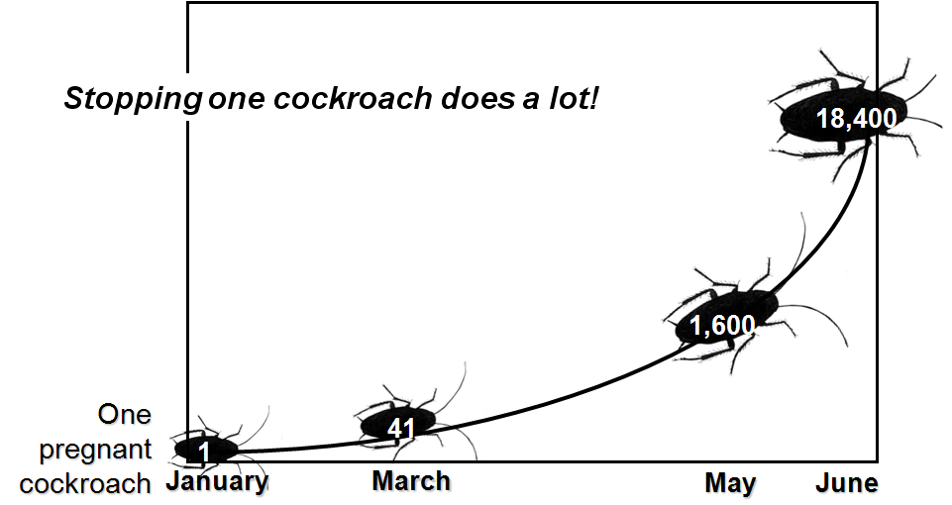
One German Cockroach, ½ a Year
Notes:
Cockroaches reproduce very quickly.
This growth curve is for a German cockroach, and illustrates how quickly a population can get out of hand.
Let’s assume we have one pregnant cockroach in January. Female cockroaches develop one egg case a month.
She has 40 eggs in her case, 20 male and 20 female, and lets say conditions are ideal and they all survive. By March, we have 41 cockroaches, who also begin to breed. Resulting in 18, 400 cockroaches by June.
These calculations are based on one month for eggs to develop, one month after hatching they can reproduce. The graph assumes no death due to environmental factors and a 1:1 male to female ratio, which may be unrealistic.
The potential for population growth is a fact. You can see from this graph, and the asthma connection, that no number of cockroaches should be tolerated.
14

Slide 15
Signs of Cockroaches
Live cockroaches
Dead cockroaches and their parts
Frass
Egg cases
Notes:
15
It’s important for us to recognize the signs of cockroaches.
Cockroaches spend most of their time hiding in walls, only emerging at night.. Nymphs and pregnant females don't travel much at all.
In early infestations, we may not see the actual cockroaches, but only their evidence.
We may see their frass, or even smell them.
If a live cockroach is seen during the day, it usually means that a good hiding area was disturbed or that the infestation is severe and they have run out of hiding spots.

Slide 16
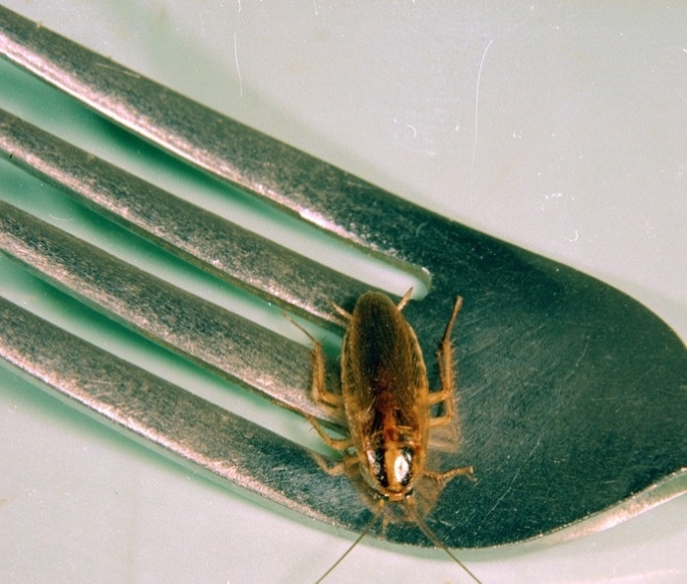
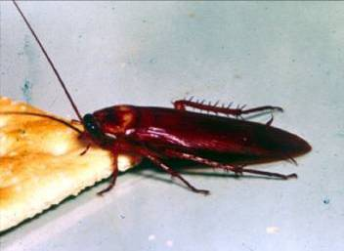
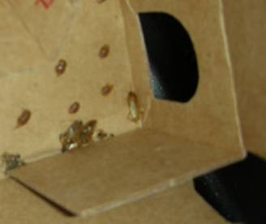
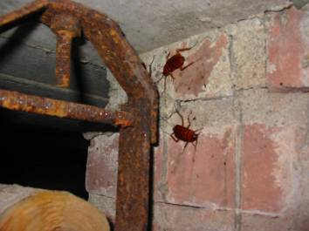
Live Cockroaches
German Cockroaches
American
Cockroaches
Notes:
On the left are photos of American cockroaches.
On the Right, note the German cockroach on a fork, for scale, cockroaches in a cardboard box.
Boxes make a great transport mechanism for roaches and eggs to travel from a distribution facility into the home. The corrugated sections of cardboard offers great hiding spots, and any food residue or glue can serve as dinner for the cockroaches. Any cardboard or paper bags should be recycled, or disposed of, immediately after being emptied.

Slide 17
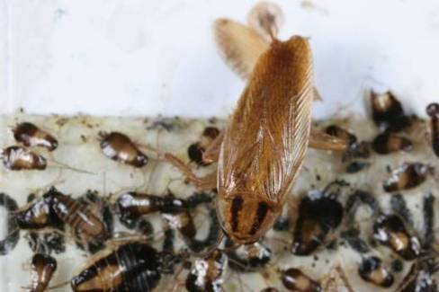
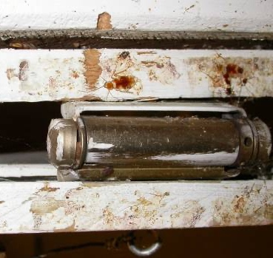
Dead Cockroaches
Dead
German cockroaches on a sticky trap
Brown banded cockroaches
by a door hinge
Notes:
On the left we see a Sticky trap with German cockroach adults and nymphs. We’ll discuss the sticky trap in more detail in a few minutes. Note the presence of so many nymphs on the trap, indicating it may have been placed near a good cockroach hiding spot. It is important to note where traps are placed so that patterns like this can be seen, and the area can be treated accordingly.
On the right are Brown banded cockroaches that have been squished when the door closed.

Slide 18
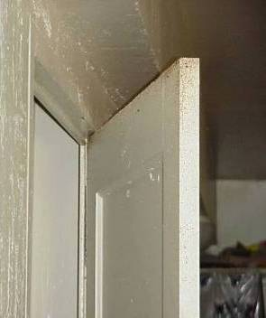
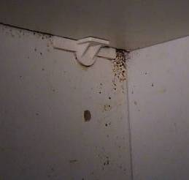
Frass
Door
Under a cabinet
shelf
Notes:
See the Frass along the top of a door? Cockroaches love small spaces, and had gathered into a space where the panels of this door were delaminating.
The next photo shoes frass under a kitchen cabinet shelf. The ¼’ space between the shelf and cabinet sidewall make a perfect hiding space for cockroaches.

Slide 19
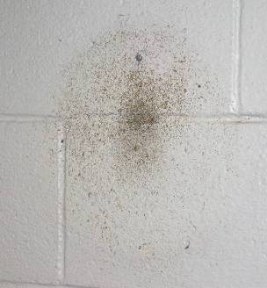
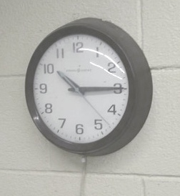
Frass
Behind the wall clock
Wall clock
Notes:
Look at this wall clock. When the clock was in place, the room appears to be clean. Moving the clock exposed this hiding spot. We need to think about where to look to find signs.

Slide 20
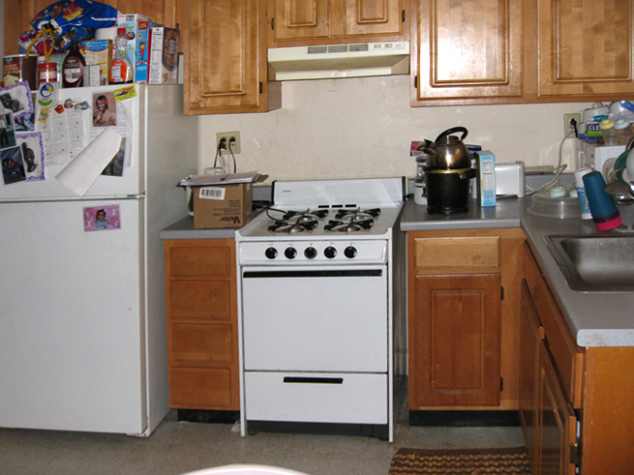
Where Cockroaches Live
Near water, food and warmth
Cracks and crevices
Anywhere in a building
Notes:
20
Cockroaches are most active at night so we need to know where to look for cockroaches because most will be hiding at any time. Cockroaches love appliances that have water associated with them. put yourself in a cockroaches shoes, where you would want to live in this photo? Feel free to share in the chat
They prefer spots near water, but also need food and warmth. For cockroaches, the kitchen is the most likely place. Consider all the food and warmth available from the stove, refrigerator, and under the sink. The bathroom is also a favorite place because of the availability of water, and access to other biological matter. Because cockroaches love these wet places, they can easily transfer bacteria between bathroom and kitchen.
They like cracks and crevices where their bodies touch surfaces above and below
Cockroaches can be found in other rooms as well, particularly in rooms where people like to snack.
If cockroaches are found in the kitchen, all rooms should be inspected, even bedrooms and living rooms, especially when the infestation is heavy.
If cockroach signs are found in the unit, bait should be placed in all rooms we find those signs. We’ll discuss this more when we get to treatments.

Slide 21
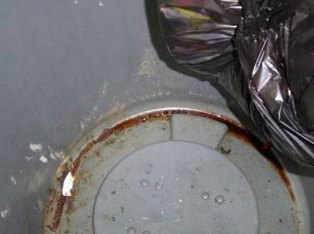
What Cockroaches Eat
Crumbs
Grease
Trash
Cardboard glue
Just about anything*
*This knowledge will help us later
Notes:
21
Cockroaches will survive, and thrive, on just about any source of food.
This will actually help us to control them when we use this behavior against them.
The photo shows a plastic trash can that has grease and other food waste on the bottom. This could be a teaching moment for the occupants.
And consider this… One drop of grease will feed 20 cockroaches for a day…cleaning is important in cockroach control

Slide 22
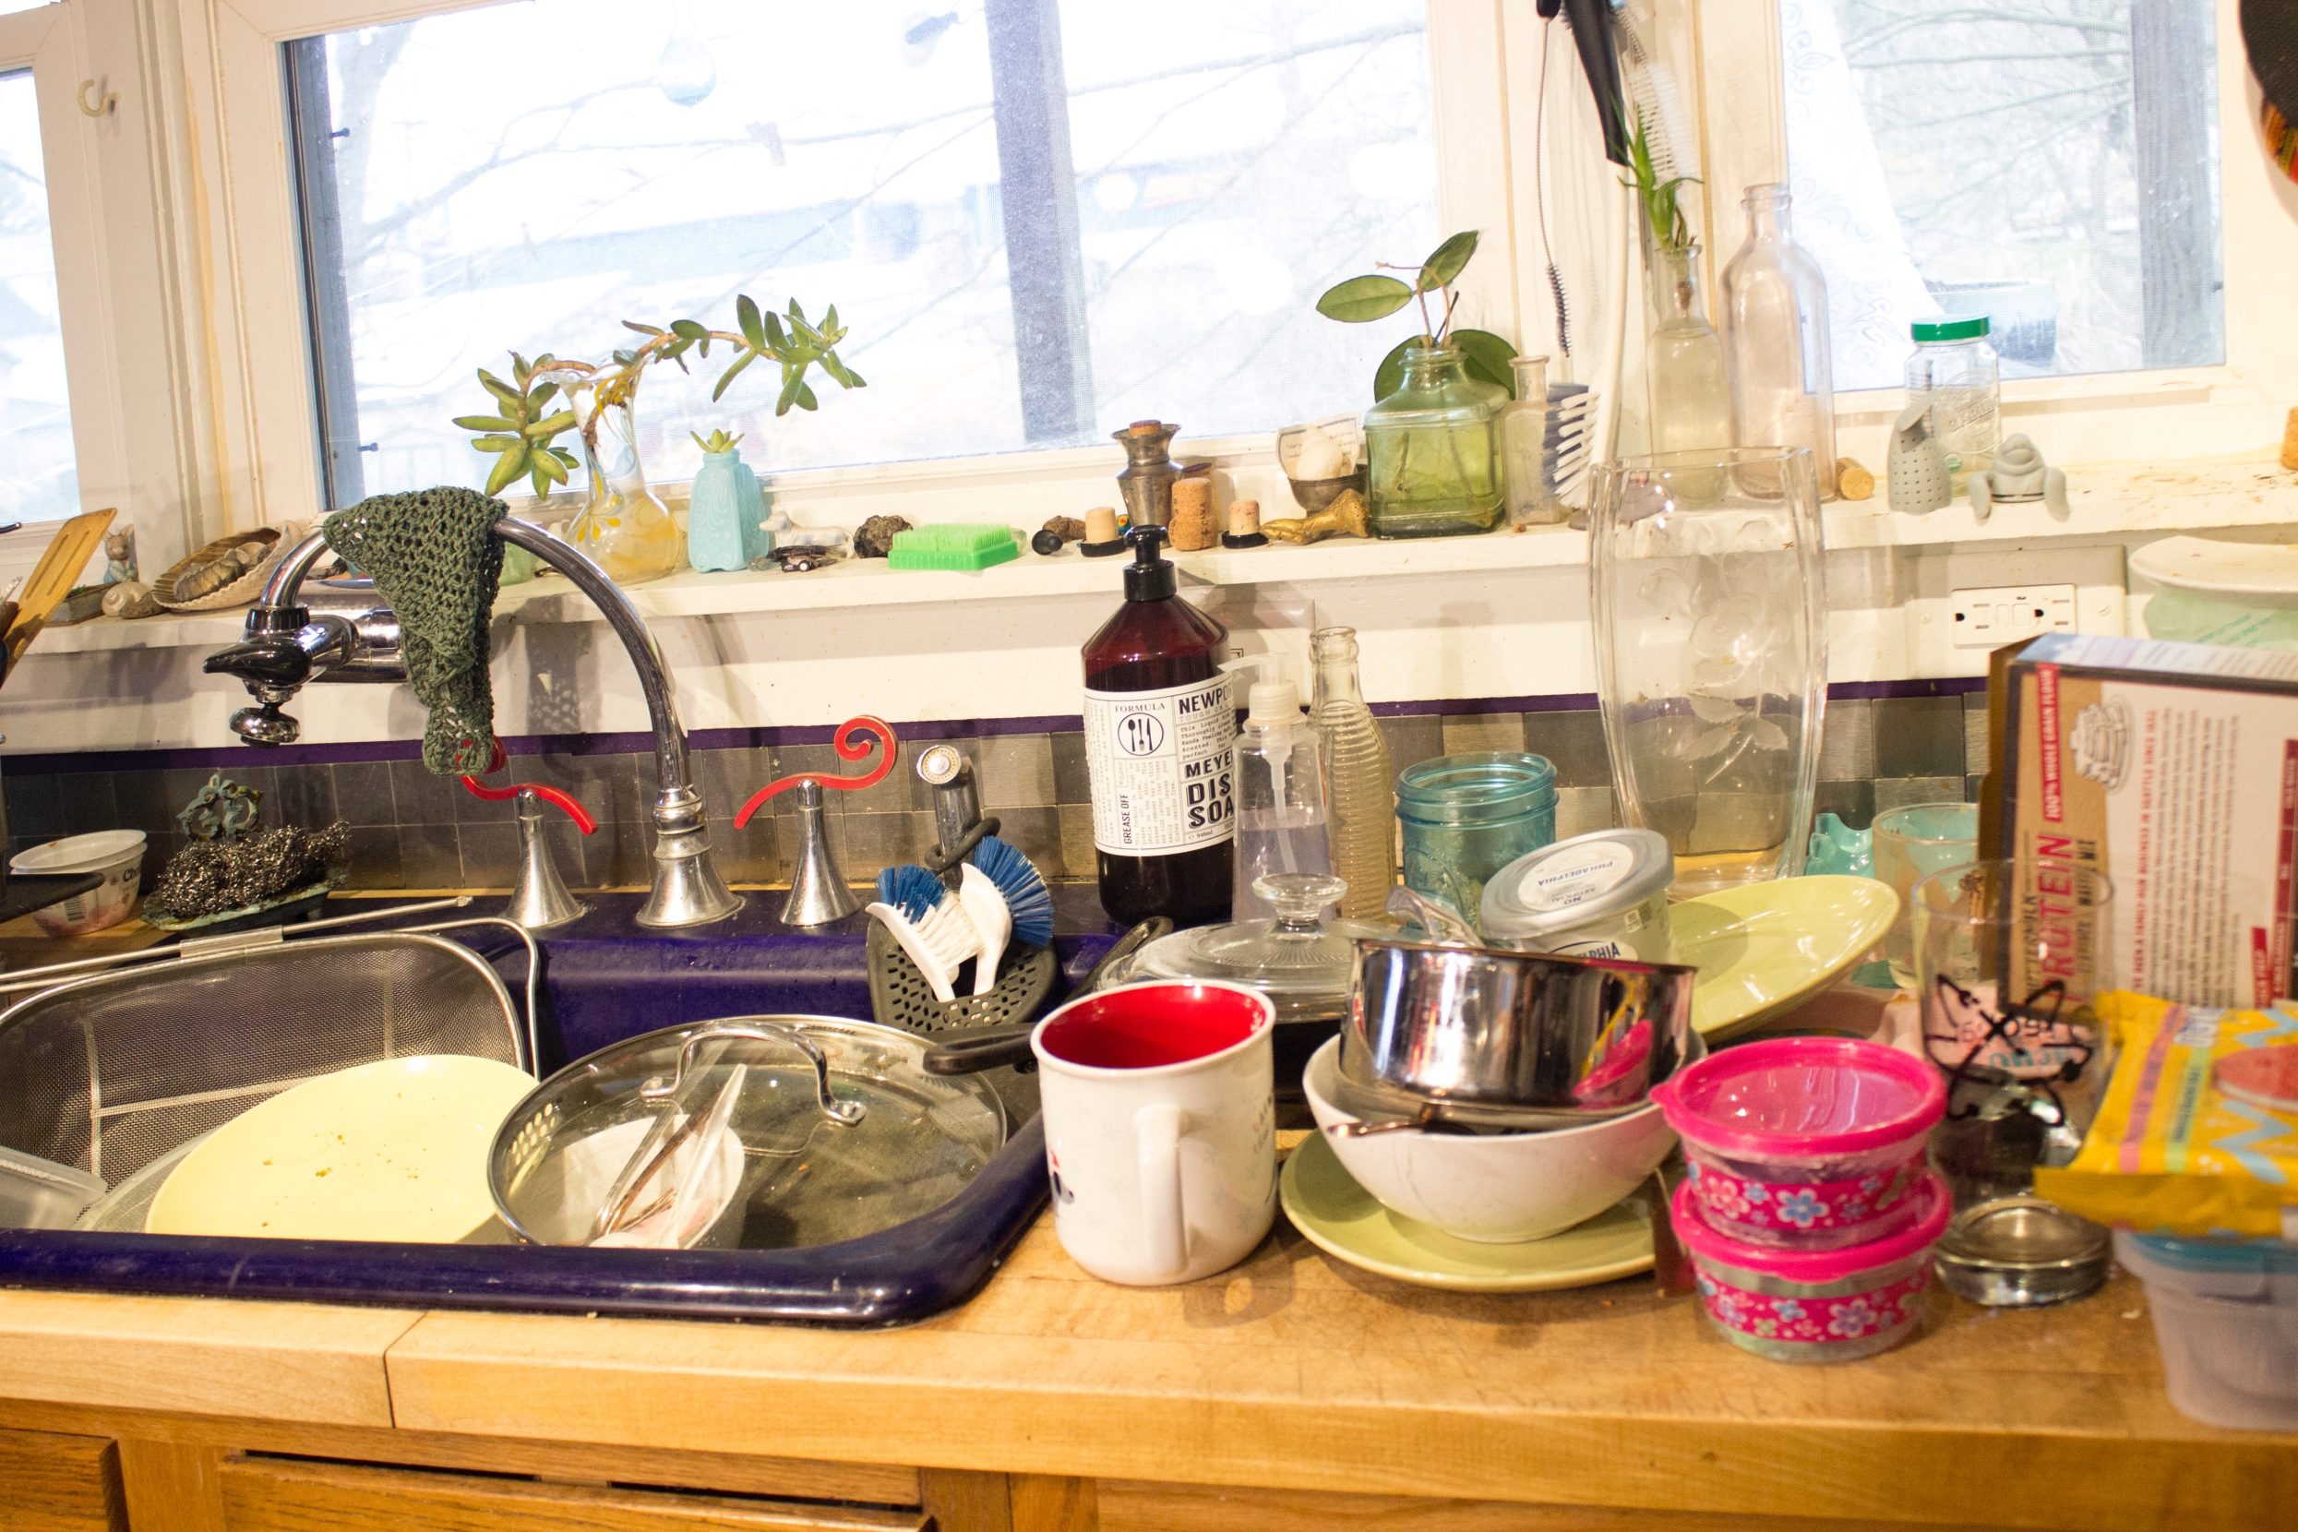
Where Cockroaches Drink
Sinks
Counters
Floors
Pet bowls
Shower stalls
Sweaty pipes
Refrigerator drip pans and gaskets
AC units
Notes:
Cockroaches can live a month without food, but survive only a week without water…removing water sources is important!
Let’s take a moment to examine this photo, making note of all potential water sources.
And here’s a list of typical water sources for cockroaches.

Slide 23
Inspect & Monitor
IPM
Program
Lifecycle
Evaluate Success
Identify
Use Multiple Tools
Scale the Response
Notes:
Remember, regardless of the pest, our IPM program lifecycle remains the same.
For cockroaches, we’ll follow the same IPM decision-making process that emphasizes prevention, knowledge of pest biology, and the use of least-disruptive control tactics, with pesticides saved as a last resort.
We'll start with
Inspection , moving on to
Identification
We’ll then Scale the response to the level of infestation
Employ control measures, or tools, and
Evaluate the effectiveness of the program

Slide 24
Inspect & Monitor
Inspect & Monitor
Notes:
As part of inspecting and monitoring, we‘ll try to discover where the cockroaches are most numerous. Cockroach “hot spots” should be given the most attention and may be the source of the whole population. If the most infested units are identified and focused on, you’ll stop their spread into new apartments. Identifying focus units through inspection should be one of the first steps in an IPM program.

Slide 25
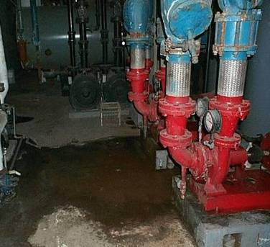
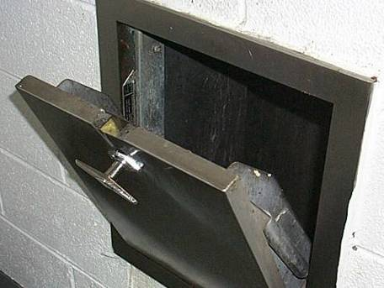
Inspect
Using a flashlight, look for evidence where cockroaches would find food, water, or a hiding spot: up, down, behind, and under
Think like a cockroach – look in hidden areas
Boiler room
Trash chute
Notes:
To inspect effectively, we must know to look in areas where cockroaches are living. This means anywhere they would find food, water or harborage. We should look for the previously discussed signs of cockroaches in any of their potential hiding spots. A reporting system that tracks the signs and the conditions cockroaches prefer is crucial so the PMP will know where to apply pesticides (and where NOT to apply), the staff will be aware of units having sanitation issues, and all will know if any units are occupied by vulnerable or sensitive populations.
If cockroaches are being reported in clean units, we should always check the adjacent units, because they may be generating or supporting a cockroach population.
Be sure to use a flashlight, even during the day.
25

Slide 26
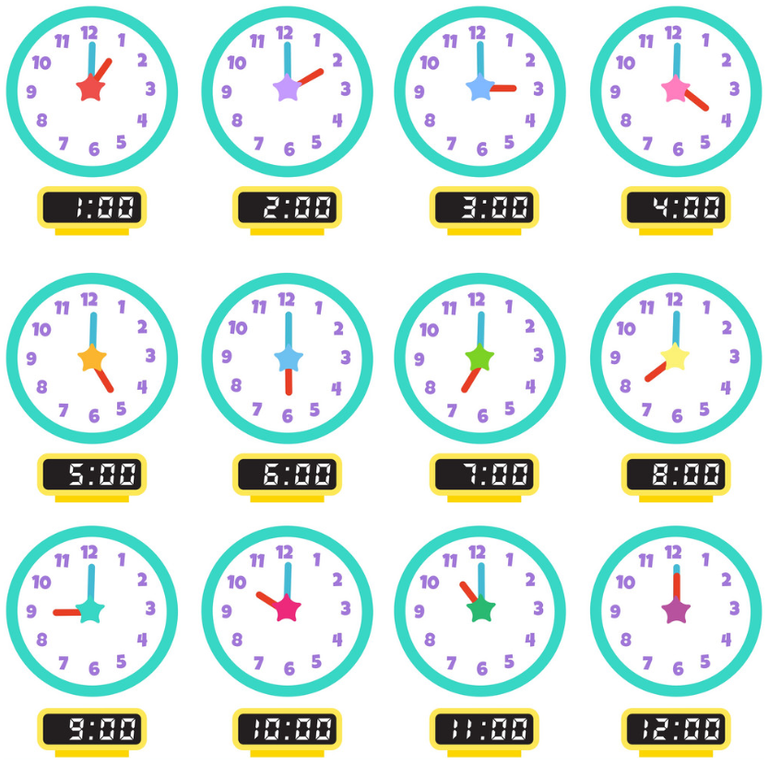
When are cockroaches most active?
Cockroaches are active at night when people aren't looking
They hide where people don't usually look.
Monitors help find cockroaches when and where people can’t.
Notes:
Think about the time of day most of us are looking for pest evidence. As a resident, it might be while preparing a meal. As a maintenance worker, it might be in the middle of our shift.
Yet, that’s not when cockroaches are most likely to make themselves known.
Cockroaches are most active at night when people aren't looking, and they hide where people don't usually look.
But we don’t need to conduct our inspections in the middle of the night.

Slide 27

Monitors Can Help
Monitors help find cockroaches when and where people can’t.
Notes:
Monitors help find cockroaches when and where people can’t.
A common way to monitor for cockroaches is to use sticky traps. These are folded paper, with a Sticky mineral-based glue. There is no pesticide.

Slide 28
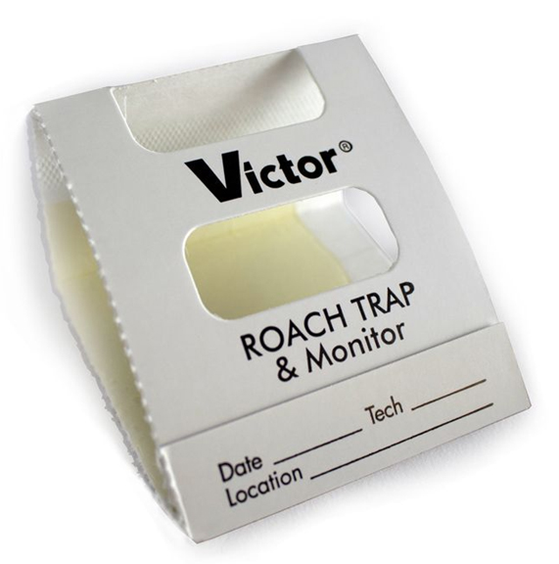
Monitor
Monitor by placing sticky traps near areas where cockroaches might travel - at corners and near warmth, food, and water
Notes:
The cockroaches walk across the glue and become trapped. The purpose of monitors is to conduct a census of cockroach activity during their most active times – at night, when we’re not watching. Of course, some cockroaches become trapped and die, and this helps reduce the population.
The paper is folded to keep out other pests, and the curious cat.
In this type, the paper is folded into a triangle.
Note the space to fill in the date, location, and technician. Mark the date and specific location (for example, Unit 315 Bathroom) on the monitor when placing it, so that patterns, and the time it took to catch the number of cockroaches, will be known.

Slide 29
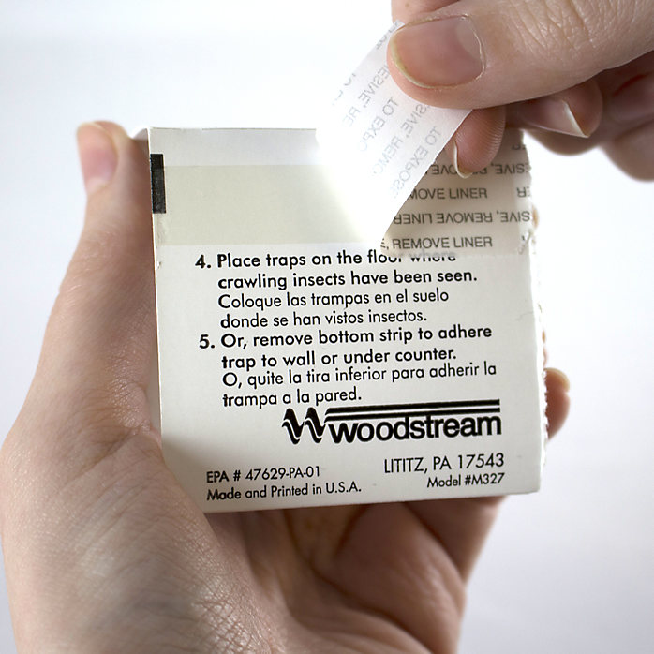
Monitor
Monitor by placing sticky traps near areas where cockroaches might travel - at corners and near warmth, food, and water
Notes:
Sticky traps are information-gathering tools. They alert to a growing infestation in common areas, such as trash chutes and trash storage areas.
The key is to properly place the trap in a corner, or near a water or food source.
If your pest management company does not use cockroach monitors, ask them to purchase monitors in bulk and have staff set them out.
This monitor has a exterior glue strip, which helps to keep the monitor in place. When you are ready to place the monitor, simply remove the paper covering to expose the adhesive, and attach to a clean, dry surface.
To see changes that indicate a growing population, the sticky traps must be checked and changed periodically. The concept of an IPM log was introduced in Module one. Can you see how keeping records of trap counts could tell a lot about the problem?

Slide 30
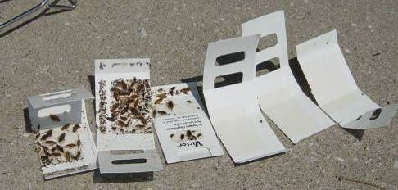
Monitor
Notes:
A few things to note about this picture:
The traps on the far left were in the kitchen and bathroom. The kitchen was most heavily infested. The other traps were in the bedroom.
The small cockroaches (nymphs) in the lower left photo indicate that the trap was close to where cockroaches were thriving. Adult male German cockroaches will travel as much as 12 feet to find what they need to survive, adult females will travel about 6 feet, while nymphs usually stay within a foot of their hiding place.
Cockroaches can survive for several weeks on the glue trap. The tongs in the background serve as a reminder to avoid touching the cockroaches on the traps. Wear gloves or use tongs.
Traps that are covered with cockroaches, like the three on the left, should be put in a re-sealable bag and brought to the property manager or designated person who will assess the information.

Slide 31
Identify
Check your monitors:
Is it a cockroach?
What kind?
Identify
Notes:
Check your sticky trap monitors. Can you identify what the pest is? Is it a cockroach? What kind? We’ll use what we just learned about the different types of cockroaches to determine the most effective method of treatment.

Slide 32
Scale the Response
How many cockroaches do we have?
Scale the Response
Notes:
Now that you’ve identified the pest, we want to respond accordingly. How many cockroaches do we have? Is this just a beginning infestation, with only a few cockroaches, or a full blown, long-term infestation? The former situation can most likely be handled with relative ease, and with the fewest interventions. The latter will require everyone’s cooperation to the fullest. Investing time to inspect early, will help you to assemble an effective and efficient action plan.
Use of monitoring tools to get an accurate census of cockroach populations can help us scale the response, to the size of the infestation.
Obviously, we should treat the presence of three cockroaches differently than 3000 cockroaches.
For instance, a common reason for control failure when using baits is not applying enough bait. The heavier the infestation, the more bait needed.
A half or whole tube of bait may be needed for a very heavy infestation treatment but it’s not uncommon to see a technician carry one or two tubes to treat an entire building.

Slide 33
Use Multiple Tools
Sanitation
Exclusion
Targeted Chemical Use
    (Only by Licensed Professionals)
Use Multiple Tools
Notes:
Non toxic and low toxic treatments for German cockroach control are available.
Sanitation and exclusion are powerful, non-toxic tools for combatting infestations.
A unit with fewer sources of food and water, is less attractive to pests.
Finally, exclusion practices, such as sealing cracks and crevices, will reduce harborage space, negatively impacting both population size and access between apartments.
And fewer pests makes it easier for targeted chemicals to work, when necessary.
Here are some additional examples of sanitation, exclusion and targeted chemical use as IPM tools.

Slide 34
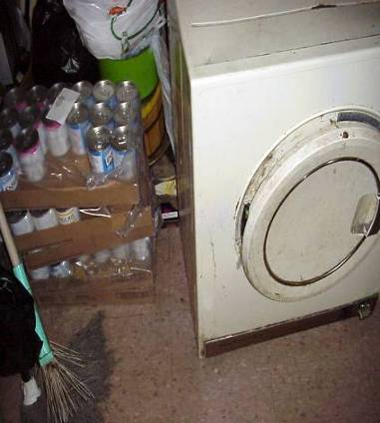
Sanitation
Detailed sanitation makes pest control work better
Eliminate hiding spots, food, and water available at night
Notes:
34
"Detailed sanitation" includes all crevices and spaces, especially around and beneath the stove, refrigerator, and dishwasher.
Removing clutter and hiding spots, such as boxes and bags, can have a big impact on reducing pest populations
In this photo we see numerous harborage opportunities for pests.

Slide 35
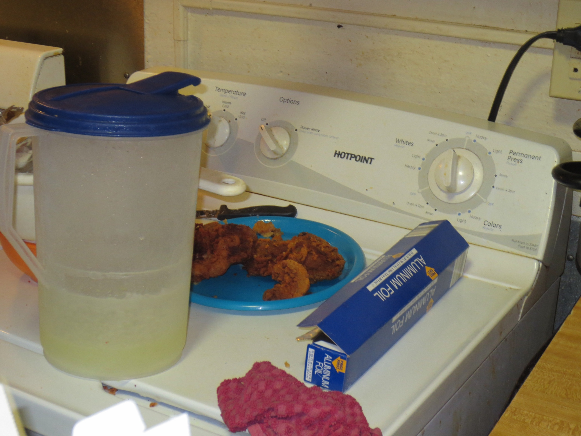
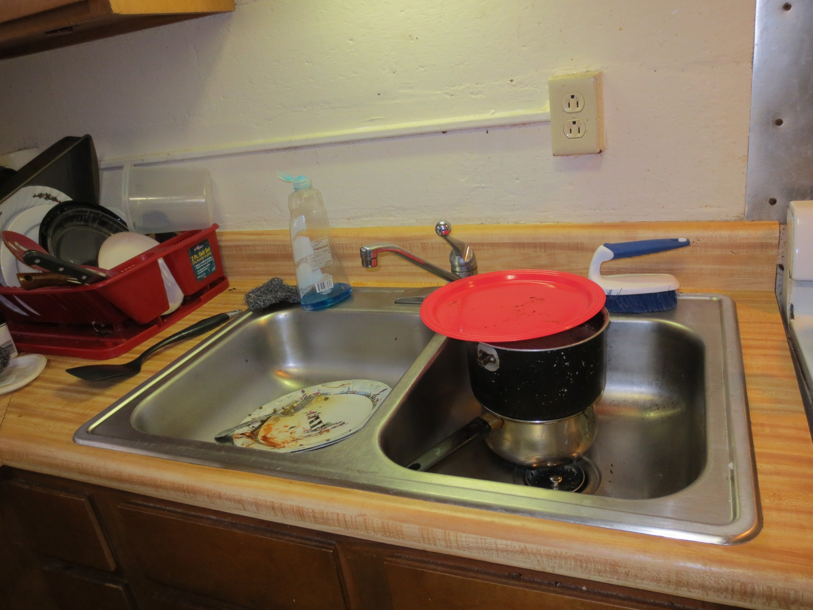
Clean the Kitchen
Notes:
With its access to food and water, along with numerous hiding spots, the kitchen is usually the first place cockroaches settle. Counseling residents to clean dishes and store leftovers promptly will discourage pest picnics. Washing dishes and picking up pet food should be part of a daily housekeeping routine.

Slide 36
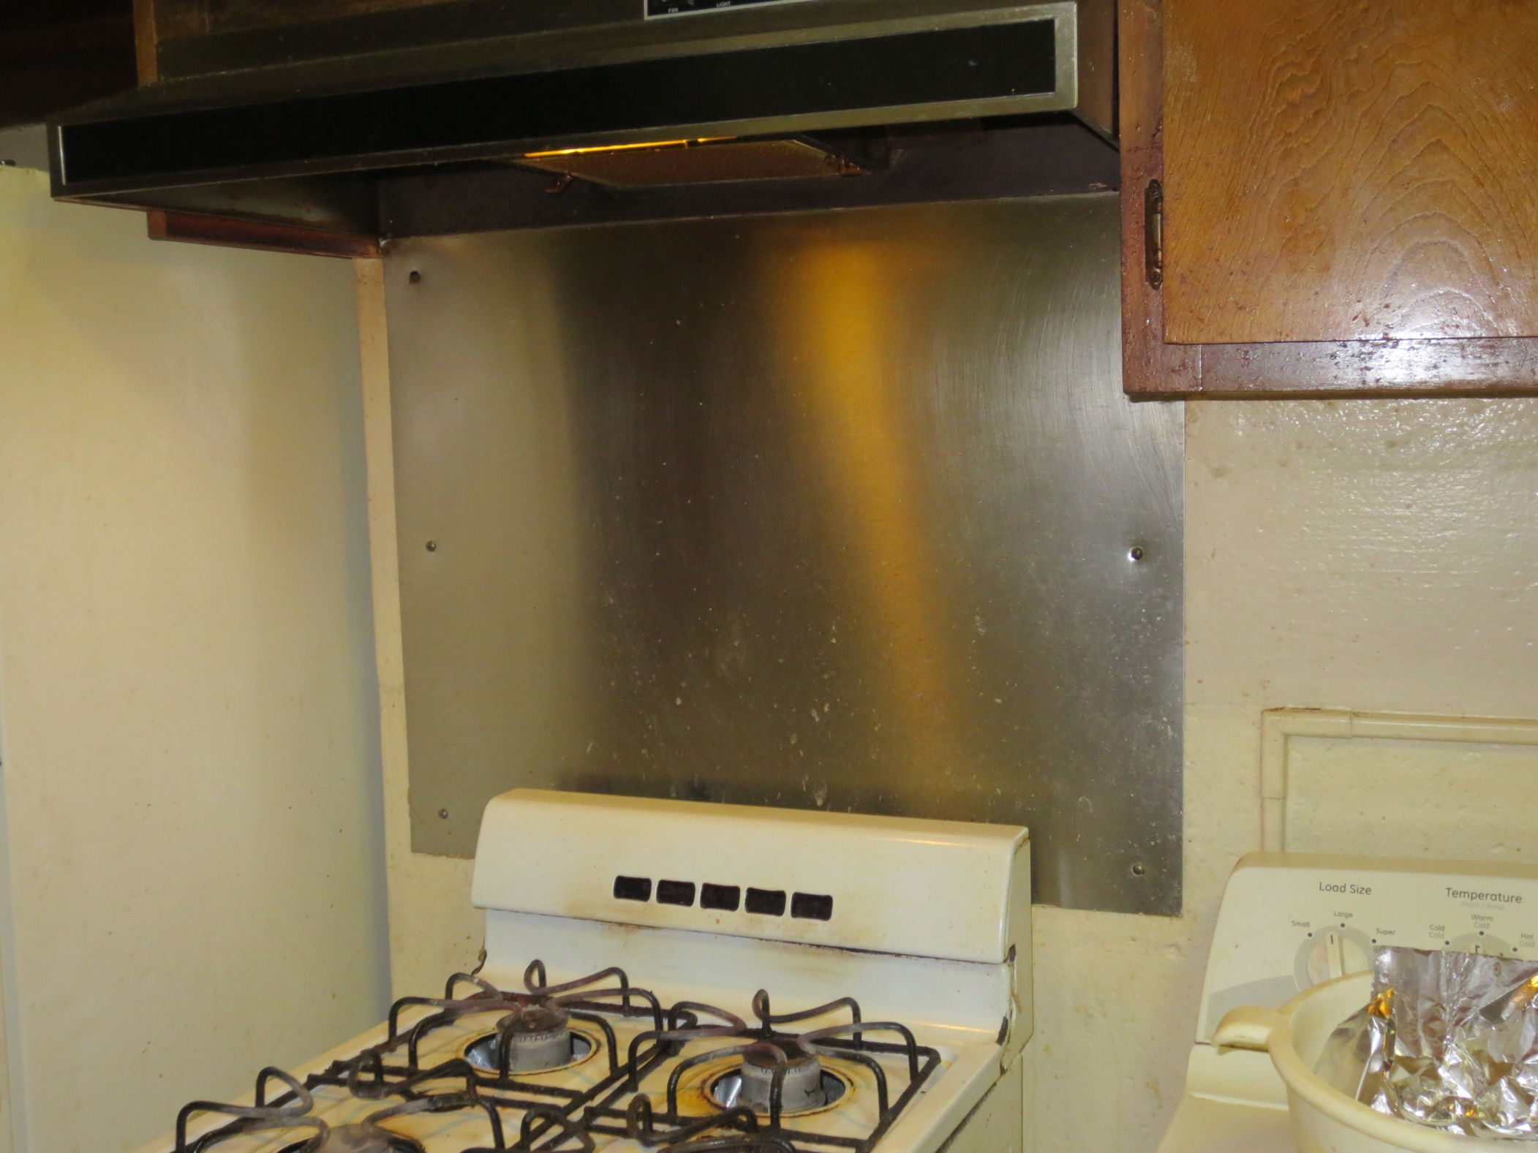
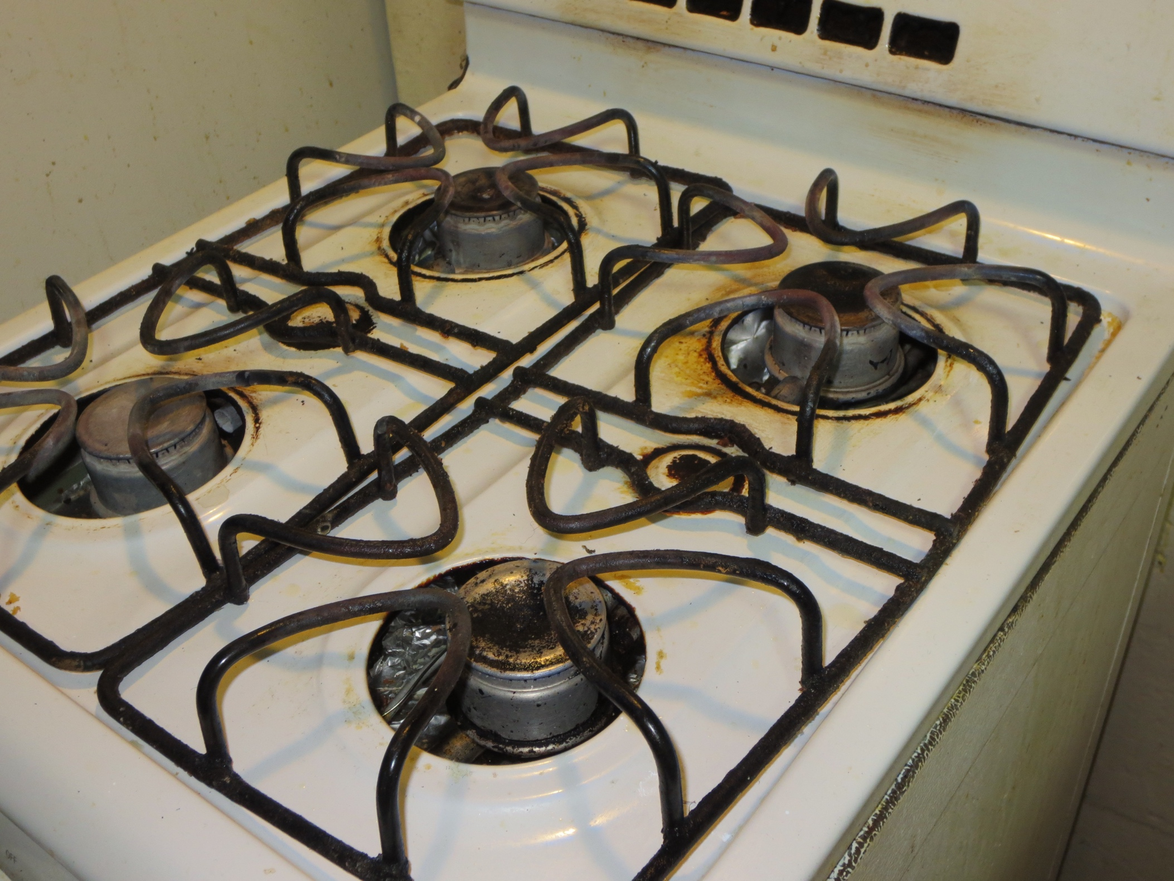
Clean the Kitchen
Notes:
Appliances, both small and large, can offer the food & warmth that cockroaches crave. The stovetop, backsplash and range hood filters are reservoirs for grease, and should be cleaned regularly.

Slide 37
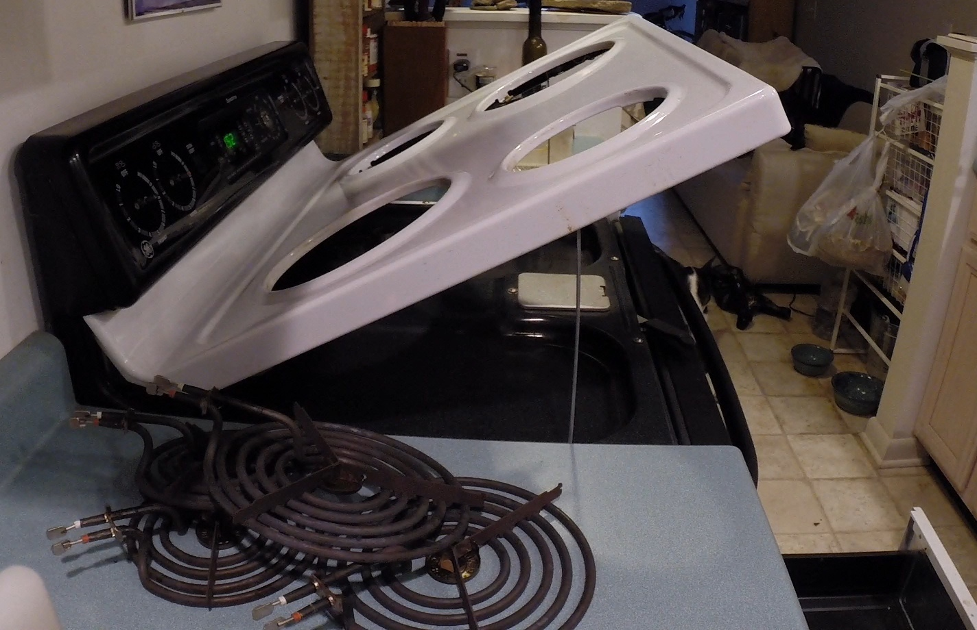
Thorough Stove Cleaning
Notes:
When residents move in, demonstrate how to access all cleanable areas of these appliances, including gaskets. At a minimum, show the resident how to remove the burners, drip pans, and lift the stovetop if the stove has this feature. If management prefers, a maintenance technician can be the one who pulls the refrigerator or stove away from the wall. Encourage the resident to arrange this service at least once every quarter.

Slide 38
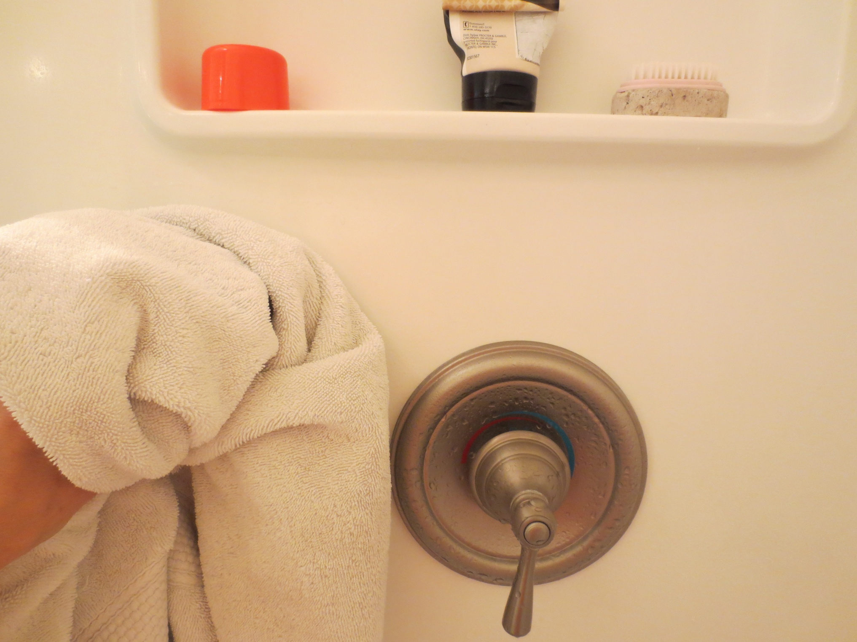
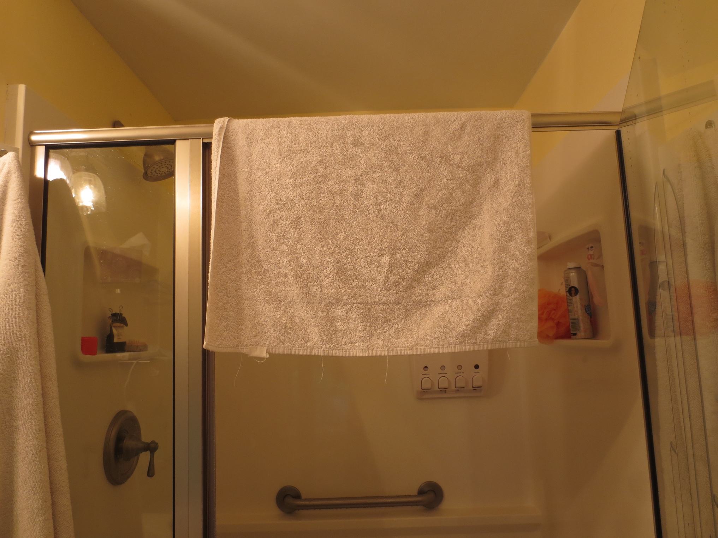
Clean the Bathroom
Notes:
Bathrooms offer numerous sources of moisture and food for pests. Wiping down shower walls, and hanging damp towels to dry, can reduce the number of water fountains for pests.

Slide 39
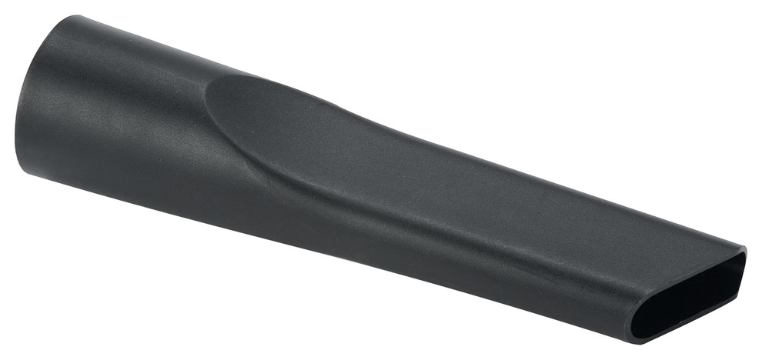
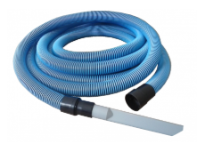
Vacuum Cockroaches
Non-chemical intervention
Quickly reduce cockroach population
Remove live roaches, dead roaches, shed skins
Prepare the area for cleaning and treatment
Notes:
Using the vacuum to reduce the cockroach population is a safe, non-chemical solution with immediate results. It serves to quickly reduce the population of cockroaches by simply removing all visible roaches from the area. We can remove live roaches, dead roaches, shed skins, and even some frass – all of which can cause respiratory reactions. It also clears the area for cleaning and treatment.
Using a vacuum with HEPA filtration is best. These filter out 99.97% of particles down to .03 microns in size. For reference, a human hair is 50-150 microns in diameter.

Slide 40
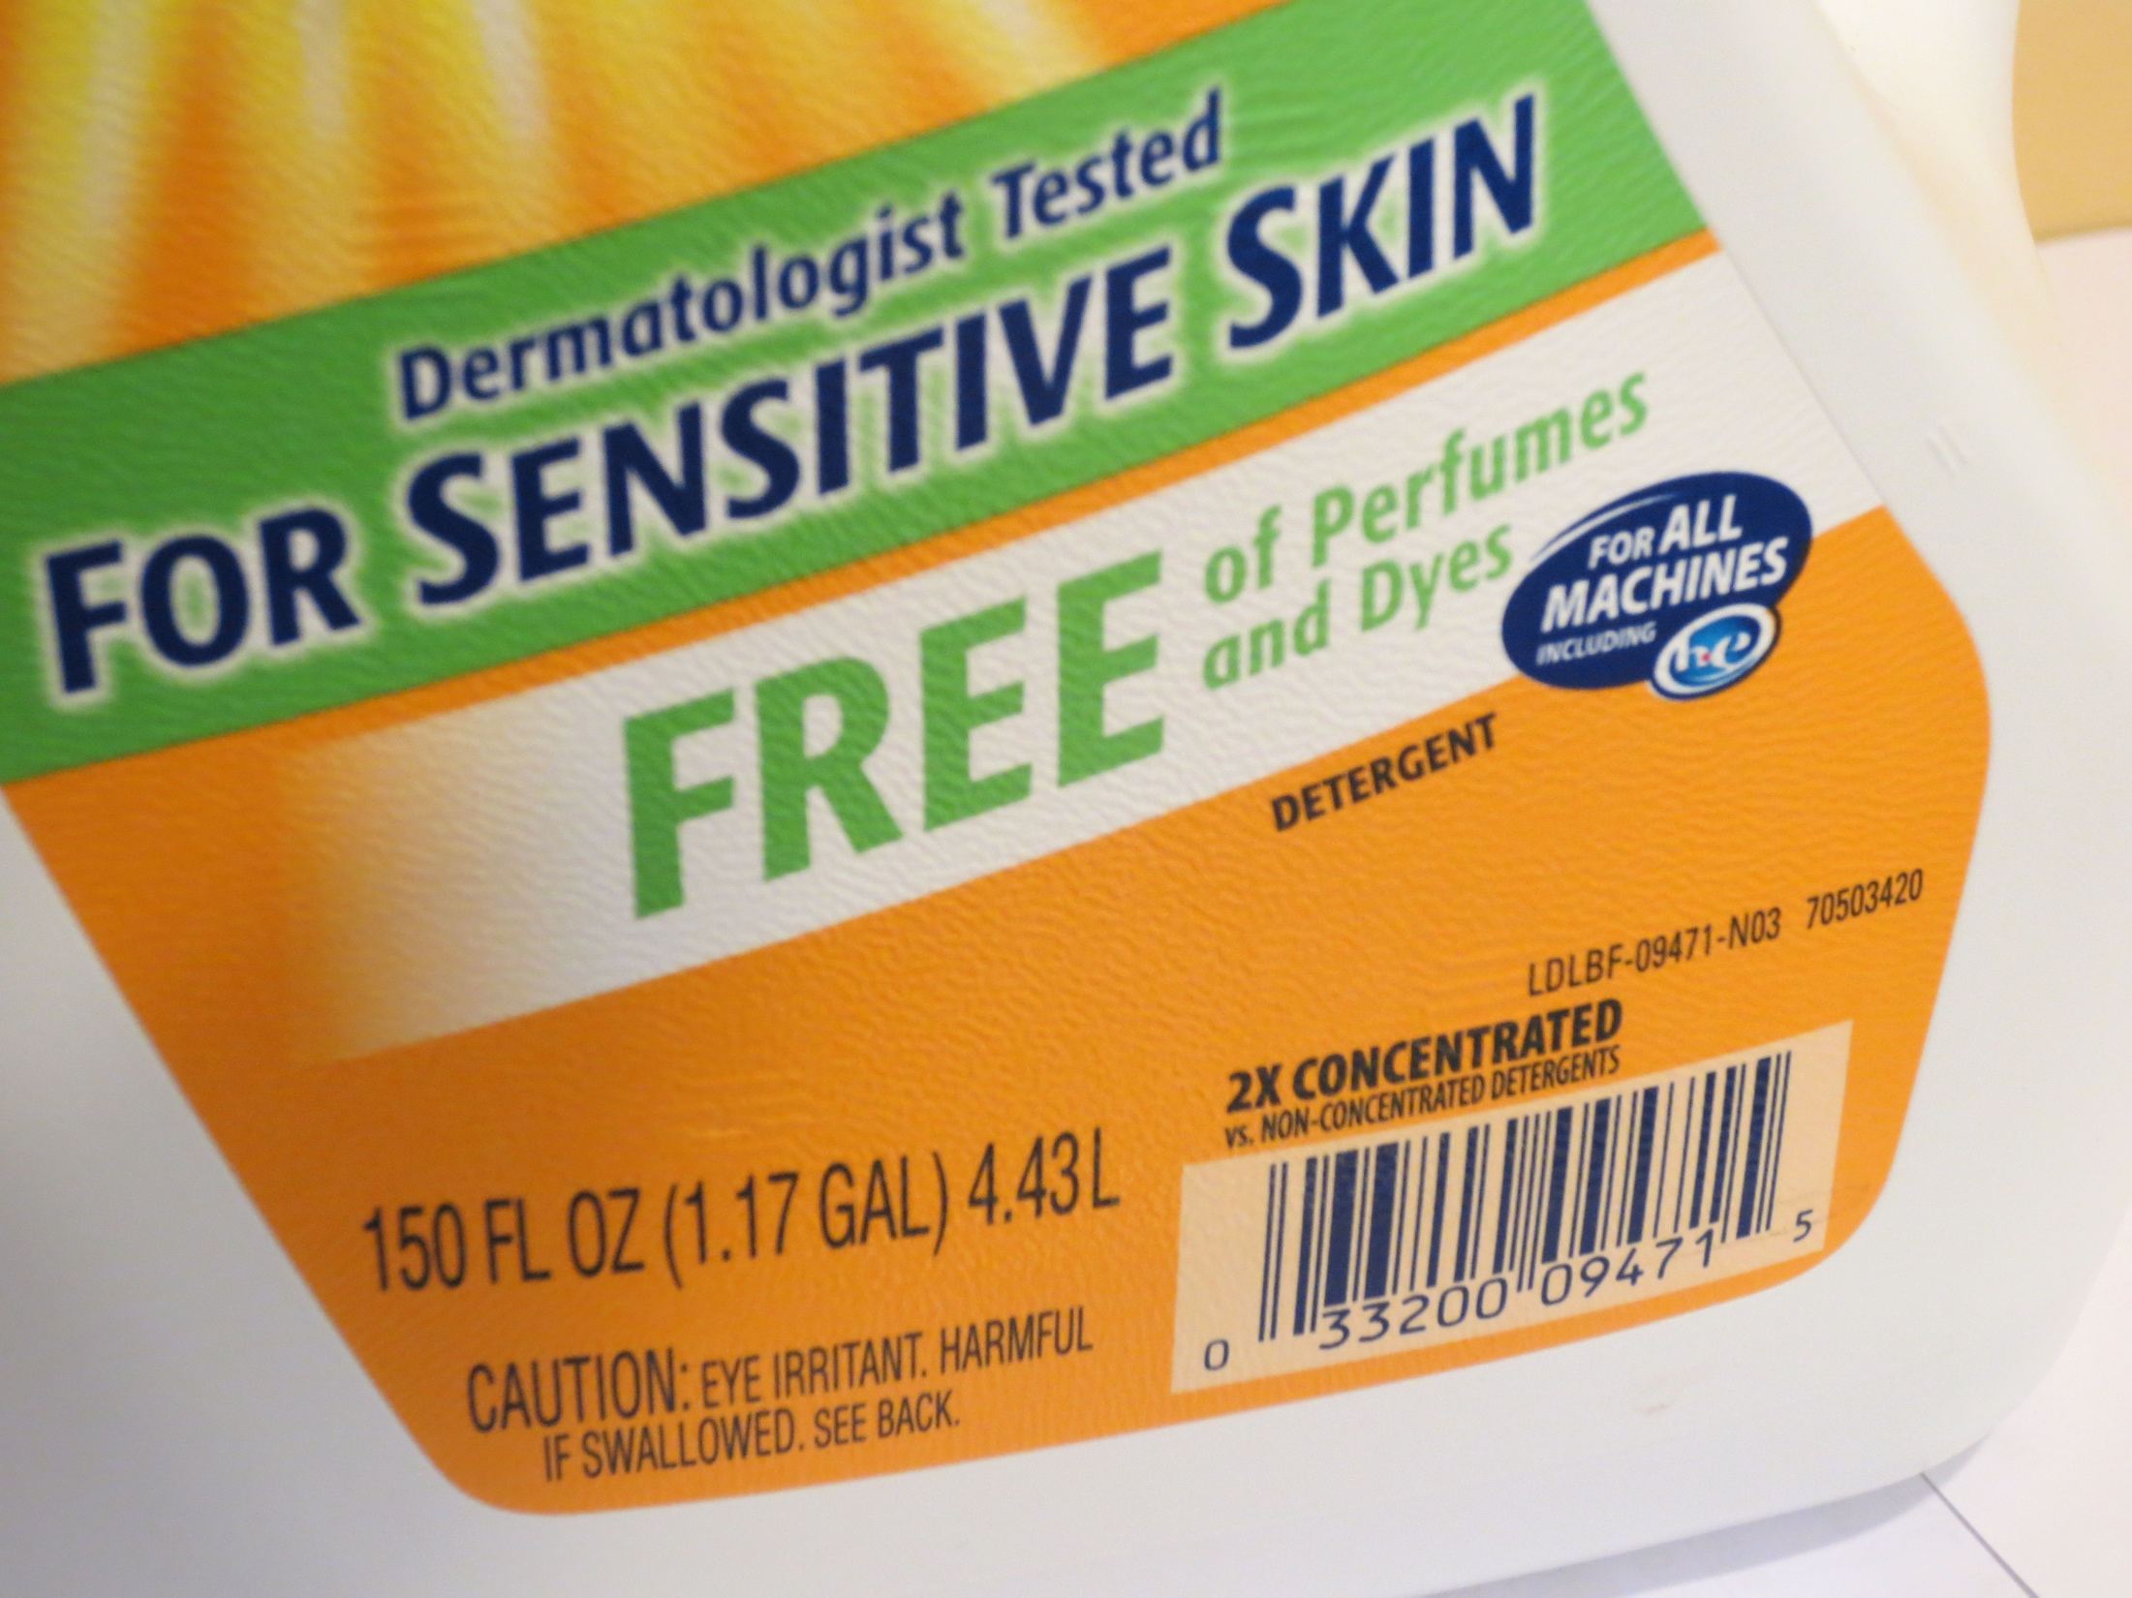
Simple Soap and Water Work Best
We must clean the dead roaches, skins & frass.
Notes:
40
We learned earlier that Cockroaches communicate by smelling and tasting frass. And that the asthma connection comes from frass and body parts that the cockroaches leave behind.
Cleaning using simple soap will remove the allergens, remove the cockroaches’ mode of communication, and allow residents and staff to see when new evidence shows up.
By “simple soap” we mean unscented, simple cleaning products. It doesn't take much to break the molecules that trigger asthma, but water alone won’t be effective. Strong chemicals aren’t necessary, and will contaminate nearby baits. It’s important to remove the frass, since that is the asthma trigger, but not reduce the efficacy of other control tools.
The EPA website has guidance on appropriate cleaning products.

Slide 41
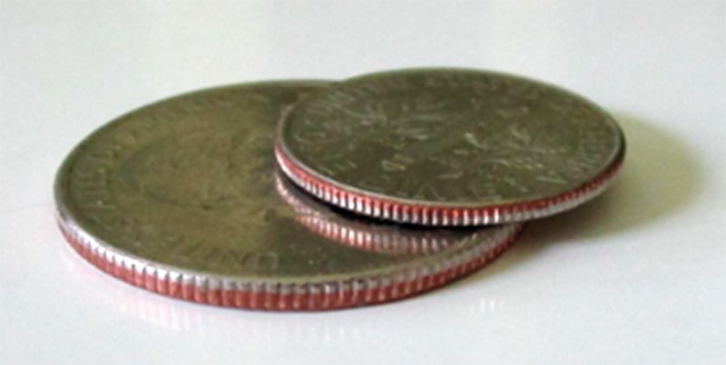
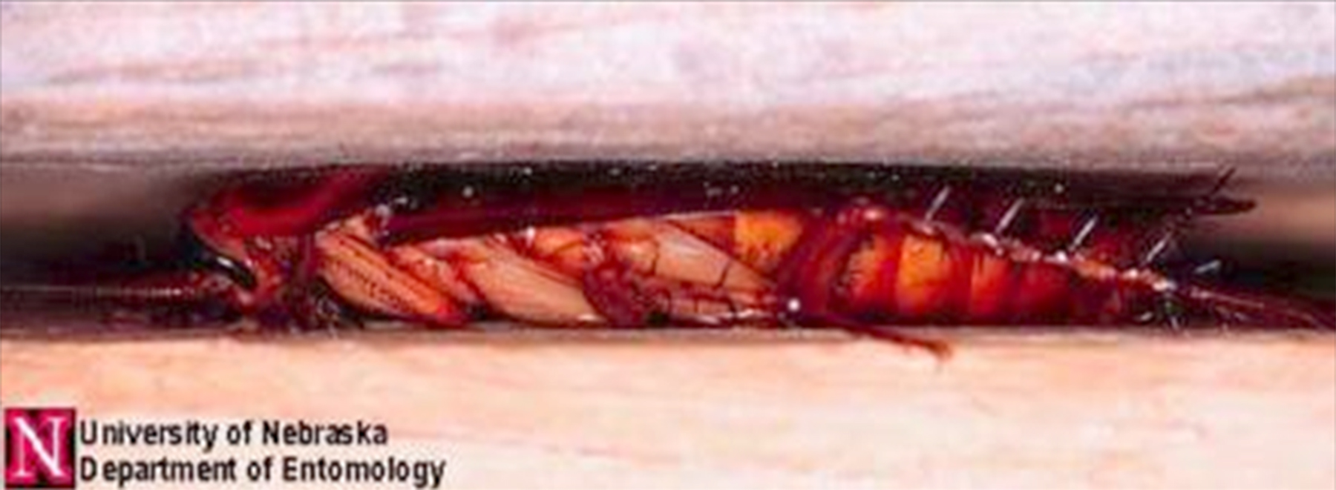
Cockroaches like to be squeezed
Notes:
41
Exclusion means keeping pests out. Think about this - Young cockroaches feel comfortable in a crevice as thin as a dime.
Adult males want a space the thickness of a quarter.
Pregnant females want the most space of all to hide: two stacked nickels. All like to be squeezed.

Slide 42
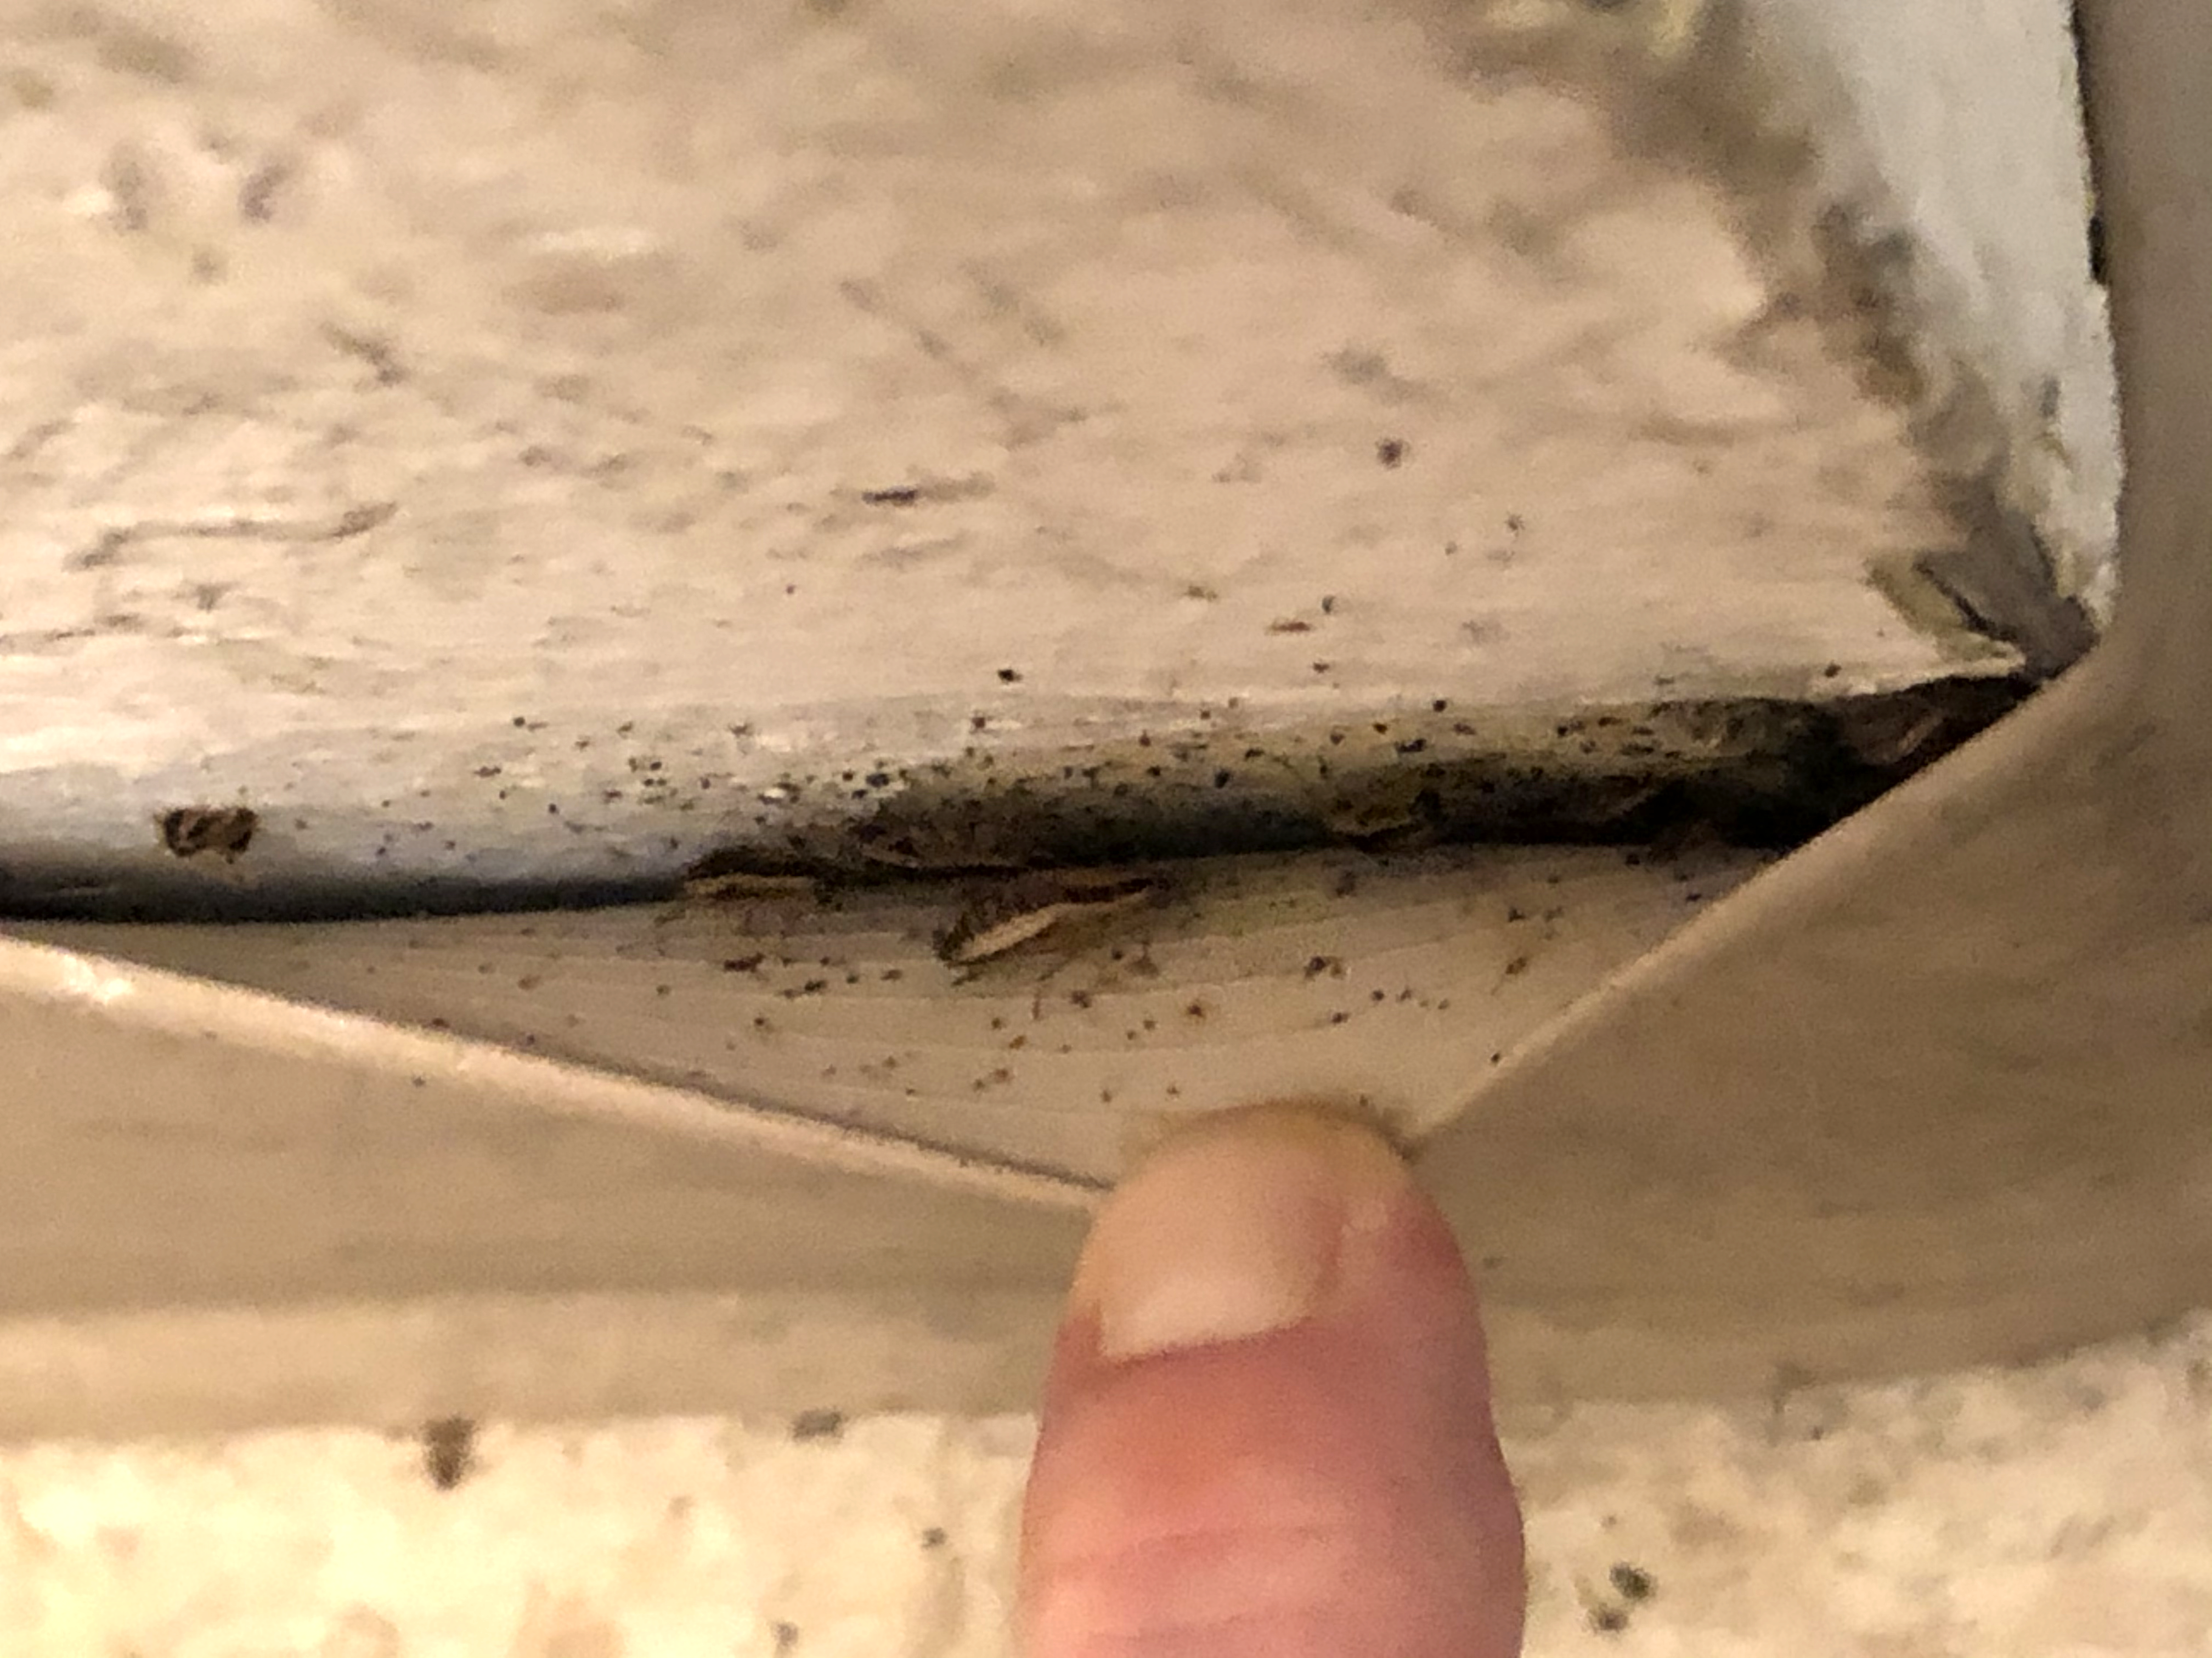
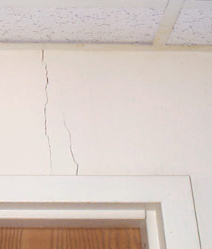
Exclusion
Seal or fix cracks, loose moldings, or holes where cockroaches could fit
Notes:
42
The photo on the left shows a crack in the plaster that could be hiding cockroaches.
ON the right we see cove molding that is not secured to the wall. It’s harboring cockroaches behind the molding.
Making these types of repairs is good for the building and good for pest control.

Slide 43
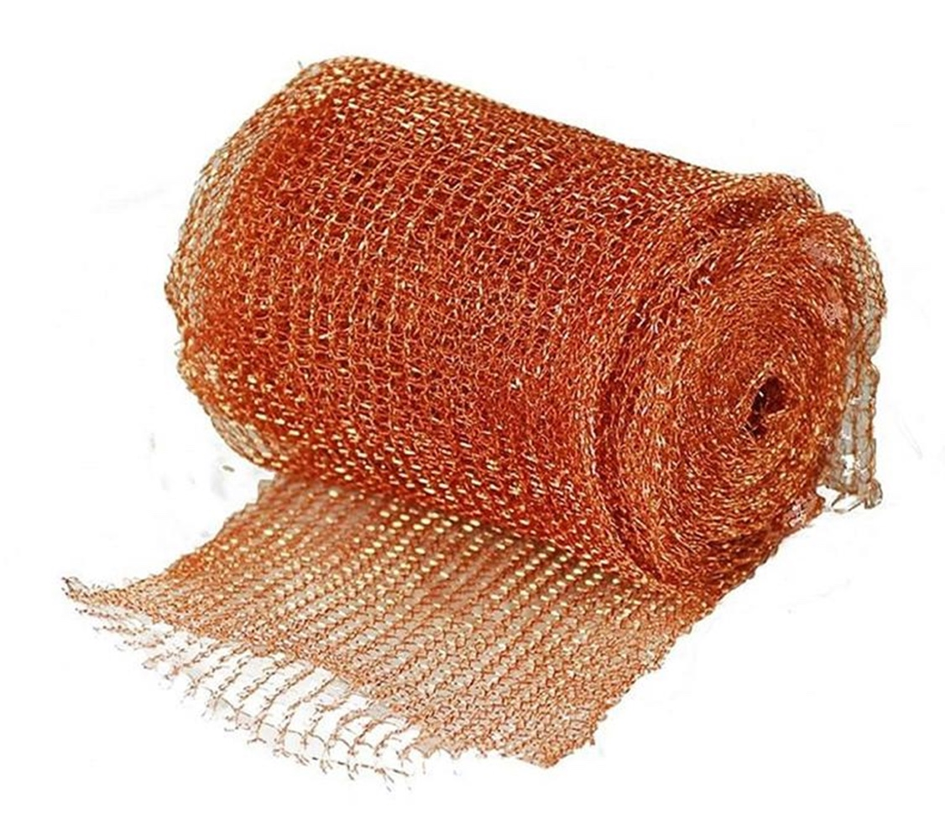
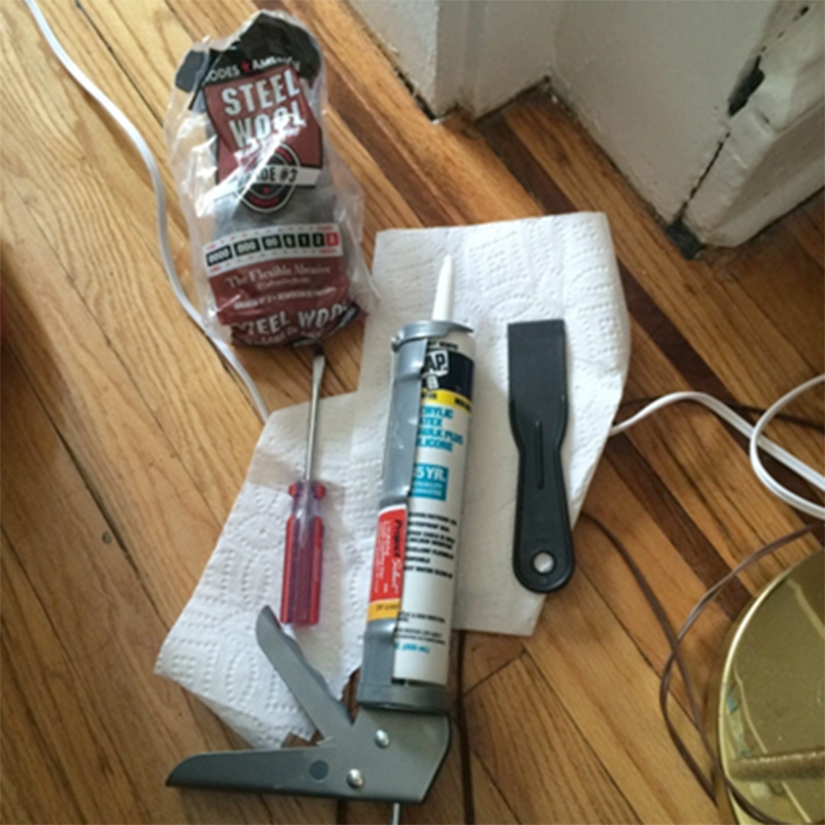
Exclusion Tools
Use:
Silicone caulk
Copper mesh
Screens
Notes:
43
Although relatively expensive, silicone caulk will provide the longest lasting control since it adheres to surfaces and holds through the inevitable slight shifting of buildings. We’ll discuss exclusion tools more thoroughly in Module 3, on rodents.

Slide 44

Exclusion
Caulk:
Around cabinets and counters to limit access
Notes:
44
Caulk around cabinets and countertops can limit cockroach passageways and hiding spots

Slide 45

Exclusion
Door sweeps:
Always on boiler, trash room and exterior doors
Notes:
45
Functional Door sweeps are essential on doors leading to the outside.
This door sweep is deteriorated, and providing an “open door” for pests.
Interior door sweeps can prevent infestations from moving between units and common areas.

Slide 46















Targeted Chemical Use by PMP
Ideally, sanitation first
Monitor and Inspect before treatment to scale response
OR
Notes:
46
Remember, Sanitation and monitoring should come before treatments.
We want the monitoring results to tell how much pesticide we need, and where to apply it.
If we have more cockroaches, we need more treatment.
Each unit has different conditions and require will each require a specific plan. Vacant apartments allow more in-depth control to take place, but attempts should still be made to minimize the pesticide residues that might be left behind. Bear in mind that pesticides may not be an option for the chemically-sensitive. In those instances, sanitation, sticky traps, vacuuming and exclusion can still be used in the IPM plan.

Slide 47
Targeted Chemical Use by PMP
Ideally, sanitation first by resident, then…
Monitor and Inspect before treatment
  How much to apply
  Where to apply
Only licensed individuals should apply pesticides
  No “calendar-based” spraying
Notes:
47
PMPs should not be using calendar-based residual sprays to kill cockroaches, even though many still rely on it—partly because they think the customer expects to see it. Routine calendar-based spraying is not part of an IPM program.
The effectiveness of typical baseboard spraying relies on two things:
1. The cockroach must walk through that narrow band of pesticide spray, and
2. It must pick up enough of that product to kill it.
As we learned earlier about cockroach behavior, most of them are hiding and will never come in contact with that band of spray.
You and your PMP may consider occasional use of pesticide sprays for heavy infestations, thye should be applied as crack and crevice treatment, protecting the residents from exposure and getting the pesticide to the insect. In some circumstances, professionals will want to use a residual spray and/or a flushing agent when performing an initial knockdown of a large population. Discuss with your pest management professionals when and how they will use residual sprays.
There is no need for regular baseboard spraying for cockroaches if IPM is being used.
Next we’ll talk about some pesticide options for cockroaches that can be used to complement other IPM practices.

Slide 48

Baits: The most effective pesticide option
Cockroaches feed and share for econdary kill
Kills all stages (except eggs)
Use in every room where inspection finds evidence
Bait Station
Notes:
48
Baits are the most common and effective pesticide for cockroaches nationwide.
Let’s review a few points:
Cockroaches spend most of their time hiding – in walls, behind baseboards and cabinets – anyplace they won’t be disturbed. Therefore, many of our traditional treatments don’t reach them there. But baits allow us to use our knowledge of cockroach behavior to deliver the pesticide to where its needed.
These bait stations contain a slow-acting insecticide combined with attractive food source to lure the cockroaches to it.
Once a roach ingests the bait, it goes back to the hiding spot to die. And it dies slowly.
Remember we said that cockroaches will eat just about anything? The hidden roaches feed on the dying cockroach's frass and body, and they get poisoned too.
Pregnant cockroaches and nymphs don’t travel very far from the hiding spot. So baits have a unique capacity to provide a secondary kill of ALL stages of cockroaches by delivering the poisoned meal to the hiding roaches.
Baits should be used in every room where inspection finds evidence of infestation.

Slide 49


Bait Delivery Mechanisms
Bait Station
Gel Bait
Gel Bait
Notes:
49
These photos show two common methods of delivering baits. There are several excellent cockroach baits sold in stores and online and some only available to professionals. Those available to consumers come in ready-to-use plastic stations (usually 12 to a box), while others used by professionals come in a large plastic syringe, as shown on the left.
Bait stations are popular because there is very little risk of pesticide exposure and the container is tamper-resistant. The see-through cover allows the user to see the pesticide in the bait station, and tell if the cockroaches have been feeding. The pesticide is the white or brown material in the center. If the bait isn’t being eaten, there could be other more attractive food sources in the area – remember “sanitation first”. If the cockroaches have not fed on the bait after a few days, it should be placed a different area. If that doesn't work, a different kind of bait should be used
<click>The photo on the left shows a syringe applicator. Most professionals find the syringe to be versatile and efficient.
the attractant in the bait will not draw the cockroaches from very far away, the bait must be applied where the cockroaches are hiding. Inspecting for frass can tell us where the insects are located. Gel bait should be used only in cracks and crevices to keep it inaccessible to children.
The syringe makes it possible to inject many small dabs of bait only where needed.
Applying bait in narrow cracks also protects the bait from drying out. Sufficient amounts must be applied to kill the cockroaches, but not so much that it creates a mess. Bait should be reapplied every two to four weeks, or sooner if all of it is consumed. If old bait is still present when re-applying, it should be removed. Dried bait is not as appetizing to the cockroaches

Slide 50


Baits
Will still work where sanitation is low
More roaches = more bait
Rotate formulations
PMPs applies gel bait under a drawer
Notes:
50
Cockroaches feeding on baits die within 1-3 days. This allows them to return to harborages and “share” the bait. For every one cockroach that consumes the bait, we estimate it kills 30 more back in the harborage.
Although the resident may not see an immediate reduction in a population, they should see a decline within a few weeks.
Baits have virtually no odor and present minimal hazard to children or pets. Another plus for residents? It usually is not necessary to empty kitchen cabinets or cover food preparation surfaces before a bait treatment.
We want to remember to scale the response. If monitors show lots of cockroaches, we want the professionals to use more bait. If bait remains uneaten but there are still cockroaches, the cockroaches may have developed an aversion to it. It is recommended that professionals rotate bait formulations every month, or at least every 3-6 months, to avoid resistance.

Slide 51




Keeping Baits Attractive
PMP: Wear gloves
Resident:No pesticide sprays
Resident: No scented cleaners
Resident: no smoking
Notes:
51
The success of Baits and gels relies on roaches finding them attractive and WANTING to eat them. If baits are contaminated with chemicals that the cockroaches recognize as poison, cockroaches will avoid them. This is often why residents say that baits “don’t work.” They won’t if the resident is also applying aerosol cockroach killers in the same room. Strong-smelling cleaners can have the same effect. Nicotine from smoking will also contaminate the bait. This is one reason why gloves should be worn when placing bait. When cleaning out cabinets before putting in bait stations, strong-smelling cleaners should not be used. Regular soap and water will work, and won’t ruin the bait’s effectiveness.
Note that bait storage is also a concern. If baits are stored with other pesticides or cleaning products, they may become contaminated and ineffective. This also holds true for rodent baits, which will be discussed in Module 3.

Slide 52

Insecticidal Dusts
Boric acid - Stomach poison
Silica and diatomaceous earth - desiccant
Chemical
Notes:
52
Another tool available to PMPs are various insecticidal dusts.
Insecticidal dusts will kill insects in different ways, depending on the active ingredient.
Dusts that contain boric acid act as stomach poisons. The cockroach walks through the dust and ingests the poison when cleaning itself.
Other dusts, such as diatomaceous earth, or silica,- based product affects the cockroach's outer layer so that they can't retain enough water to stay alive. Many PMPs use dusts with a chemical pesticide added to the silica for faster kill.

Slide 53
Insecticidal Dusts
Light dusting,
Keep dry
Unit turnovers or Cabinet replacement:
  Clean first
  Apply in walls, under and behind cabinets
Notes:
53
With insecticidal dusts, a light touch is best.
When there is a pile, the cockroach will avoid it. Think of a pile of snow versus a shoveled path. Which would you rather walk through?
Insecticidal dusts can be put in the wall void before replacing the faceplates of electrical outlets.
If the dust can be seen, there’s too much or it’s in the wrong place.
Click> Unit turnovers and renovations are a good time to apply dusts behind cabinets, in wall voids, and other normally inaccessible places. Work with a licensed professional to schedule dust application. This may take some effort but once applied, they remain effective as long as they stay dry.
Because insecticidal dusts can become airborne easily, a respirator should be worn while applying them and ventilation systems should be turned off.
As always, documentation is key.
If an inspector finds a white powder in a unit, a record of what it is and where it was applied should be available so that a narcotics or Hazmat crew is not needed.

Slide 54

Insect Growth Regulators
Interfere with cockroach growth and egg hatching
Take a ~month to work, effective for +/- 90 days
Compatible with other IPM methods; may enhance or be in baits
Credit: Brad Harbison
Notes:
IPM Coordinators should consider asking their PMPs about insect growth regulators, or IGRs. They prevent cockroaches from maturing, so they cannot reproduce. IGRs, are slow-acting, can take a month to work, and remain effective for +/- 90 days . IGRS are compatible with other IPM methods; They may be used with baits and are often an active ingredient in baits.
The come in many forms, including Sprays, aerosols, baits and impregnated discs. IGRs may be sprayed in cracks and crevices by PMPs using a spray application. Communication between the PMP and the resident will help the resident understand the service and address pesticide concerns, vulnerabilities, or sensitivities. The goal is to have everyone understand why conventional residual pesticide sprays are not to be used.
The PMP may explain, “I am applying a pesticide that makes it so that the cockroaches can’t grow up properly. It’s called an insect growth regulator and it is a pesticide that poses less risk to you and your family than the sprays you may have seen before. Don’t expect to see dead cockroaches right away. IGRs take a few weeks to work.”
IGRs can be a good choice when transitioning to an IPM program, and can help prevent reinfestation.

Slide 55
Which treatment/s does your PMP use?
Monthly or quarterly sprays
Baits
Monitoring
Insect growth regulators
Insecticidal dusts
I don’t know
Notes:
Ask the audience

Slide 56


Prohibit the Use of Over-the-Counter Sprays & Foggers
Not part of IPM
Not compatible with baits
Cockroaches develop resistance
Notes:
56
We want to discourage the use of pesticides by anyone other than the PMP.
There are more effective products than over-the-counter sprays and foggers that pose less risk and get at the source of the pest problem.
Sprays and foggers—whether in a pump-up sprayer or pressurized can— promise to deliver pesticides to kill cockroaches. In general, these pesticides repel the cockroaches further into hiding or only kill them on contact. Some items to note:
Repelling may only chase cockroaches to another unit. Furthermore, it is difficult to reach cockroaches with sprays. As a result, the sprays do not usually get the hiding cockroaches and have limited residual . So The quick- and sometimes visible - kill does not last.
Sprays may contaminate the baits, rendering them useless. If the bait is contaminated, the cockroach will not go in the bait to feed.
Sprays can result in unnecessary pesticide exposure for people. Given the effectiveness of baits, this exposure and the health risks may be unnecessary.

Slide 57
Evaluate Success
Evaluate Success
Notes:
Evaluation is crucial for success, and an ongoing process. Regularly ask yourself the following questions:
Are you seeing fewer cockroaches? If yes, that’s great – you're on the right track
Not getting the results that you would like? Then meet with your PMP to discuss the situation, here are a few scenarios to consider:
Is there a sanitation issue? Is there a neighbor with an infestation that has not been addressed? Is the PMP applying sufficient amounts of bait? Could they spend more time in the units with on-going issues? Has the PMP switched products in the last 6 months? Ask your PMP to consider using a different formulation. Rotating products is important so that the cockroaches do not develop a resistance to the treatments.
Continue to monitor, so that any reintroductions are caught early.

Slide 58
IPM Practice
What’s the problem here?
How would you fix it?
Who is responsible?
Please share!
Examine each photo, then tell us:
Notes:
58
Let’s think through some of the problems that contribute to pest infestations.
We’ll develop our skills by reviewing the following photos.
As you view each photo, see if you can spot
What’s the problem, or the pest conducive condition?
How would you fix it?
Who is responsible for the fix?
We’ll give you a few seconds to examine the photo, then discuss our findings
Note: We can reduce the number of photos if needed. The idea is to ask viewers to consider each photo, write down the problem, the fix, the responsibility, then the narrator will review

Slide 59

Notes:
What’s the problem, or the pest conducive condition in this photo? Cockroaches have gathered at the crown molding near the ceiling. The frass is quite obvious. Less obvious is the fact that the walls are covered with a thin film of grease, providing food for the cockroaches.
How would you fix it?
The roaches, frass, and grease all need to be cleaned away.
Who is responsible for the fix? The housekeeping practices of this resident and any supporting lease provisions need to be examined. Does this resident need training? Is it time to enforce the housekeeping standards in the lease?

Slide 60

Notes:
What is the problem, or the pest conducive condition in this photo?
Pests could access the living space from the hole in the wall, under the bathroom sink.
How would you fix it? Install an escutcheon plate, fixing it firmly in place, and caulk to seal the opening shut from even the smallest of cockroaches
.
Who is responsible for the fix? Maintenance. Residents should be encouraged to report any and all entry points that they see.

Slide 61


Notes:
What’s the problem, or the pest conducive condition here?
Small kitchen appliances can offer the food & warmth that cockroaches crave.
How would you fix it?
Emptying and cleaning these areas, such as the crumb tray, while there is an active infestation, will remove a food source and help the baits work better.
Who is responsible for the fix? The resident

Slide 62

Notes:
The conditions conducive to pests in this photo are fairly obvious.
The dirty stove top, with grease on the stove, on the aluminum foil, and in the crack between the countertop and the stove, all provide numerous sources of food for cockroaches.
How would you fix it? This all needs to be cleaned. The stove should be pulled away from the alcove so that the accumulated grease & crumbs can be removed. And we should ask ourselves if this stove is really cleanable.
Who is responsible for the fix? The resident is responsible for cleaning, but may need the help of maintenance to move the appliance. And, the maintenance staff should assess the stove to determine if it is cleanable. Replacement may be required.

Slide 63


Notes:
What are the problems, or the pest conducive conditions in the these photos?
The remnants of food in a pot will provide attractive food for pests. The same is true for the dirty pot left in the kitchen sink
How would you fix it? Good sanitation calls for storing food promptly after meals. Washing & drying all cookware before going to bed is also important. Remember, cockroaches are inclined to feed at night.
Who is responsible for the fix? The resident may benefit from education here – a reminder that even in otherwise clean units, these conditions can attract pests from neighboring units.

Slide 64

Notes:
What’s the problem, or the pest conducive condition?
The presence of cockroaches, both dead & alive, along with parts & frass. We also see poor sanitation evidenced by the dirty floor of the cabinet. There’s an undocumented white powder. Is it Cleanser? Borate dust? Or something else?
The roach bait station (on the fruit snack box) is likely not having much effect, as there is still food in the box and grease on the floor
How would you fix it?
This will require a thorough cleaning, beginning with vacuuming the roaches & powder from the cabinet base. Washing with simple soap will remove the rest of the residue.
Who is responsible for the fix?
This is a resident sanitation issue, although it appears to be long-standing. Regular checks by resident services or maintenance could catch this type of situation earlier.

Slide 65

Notes:
What problem do you see in this photo?
Pet food is pest food, too!
How would you fix it?
Putting a try under pet dishes makes for easier cleanup. Pet food & water should be removed nightly to discourage pests.
Who is responsible for the fix? The resident

Slide 66
Inspect & Monitor
IPM
Program
Lifecycle
Evaluate Success
Identify
Use Multiple Tools
Scale the Response
Notes:
As we wrap-up this module, let’s review the key strategies for addressing cockroaches within an IPM program.
We begin with Inspection and Monitoring to identify infestations at the earliest possible stage, using sticky traps in strategic locations.
Then we use Identification to make certain we know the type of pest we’re addressing.
We’ll then Scale the response to the level of infestation. Remember, more cockroaches equals more treatment.
We’ll employ IPM based control measures, or tools, including
Sanitation
Exclusion and
Targeted chemical use, avoiding the use of calendar-based sprays and foggers, while relying on baits, insecticidal dusts and insect growth regulators, applied by the PMP.
Finally, we Evaluate the effectiveness of the program, continuing to monitor, and make any adjustments to our IPM strategy.

Slide 67
?
Notes:
Are there any questions?

Slide 68
Session One Introduction
  Priority Pests
  Why IPM
  Pesticides & Health
Session Two Cockroaches
  What they are
  Associated Health Hazards
  What they eat & drink
  Where they live
  Prevention & Control
What we learned…
Notes:
In this Session, we focused on one of the three priority pests, Cockroaches.
What they are
Associated Health Hazards
What they eat & drink
Where they live
Prevention & Control
We went into quite a bit of detail discussing cockroaches, as the strategies we learn for dealing with them are transferrable to dealing with other pests as well.
Session 3 will focus on rodents.

Slide 69
Homework for Session 2
Does your PMP use cockroach monitors?
Where? (focus units only, focus & neighbors, all units, common areas)
How often are the monitors inspected/changed?

