Slide 1
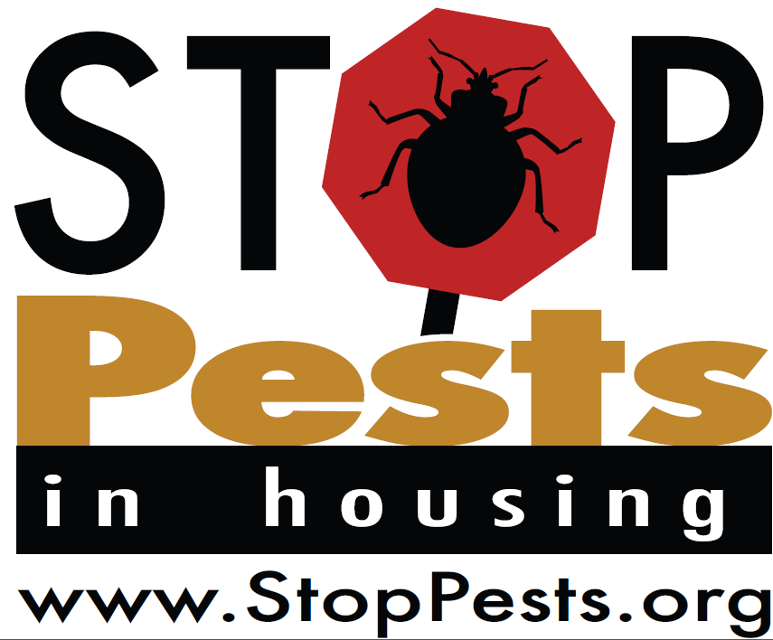
Session One of Integrated Pest Management in Multifamily Housing: IPM and Pesticide Use
StopPests is a program of the Northeastern IPM Center of Cornell University, funded by HUD’s Office of Lead Hazard Control and Healthy Homes.
Training content is research-based.
Products, vendors or commercial services pictured or mentioned are illustrative, not endorsements.
Notes:
Welcome to Session one of Integrated Pest Management for Multifamily housing
<Click>The StopPests program at the Northeastern IPM center, part of Cornell University, provides training and technical assistance for Federally-assisted housing sites. StopPests is funded by HUD’s Office of Lead Hazard Control and Healthy Homes.
<Click>This training content was constructed around a research-based, and objective approach to pest management in affordable housing and is intended to be used in its entirety. We do not recommend the partial use of these materials.
If all the staff from your building or development attend and take the quiz at the end, or a significant number of staff from your housing agency attend (5 or more) you can send me your address and I will send you a box of resident fhandouts and samples of monitors and traps and other IPM related items.
<Click>Products, vendors, or commercial services mentioned or pictured in these trainings are for illustrative purposes only and are not meant to be endorsements.

Slide 2







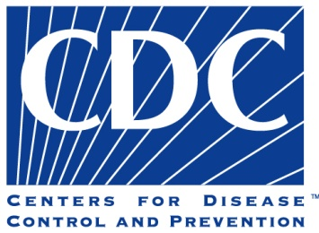
Session One of Integrated Pest Management in Multifamily Housing
Notes:
The content was developed in collaboration with all of the agencies pictured here

Slide 3
Session One - Meet Your Trainer
Trainer information
Notes:
Trainer bio here

Slide 4
Session One - Meet Your Trainer
Insert name and info of trainer
Notes:
Trainer bio here

Slide 5
  Priority Pests
  Why IPM
  Pesticides & Health
Session One Introduction
Session Two Cockroaches
  What they are
  Associated Health Hazards
  What they eat & drink
  Where they live
  Prevention & Control
Session Three Rodents
Session Four Bed Bugs
Notes:
This curriculum is a series of four, interrelated classes, beginning with this session, the introduction. In this session we will start with the connection between pests, pesticide use, and occupant health. Next we will zero in on the most problematic pest populations, and finish up with the rationale for using Integrated Pest Management, or IPM., to control pests.
This course is not designed to license anyone to apply pesticides. This course is designed for housing professionals to understand the basics of pest control.
Session two will focus on one of the three most problematic pest populations, Cockroaches.
Session three will focus on rodents, specifically mice and rats.
We’re saving bed bugs for session four.
With each of the last three sessions, we will discuss the nature of each pest group, their life cycles, what they eat, and where and how they live. Because there is great value in understanding the way each group of pests survive, as a way of leaning how to control them effectively and safely. That is what IPM is all about, safely controlling pests, while minimizing the health risks to the human occupants.

Slide 6
Schedule
agenda
agenda

Slide 7
Session One Introduction
  Priority Pests
  Why IPM
  Pesticides & Health
Notes:
Let’ get started on session one. We’ll briefly discuss the priority pests, and cover each of them in more detail in the upcoming sessions. Next, we will discuss the benefits of IPM, and lastly, wrap up this session talking about pesticides and how to reduce exposure.

Slide 8

Is “exterminating” working?
Notes:
This quote, Insanity is doing the same thing over & over again, & expecting different results, is often attributed to Albert Einstein. We believe that it is relevant to the topic of pest management.
Think about how you’ve fought pests in the past.
What pests do you see?
How do you currently deal with them?
And IS IT WORKING?
Think about “Exterminating” versus “managing” pests. Exterminating is an old term that the industry has moved away from, because relying on chemical sprays to kill all the pests simply hasn’t been working for us.

Slide 9

The “Exterminator” is now a
Pest Management Professional (PMP)
Notes:
Think about management vs. exterminating. Pest management is done with the help of a pest management professional, a PMP. “With the help of” is key. It takes a team to manage pests.

Slide 10
What is the most troublesome pest in your housing?
Cockroaches
Mice
Rats
Bed Bugs
Other
Notes:
Audience survey

Slide 11
Three Priority Pests
Cockroaches
Rodents
Bed Bugs
Notes:
Cockroaches, Rodents and Bed bugs are the top three pests in affordable housing.

Slide 12
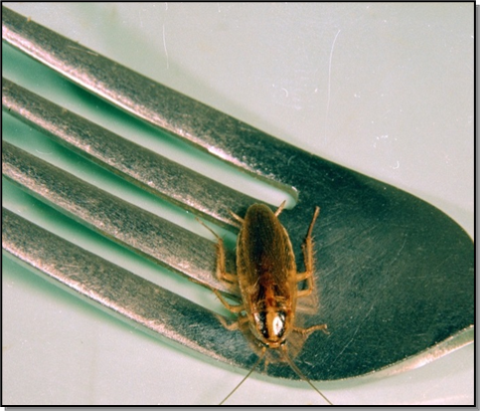
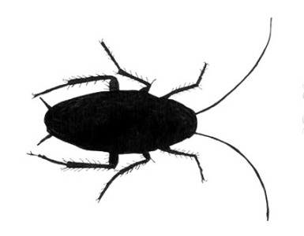


Three Priority Pests
Cockroaches
Notes:
12
Cockroaches contaminate food, and leave their poop (called frass) and shed skins behind. Their presence in a home can trigger allergies, asthma attacks and even cause asthma in infants.

Slide 13
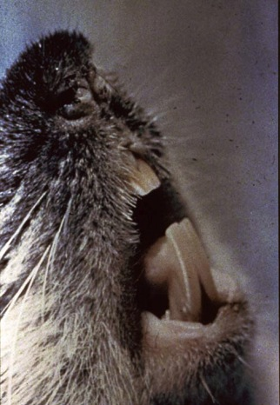
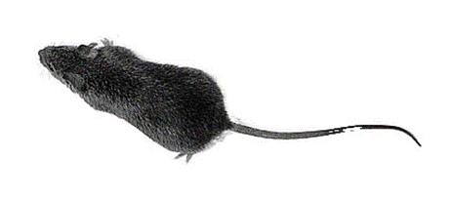
Three Priority Pests
Rodents
Notes:
Rodents, such as mice and rats, destroy property, can bite, and may even cause fires. Mice drip urine and leave their dander wherever they go, triggering allergies, asthma attacks and spreading disease.

Slide 14
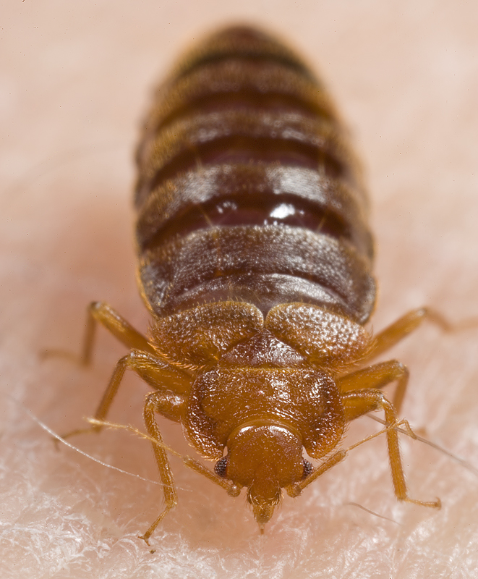
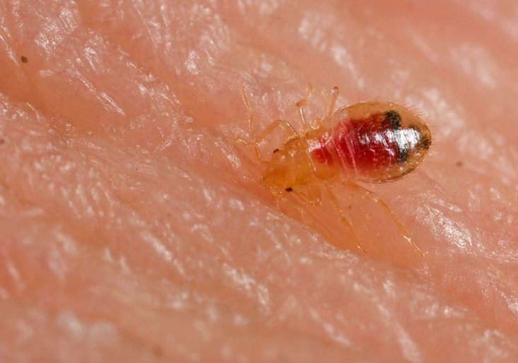
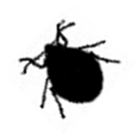
Three Priority Pests
Bed Bugs
Notes:
Bed Bugs and their bites are a nuisance and are expensive to eliminate

Slide 15
Inspect & Monitor
IPM
Program
Lifecycle
Evaluate Success
Identify
Use Multiple Tools
Scale the Response
Notes:
IPM is a decision-making process that emphasizes prevention, knowledge of pest biology, and the use of least-disruptive control tactics, with pesticides saved as a last resort. Notice we said “process” – At its most effective, IPM is considered to be a continuing cycle.
In a structural setting, an IPM program consists of the following five steps:
Inspection & monitor: First we inspect to determine if we have pests
Identification: We want to be sure we know what the pest is, so we know the best way to combat it
Scale the response to the level of infestation: How many pests do we have? , so we launch an appropriate response. For example, we would We would treat the discovery of 3 bedbugs differently than we would 300…. Monitors will help us quantify the size of the infestation so that we can scale the response.
Multiple tools means Employment of two or more control measures (which may be behavior change, mechanical, biological, or chemical), and
Evaluation of effectiveness : How do we know if we’ve been effective? We don’t see pest activity, our monitors back up that claim, and our residents are not reporting pests sightings.

Slide 16
The IPM Team
Property Manager
Pest
Management
Professional
Resident
IPM
Coordinator
Landscaping
Services
Maintenance
Crew
Resident
Support
Services
Procurement
Specialist
Janitorial/
Custodial
Notes:
Give a brief introduction to the IPM team approach. IPM and roles and responsibilities will be further discussed throughout the day.
IPM Coordinator Makes sure all jobs are funded and completed. The property can’t outsource the responsibility for quality assurance of an IPM program.
Property Manager Responsible for the time and resource allocation at the property and often sets the tone for resident involvement.
Resident Support Services Gets assistance for residents.
Janitorial/Custodial Services Cleans common areas.
Building Superintendent Maintenance Crew Fixes moisture issues and makes repairs that block pests.
Resident Cleans regularly and prepares unit for inspection and necessary treatments.
Pest Management Professional (PMP) Conducts inspections and applies pesticides that pose the least risk to human health and the environment.
Landscape Services Chooses plants that are pest-resistant and grow with minimal chemical assistance. Minimizing rat habitat should be considered when planting.

Slide 17
Who coordinates pest control at your worksite?
IPM Coordinator
Building/property manager
Building Super or Head of maintenance
It’s team effort
I don’t know
The pest control professional
Notes:
Ask the audience

Slide 18
Benefits of IPM
Cost savings
A healthier building
Fewer complaints
Fewer pests
Notes:
Let’s discuss a few of the benefits of IPM
<click>Cost savings: IPM results in Lower pest management costs over time, and is more sustainable than relying on sprays alone.
<click>A healthier building: IPM relies on products and practices that work together and minimize risks to humans. This means fewer asthma attacks, less human exposure to pesticides, and less of a chance staff will take pests home. IPM repairs will make the workplace healthier for staff, too. Many of us have family members with asthma, or who are sensitive to or “allergic” to pesticides.
<click>Fewer complaints: Work orders will increase at first, since residents and staff will be encouraged to use the work order system, but when repairs have been made for prevention, there will be fewer work orders than ever. A Boston Housing Authority development reduced cockroach work orders by 68% after only one year of IPM
<click>Fewer pests: IPM results in longer lasting control aimed at preventing pests, so we can stop infestations from growing and spreading disease
100% elimination of the priority pests (cockroaches, rodents, and bed bugs) inside each unit is difficult, but can be done and should be the goal. With an IPM team effort, pest problems can be reduced to isolated incidents that get taken care of before they grow and spread. It is possible to rid a unit of pests and clean up after them, so that asthma attacks are reduced. For peer-reviewed research on these topics, visit the “research” section on the StopPests website.

Slide 19
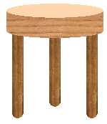
What all pests need
Food
Water
Shelter
Food
Water
Shelter
Notes:
19
Pests require three things to survive: food, water and shelter.
The three legged stool illustrates this point. If we remove any of the three legs, pest infestations won’t “stand up.”
So the more of these we can remove, the more likely it is that the pests will find somewhere else to live!

Slide 20
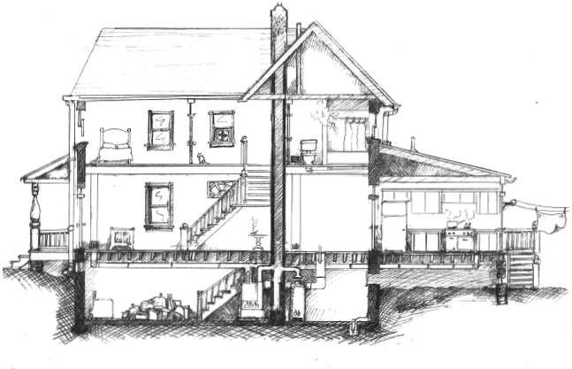
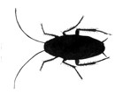
Think Like a Pest
Notes:
In order to combat pests, we need to understand how they think, and how they behave. It’s a “know your enemy” strategy. We can then use what we’ve learned about their habits against them
Look at this illustration. As humans, we tend to think of a building in terms of its rooms - Bedrooms, living room, kitchen and bath all make a house a “Home”.
Maybe we even take an occasional trip to the basement.

Slide 21
Think Like a Pest
Notes:
Even though pests share our spaces, they prefer to remain out of sight. So they look for good hiding spaces when we’re around, and usually come out only at night, while we’re asleep. Because of this, they don’t see the building the same way we do.
To a pest, a “home” is the spaces between walls and around and in appliance. Any crack or hole is a door, and in-between walls and floors is the safest place to travel and hide.
Maintenance repairs will disrupt pest travel and hiding spots, making them easy to find and kill. The repairs also benefit the building.
Take a moment to look around the room you’re in right now. Is there a dropped ceiling? What’s behind the electrical outlet? These areas are like pest superhighways.
21

Slide 22
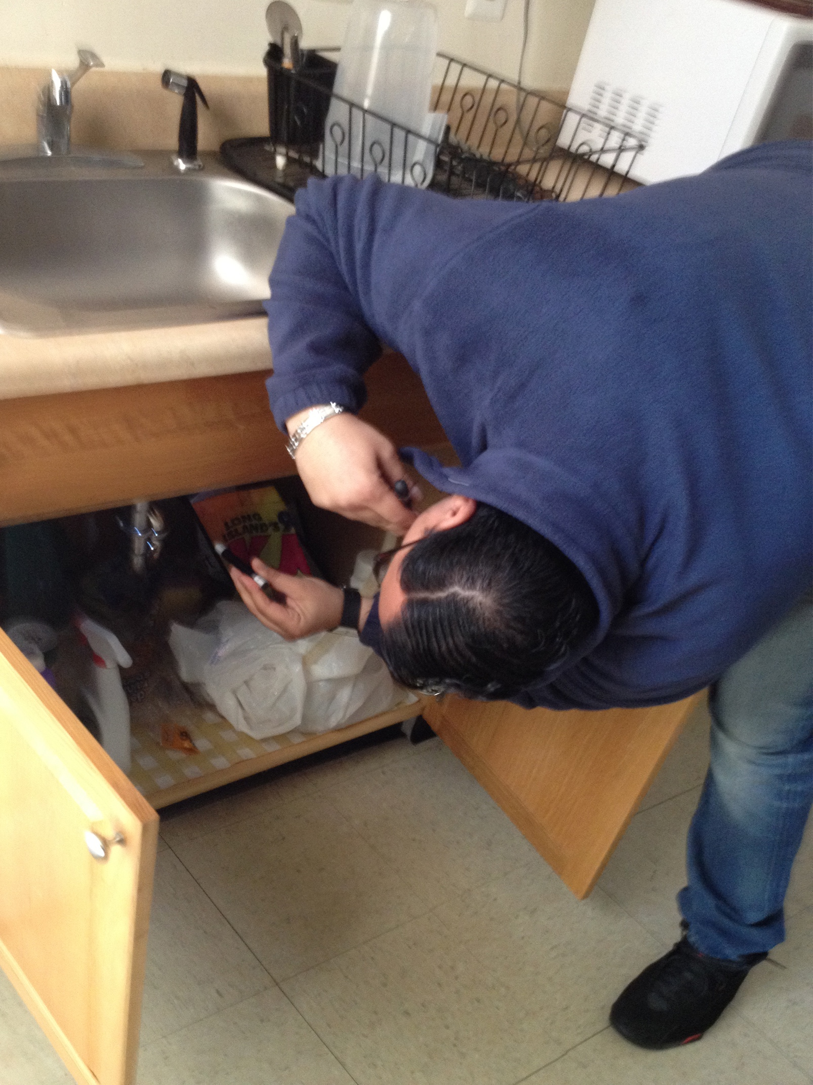
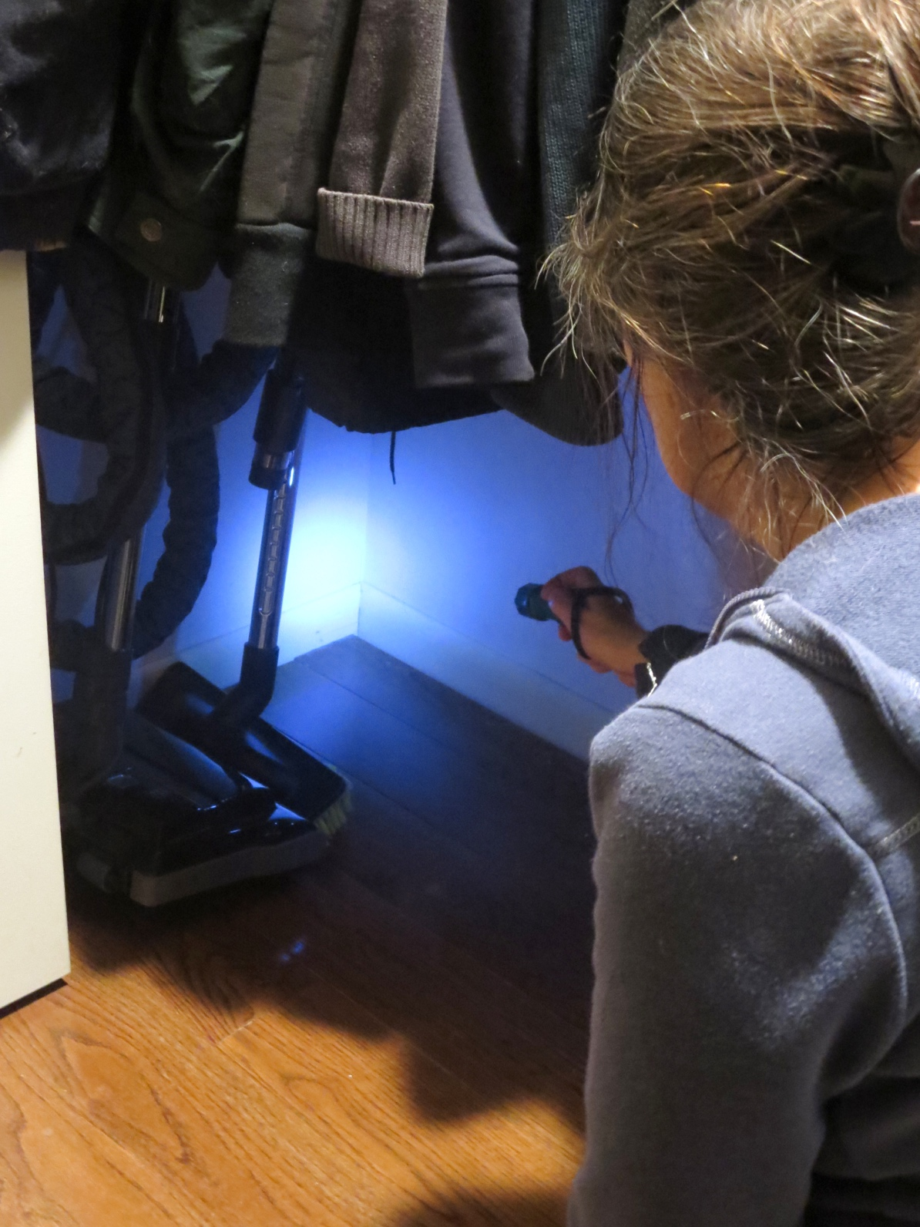
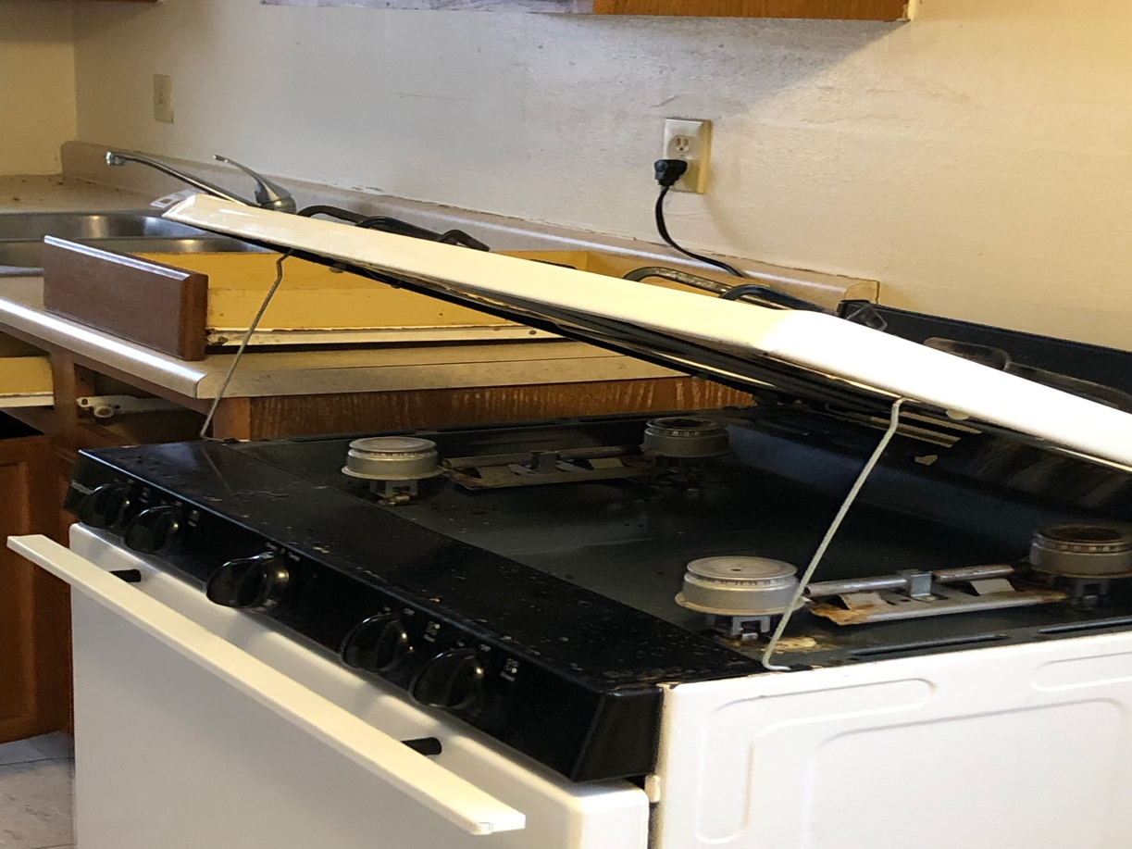
Thorough Inspection-
Look Under & Behind
Notes:
Pest management means that we are all on the lookout for signs of pests. We can’t expect our PMP to be the only ones looking.
<click>Routine inspection, looking behind, under and around, is a key component of an IPM program.
<click>Areas around appliances are especially attractive to pests, as they often combine good food and water sources with excellent hiding opportunities.

Slide 23
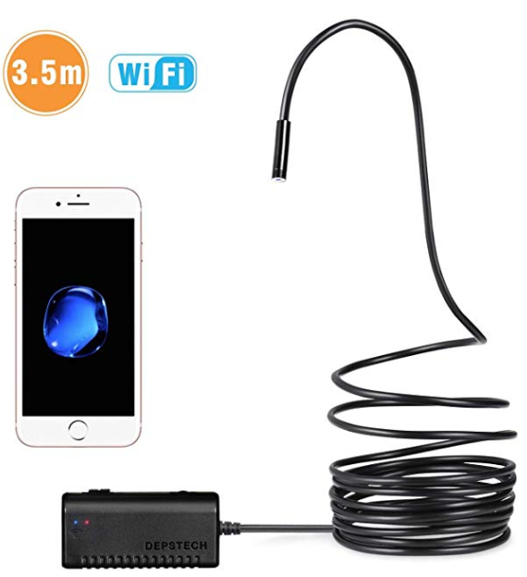
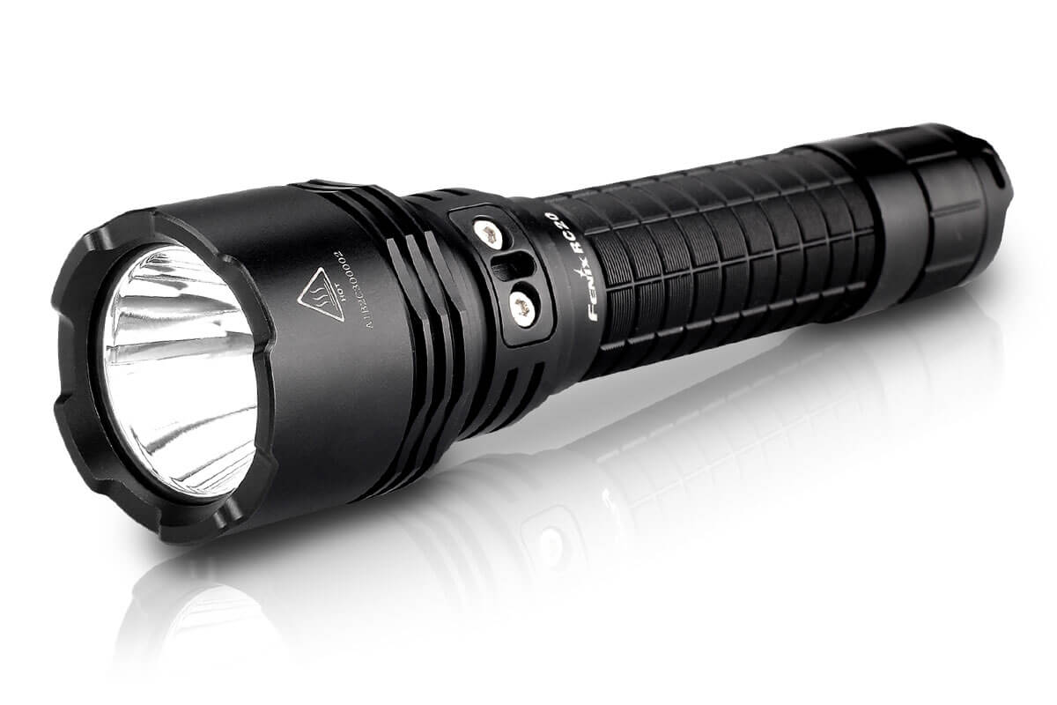

Thorough Inspection –
Look Under and Behind
Notes:
Let’s look at some tools that will help us to conduct a more thorough inspection.
First, we need a good flashlight. Using a bright light, even during daylight, can help us find pest infestations. We’ll want to search for pest evidence, entry points, hiding spaces, and possible sources of food and water.
But what about the spaces we can’t readily see? Wouldn’t it be great if we could see behind and underneath appliances without having to pull them away from the walls?
<click>One helpful tool is the telescoping mirror, which provides a view of places behind the appliance where we can’t fit.
<click>And technology is improving all the time. Consider this wireless endoscopic camera, which works from your smartphone. You can get a view of any place the scope will fit, and even take photos or videos with it, documenting what you see.

Slide 24
IPM Practice
What’s the problem here?
How would you fix it?
Who is responsible?
Please share!
Examine each photo, then tell us:
Notes:
24
Let’s think through some of the problems that contribute to pest infestations.
We’ll develop our skills by reviewing the following photos. I’ll warn you that the photos are somewhat graphic – not intended to shock you; just to illustrate the conditions.
As you view each photo, see if you can spot
What’s the problem, or the pest conducive condition?
How would you fix it?
Who is responsible for the fix?
We’ll give you a few seconds to examine the photo, then discuss our findings

Slide 25
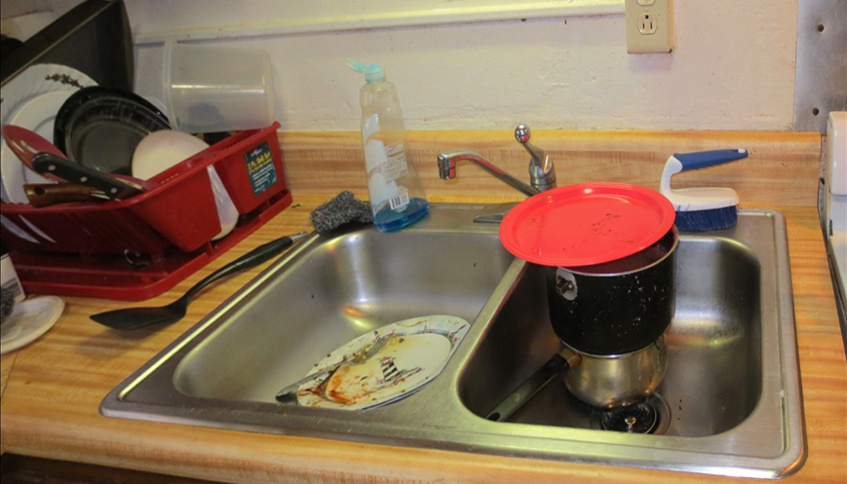
Notes:
Remember that pests are looking for food, water, and shelter. In this kitchen we’re providing all three!
The problem: Food on dishes and counters; water in the sink and the drainboard provide the perfect midnight snack for pests.
What’s the fix: Cleaning and drying dishes nightly will go a long way to control the pest at no cost to the property.
Who’s Responsible: The resident, with appropriate education, can eliminate these conditions
This example shows how knowledge of the pest, along with awareness of the environment, and a simple change in practices, can result in pest management.

Slide 26
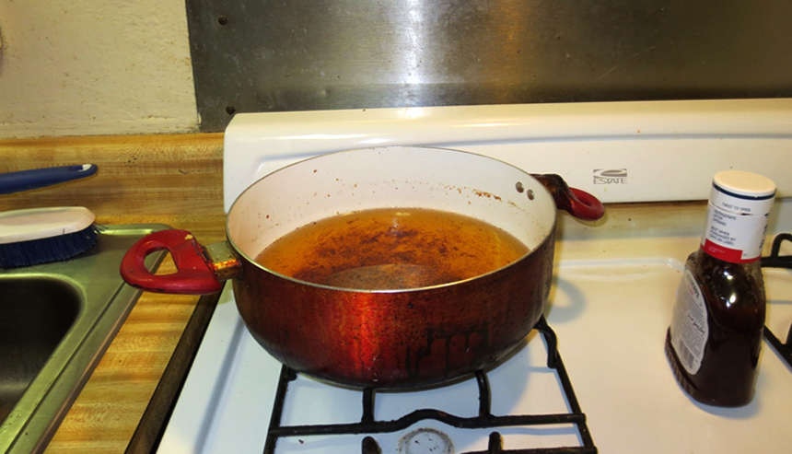
Notes:
In some homes, the pot of grease is left on the stove for later use. Did you know that 1 drop of grease can feed a roach for 20 days…
The problem: This pot of cooking grease left on the stove provides dinner for pests.
What’s the fix: Proper storage and disposal of leftover food will remove food sources.
Who’s Responsible: Once again, the resident, with appropriate education, can eliminate these conditions

Slide 27
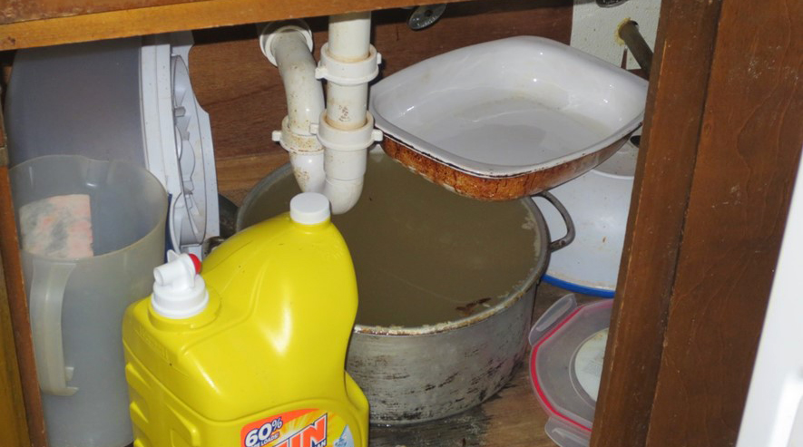
Notes:
This pot of water in the base cabinet provides water for pests, and the full pot indicates that this leak under sink has been here for sometime.
The problem: Pot filled with water, catching an active leak under the sink.
What’s the fix: Leaks should be reported and repaired promptly.
Who’s Responsible: Maintenance should respond promptly to reports of leaks.

Slide 28
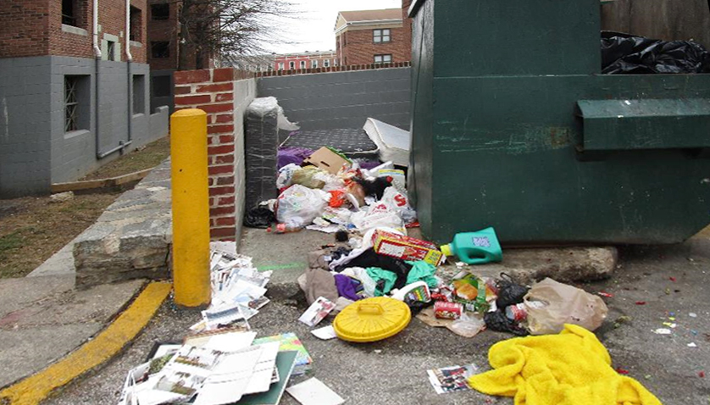
Notes:
An overflowing dumpster is an open invitation to pests, especially rats who like to snack on the same food as humans.
The problem: An open dumpster with trash, including mattresses, strewn over the surrounding ground.
What’s the fix: Dumpsters should be kept closed and emptied frequently to discourage rats from feeding here.
Who’s Responsible: The facility should see that dumpsters are emptied frequently, and residents should be educated to always close the dumpster lids after use.

Slide 29
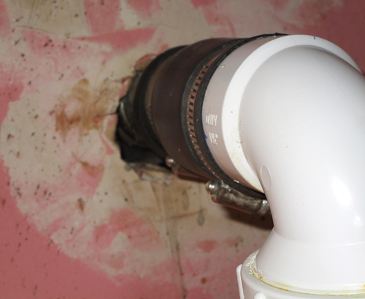
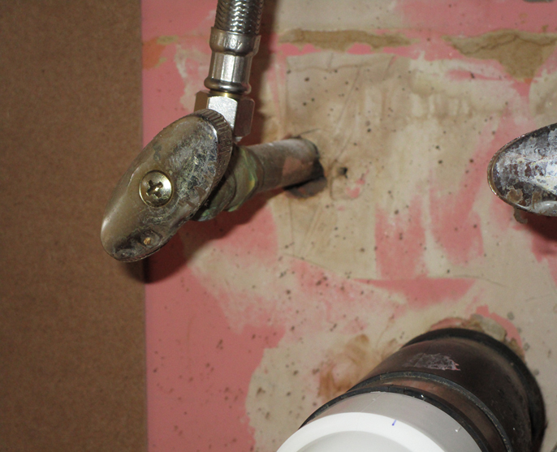
Notes:
Note the holes, or penetrations, where plumbing pipes come through the walls – that’s ample room for a pest to enter and set up housekeeping.
The problem: This is roach frass under a sink, where cockroaches have easy access to water and shelter.
What’s the fix: Adding sealant around these holes and an escutcheon plate would stop the entry.
Who’s Responsible: Facility maintenance should inspect for access points and eliminate them.

Slide 30
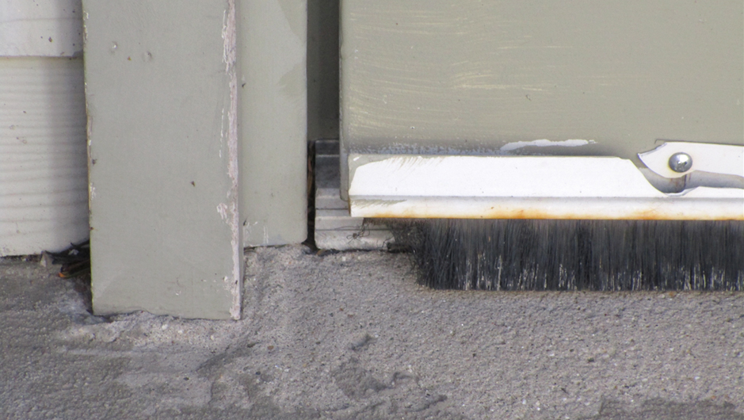
Notes:
Pests can travel through doorways, too.
The problem: This gap along the door and deteriorated door sweep provide ample opportunity for pest entry. All three priority pests could fit through this opening.
What’s the fix: Replacing the door sweep and adjusting the door for a tight fit can keep pests out.
Who’s responsible: Facility maintenance should inspect for access points and eliminate them.

Slide 31
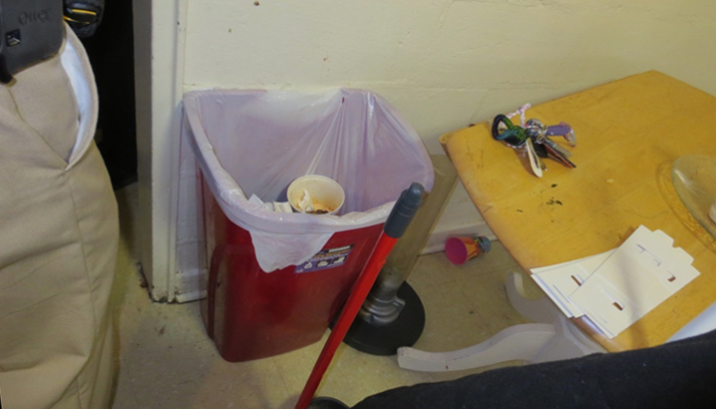
Notes:
This open trash bin might be feeding the roaches seen on this wall – and the photo was taken in the daytime.
The problem: The open trash can is an invitation for pests to dine.
What’s the fix: Trash cans should have tight sealing lids and be emptied daily.
Who’s Responsible: The resident, with appropriate education, can eliminate these conditions. Perhaps management would provide functional trash receptacles for all units.

Slide 32
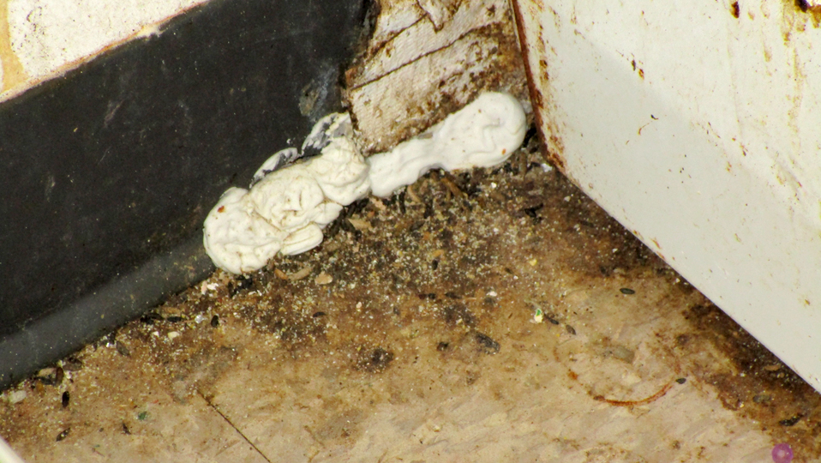
Notes:
We can’t tell if this is a current infestation or an old one. How will we know if pest treatments are working if we don’t remove the old evidence?
The problem: You can see the abundant roach & mouse droppings on this kitchen floor.
What’s the fix: Old evidence, like dead bugs, shed skins and droppings must be removed. Left behind, they create health problems.
Who’s Responsible: Maintenance should be involved in making permanent fixes to eliminate entry points. And residents must be educated that droppings and dead pests are still a health threat. It’s clear that an attempt was made to close up this entry point. In a later session, we’ll show you some more permanent solutions.

Slide 33
Healthy Homes & IPM
What is “Healthy Housing?”
Healthy Housing is designed, constructed, maintained, and rehabilitated in a manner that is conducive to good occupant health.
Notes:
We hope that these practical examples of IPM principles have been helpful. Now let’s think about the intersection of Healthy Homes & IPM.
The concepts of healthy housing and IPM are joined at the hip. Although there is no statutory definition of a healthy home, here is the one that the National Center for Healthy Housing uses:
<click>Healthy Housing is designed, constructed, maintained, and rehabilitated in a manner that is conducive to good occupant health.
Let’s consider this list of eight hazard-reduction strategies with the goal of creating healthy homes:

Slide 34








Healthy Homes & IPM
1. Keep it Dry
2. Keep it Clean
3. Keep it Ventilated
4. Keep it Safe
To reduce housing-based health hazards, “keep it”:
5. Keep it Contaminant-Free
6. Keep it Maintained
7. Keep it Thermally-Controlled
8. Keep it Pest Free
Notes:
Let’s consider this list of eight hazard-reduction strategies with the goal of creating healthy homes:
Keep the home dry,
clean,
ventilated, safe,
contaminant-free, maintained
Thermally-controlled, and pest free.
These eight points, or “keep its”, can help us remember how to keep a home healthy. Many of these principles are inter-related. For instance, keeping a home well-maintained, by repairing water leaks and sealing entry points, also helps to keep it dry and pest-free. Keeping it dry reduces sources of water for pests. And of course, keeping a home pest-free ties in with several of the other principles. Fewer pests mean fewer pesticides, or contaminants. Cleaning up dishes, harborage, and food sources to keep it pest free are also part of the bigger principle of keep it clean.
Protecting and maintaining a building for pest control will help make a building healthy for both occupants and property management staff.

Slide 35


What does HUD say about pest control?
HUD is committed to IPM as a pest control strategy.
Notes:
35
Let's see what HUD says about pest control.
HUD has a commitment to IPM, and supports its implementation by funding programs like this training and inspecting for pest infestation.

Slide 36


What does HUD say about pest control?
HUD’s promotion of IPM complies with the Federal Insecticide, Fungicide, and Rodenticide Act (FIFRA)
“Federal agencies shall use Integrated Pest Management techniques in carrying out pest management activities, and shall promote Integrated Pest Management through procurement and regulatory policies, and other activities.” 7 USC 136r-1
Notes:
36
HUD’s promotion of IPM complies with the Federal Insecticide, Fungicide, and Rodenticide Act, or FIFRA
FIFRA states, in part <click>: “Federal agencies shall use Integrated Pest Management techniques in carrying out pest management activities, and shall promote Integrated Pest Management through procurement and regulatory policies, and other activities.” 7 USC 136r-1

Slide 37

What does HUD say about pest control?
Real Estate Assessment Center (REAC)
Deficiency: Evidence of rats, mice, cockroaches (droppings, holes)
Infestation: Live roaches, mice or rats; more than one dead roach
Note! Currently you won’t lose points for bed bugs but you will under new NSPIRE standards
Notes:
37
You may already be familiar with many of the standards HUD relies on for ensuring the health and safety of their supported properties.
One of those you may know best is the Real Estate Assessment Center, better known as (REAC). There are specific pest provisions within REAC and in the forthcoming NSPIRE inspection standards.
During a REAC inspection, a property receives a deficiency if the inspector sees evidence of rats, mice, or cockroaches. Evidence may be in the form of pest droppings or entry holes.
REAC inspectors consider the presence of live roaches, mice or rats, or more than one dead roach to be more serious, and calls this a infestation. We’ll talk more about this when we get to the specific module for each pest.

Slide 38
What does HUD say about pest control?
Uniform Physical Condition Standards (UPCS)
Housing Quality Standards (HQS)
Will transition (April 2023) to
National Standards for the Physical Inspection of Real Estate (NSPIRE)
Notes:
38
There are some key provisions of HUD’s Uniform Physical Condition Standards (UPCS), and Housing Quality Standards (HQS) that relate to pests. HUD is transitioning to NSPIRE which will replace UPCS and HQS

Slide 39
What does HUD say about pest control?
Uniform Physical Condition Standards (UPCS)
Housing Quality Standards (HQS)
Quotes from these provisions:
Structures shall be kept free from insect and rodent infestation
Where…insects or rodents are found… promptly managed by approved processes… not injurious to human health
Proper precautions to prevent re-infestation
Notes:
39
Some quotes from these provisions include:
Structures shall be kept free from insect and rodent infestation
Where insects or rodents are found, they must be promptly managed by approved processes, which are not injurious to human health
Proper precautions must be taken to prevent re-infestation

Slide 40
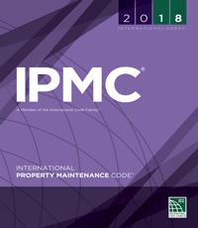
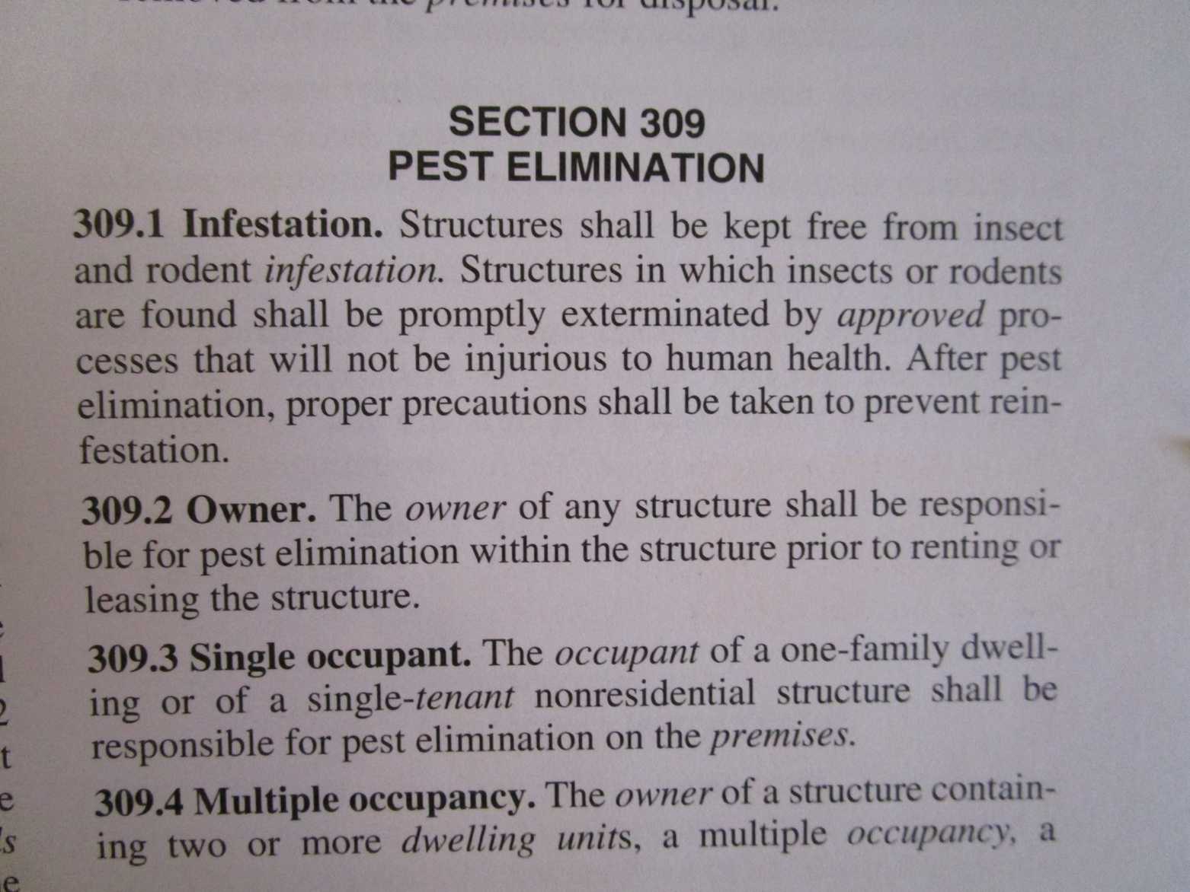
What do your local codes say about pest control?
Housing sites must also comply with local housing & habitability codes.
The International Property Maintenance Code (IPMC) is an example of a habitability code
Do you know…does your community have laws regarding bed bugs?
Notes:
40
What do your local codes say about pest control?
Housing sites must also comply with local housing & habitability codes.
The International Property Maintenance Code (IMPC) is a common example.
<Click> Section 309 addresses pest control.
Do you know…does your community have laws regarding bed bugs?
One example of what a local law might look like…:
This week, the Delaware state Senate voted for legislation prohibiting landlords from renting residential units with known or suspected bed bug infestations. Also, it requires landlords to notify prospective tenants if adjacent units are infested with BB, and to keep written records of all complaints and control measures for two years.
The legislation now goes to the state House for consideration before it becomes a law.

Slide 41
HUD’s Guidance on IPM
Ensure efficacy of pest elimination
Protect health of residents, staff and the environment
Extend the useful life of a building
Generate significant savings that could offset the costs of the pest control
IPM effectively eliminates pests in safer and longer-term, cost-effective ways than traditional pesticide treatments.
Promotion of Integrated Pest Management (PIH 2011-22)
Notes:
41
HUD issued a voluntary guidance on integrated pest management in 2006. The Public and Indian Housing Notice on Promotion of Integrated Pest Management was updated in 2011. According to HUD’s guidance documents, IPM offers the potential to:
<click>Ensure efficacy of pest elimination - Efficacy means the ability to produce a desired or intended result.
<click>IPM can protect the health of residents. Minimizing the use of dangerous chemical treatments also it protects the property staff and the environment.
<click> When we seal up pest entry points and repair water leaks to control pest infestation, the life of the building is often extended.
<click>Since IPM’s methodologies are often long-term treatments, they can generate significant savings compared to the ongoing use of pesticides.
<click>IPM effectively eliminates pests in safer, longer term, and cost-effective ways than traditional pesticide treatments.

Slide 42
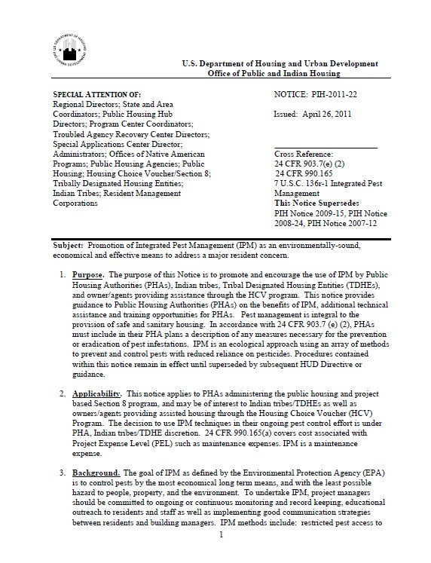
HUD’s Guidance on IPM
Promotion of Integrated Pest Management (PIH 2011-22)
Find this guidance at HUD.gov
Notes:
42
And, the full federal notice on HUD’s IPM guidance can be found at HUD.gov

Slide 43
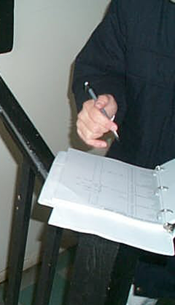
Documentation is key
One IPM log in each building to:
Track pest population
Identify focus units
Ensure prompt action
Find sample documents at stoppests.org
Notes:
One of the main points in HUD’s guidance on IPM is recordkeeping is essential. the IPM guidance encourages good record keeping. In IPM, documentation is Key. It is important to keep accurate, thorough records.
Record keeping brings accountability to pest management and ensures that problems are fixed before the infestation grows. Accurate recordkeeping can also protect your agency in the event of any legal complaints.
One cohesive log for each building allows building managers and PMP to track pest trends within the building.
We can then identify the units that have the highest level of infestation.
We call these focus units because we want to “focus” most of our pest control resources in these units, enabling prompt action.

Slide 44
Documentation is key
Have a system that is available and accessible to everyone who needs the information
Manual (paper)
Electronic
Find sample documents at stoppests.org
Notes:
An IPM log is one of the most essential pest control tools.
Think of it as a master communication center for collecting and sharing information with everyone on the IPM team, allowing you to review and evaluate the efficacy of your program.
One way to ensure that the log is available to all who need it is to have your pest control records saved electronically. Paper records may not be easily accessible to all for analysis.
Whether you chose to save your records electronically or on paper, just have a system that works for your organization

Slide 45
What’s in the IPM log?
All documents related to pest management
Information from HUD inspections related to IPM
Schedules, Notifications, Product Info, Licenses, etc.
Find sample documents at stoppests.org
Notes:
The IPM log is a place to store all documents related to pest management. Any IPM-related information collected during HUD and in-house inspections should be transferred to the IPM log. Examples of documents includes, schedules for treatments, Notifications, Pest Management product information, licenses, and numerous other documents.
Let’s review a few sample documents.

Slide 46
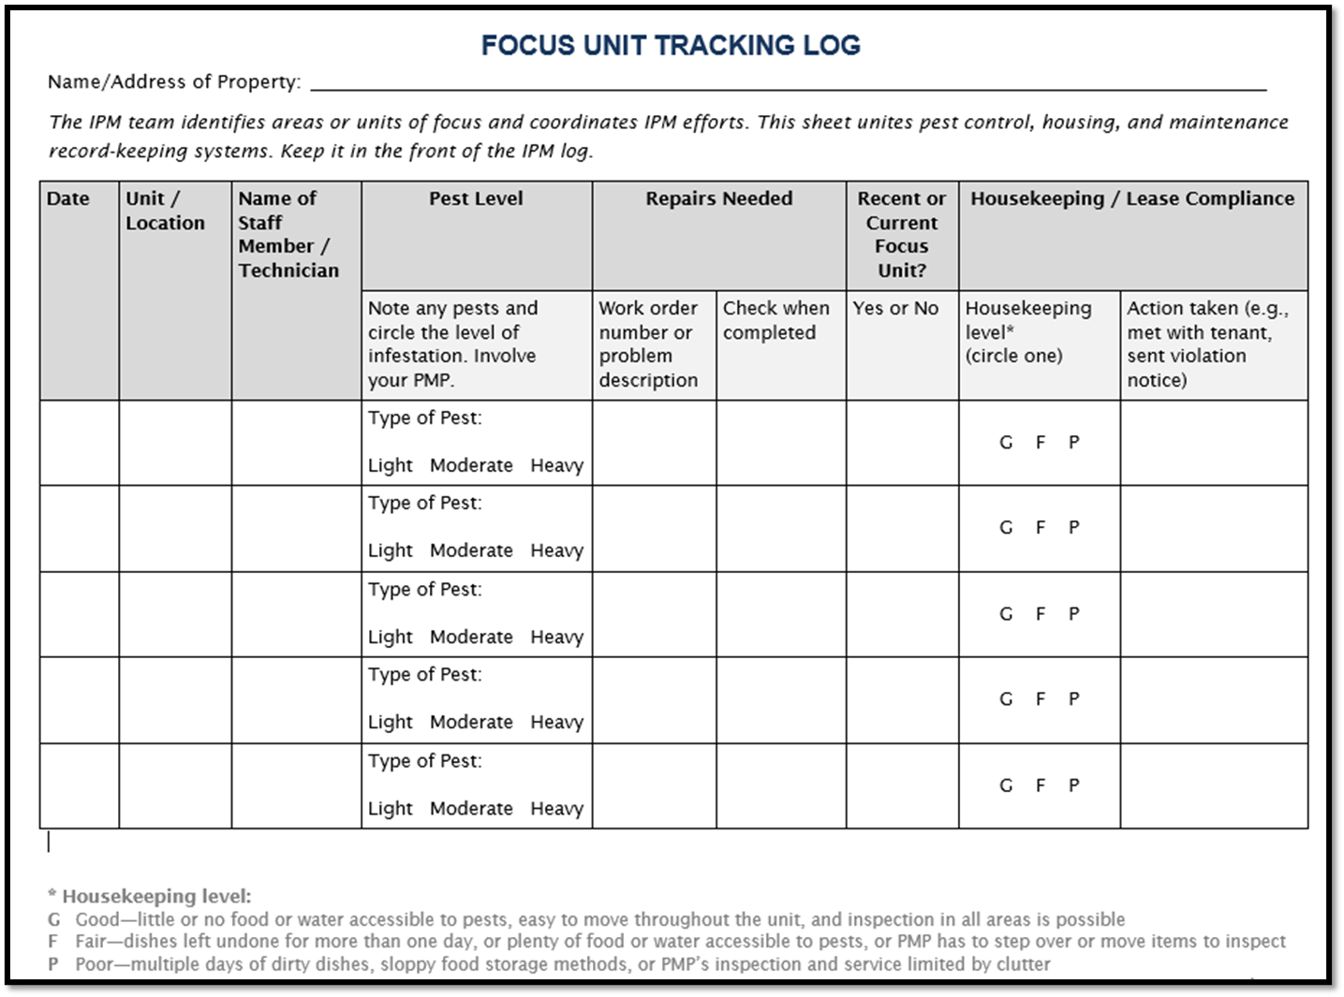
What’s in the IPM log?
Focus unit tracking log (sheet)
Find this log in your handouts or at stoppests.org
Notes:
The Focus unit tracking log (or sheet), involves action from multiple departments (pest control, maintenance, resident support, etc.). This is one way that we can provide a holistic, or coordinated approach to IPM that unites sanitation, exclusion, repair, and pest control treatments. This log highlights the treatments for Focus Units because of their higher level of infestation. Quickly addressing Focus Units is a key strategy in multi-family IPM.

Slide 47
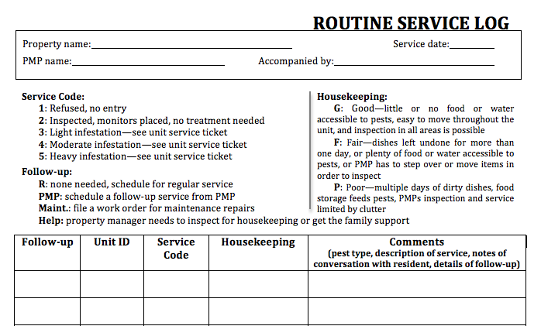
What’s in the IPM log?
Service log or ticket
Find sample documents in your handouts or at stoppests.org
Notes:
Here is a sample Service log or service ticket, where we record all of the services the PMP performs, the types of pests present, the follow up recommendations, and the condition of the unit relative to pest management.

Slide 48
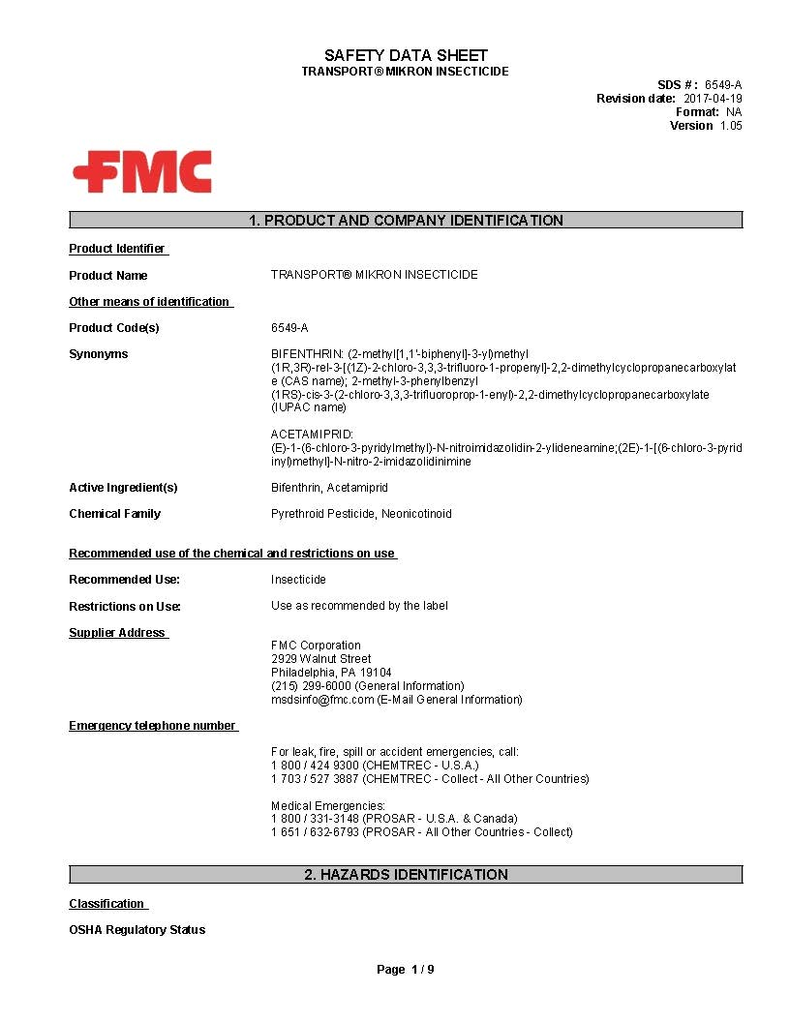
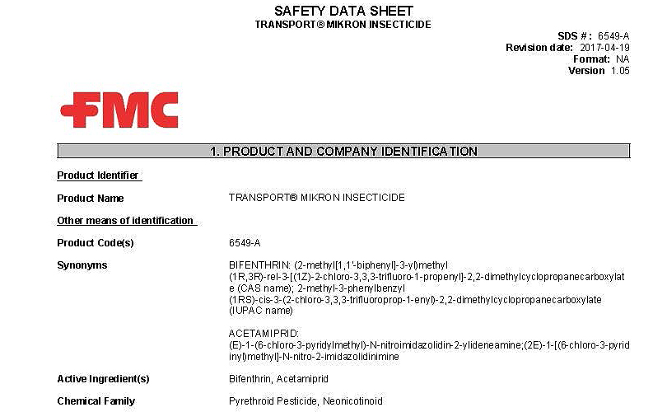
What’s in the IPM log?
Product labels and Safety Data Sheets (SDS) for all pesticides
Find sample documents in your handouts or at stoppests.org
Notes:
For all of the pesticides being used, the IPM Log should also include both product labels and Safety Data Sheets, also referred to as an SDS. This is the SDS for Transport-Mikron, a bed bug pesticide.
<click>And here’s a closeup of the Transport-Mikron SDS cover page. Having quick access to detailed information on the pesticides in use can be very helpful to property management staff.

Slide 49
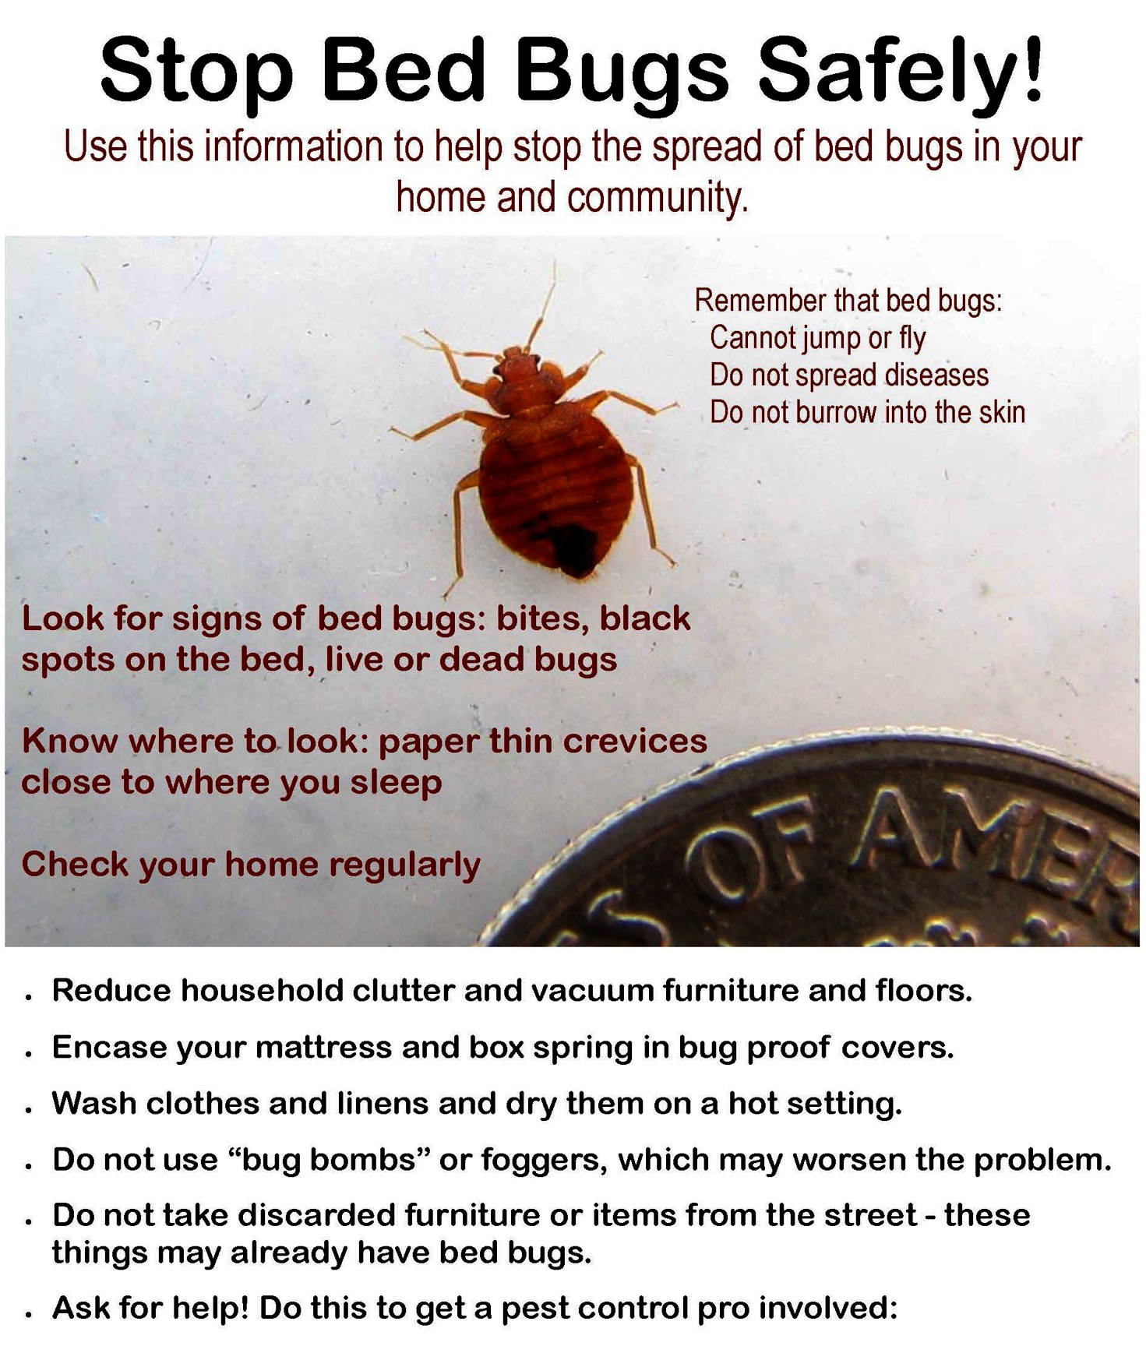
What’s in the IPM log?
Educational materials for staff and residents like this poster on bed bug safety
Find sample documents in your handouts or at stoppests.org
Notes:
Educational materials for staff and residents are an important component of IPM.
And good graphics are an effective tool to illustrate how residents can play a role in IPM. Be certain materials are available in the native languages of staff and residents.

Slide 50
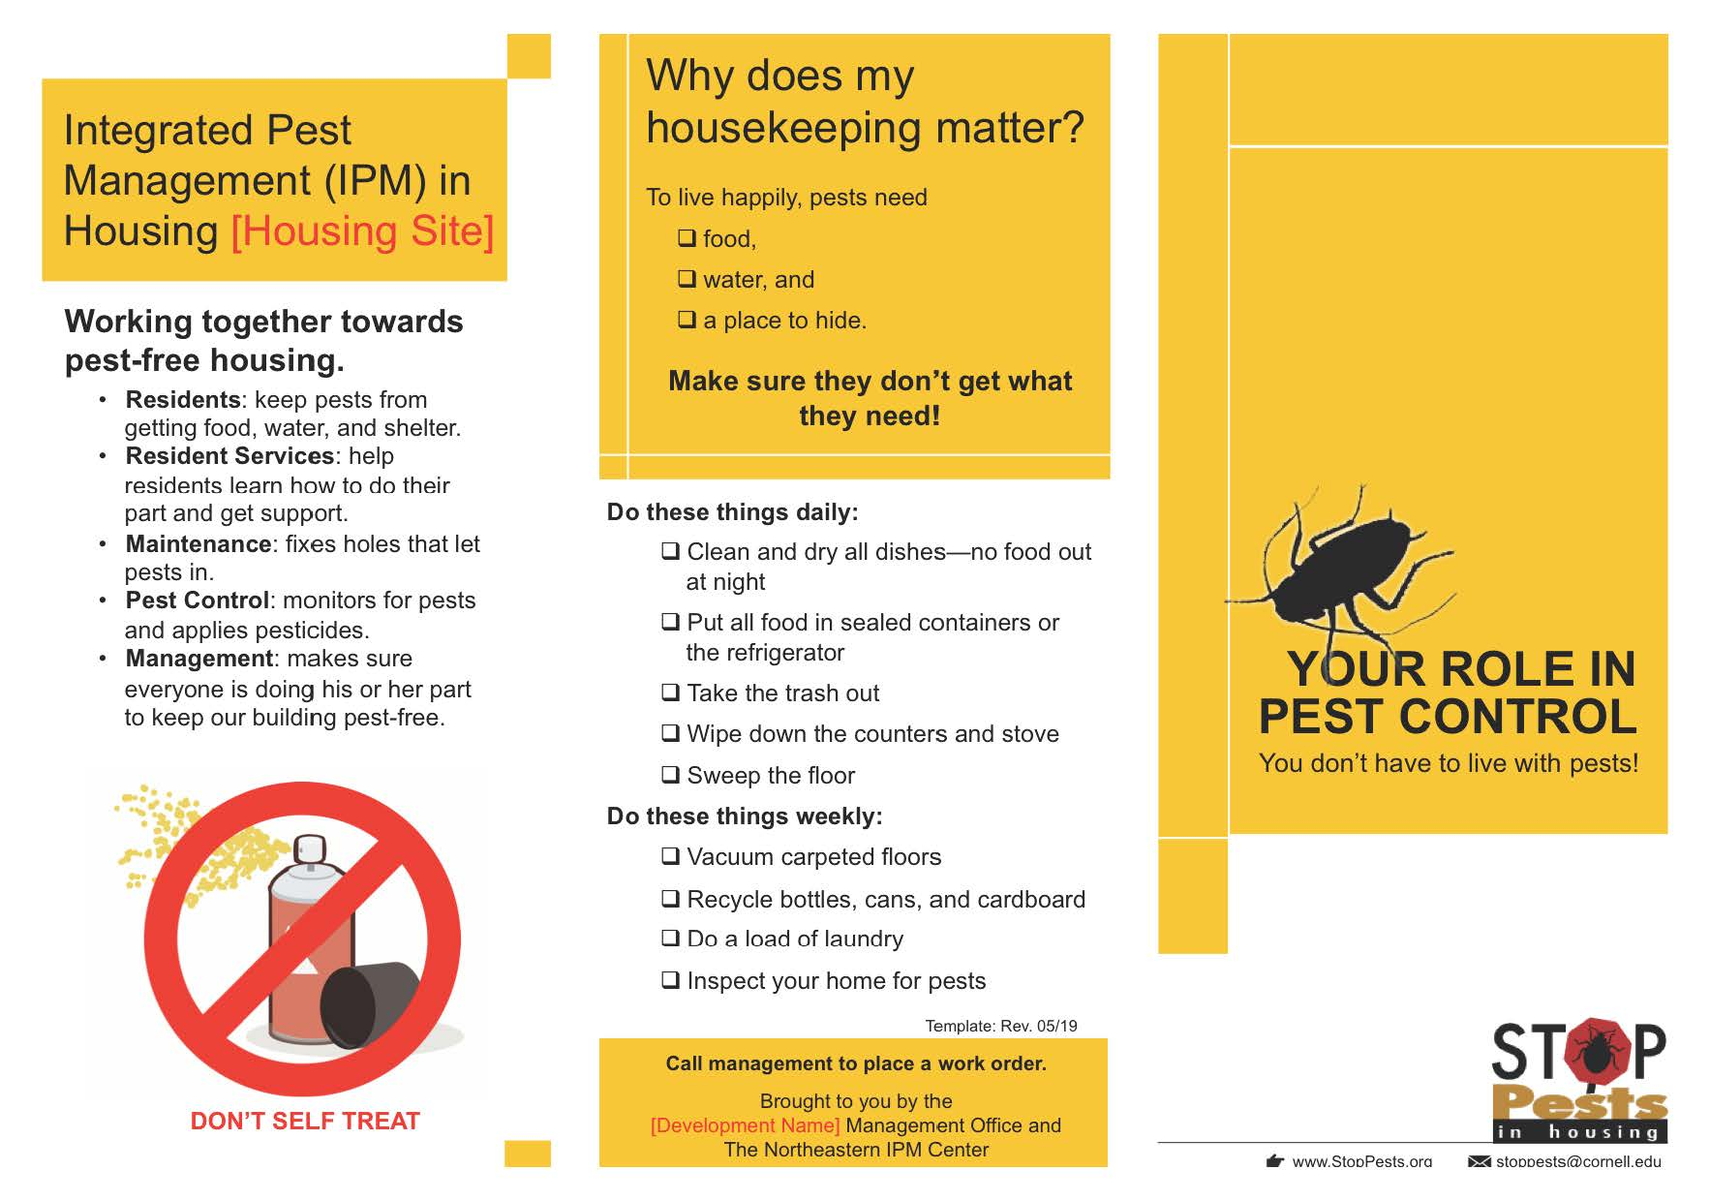
What’s in the IPM log?
  More resident info: This is the first page of a tri-fold flyer on the tenant’s role in IPM.
Find sample documents in your handouts or at stoppests.org
Notes:
Here’s another example of educational materials for residents, describing their role in IPM on a two sided tri-fold flyer.

Slide 51
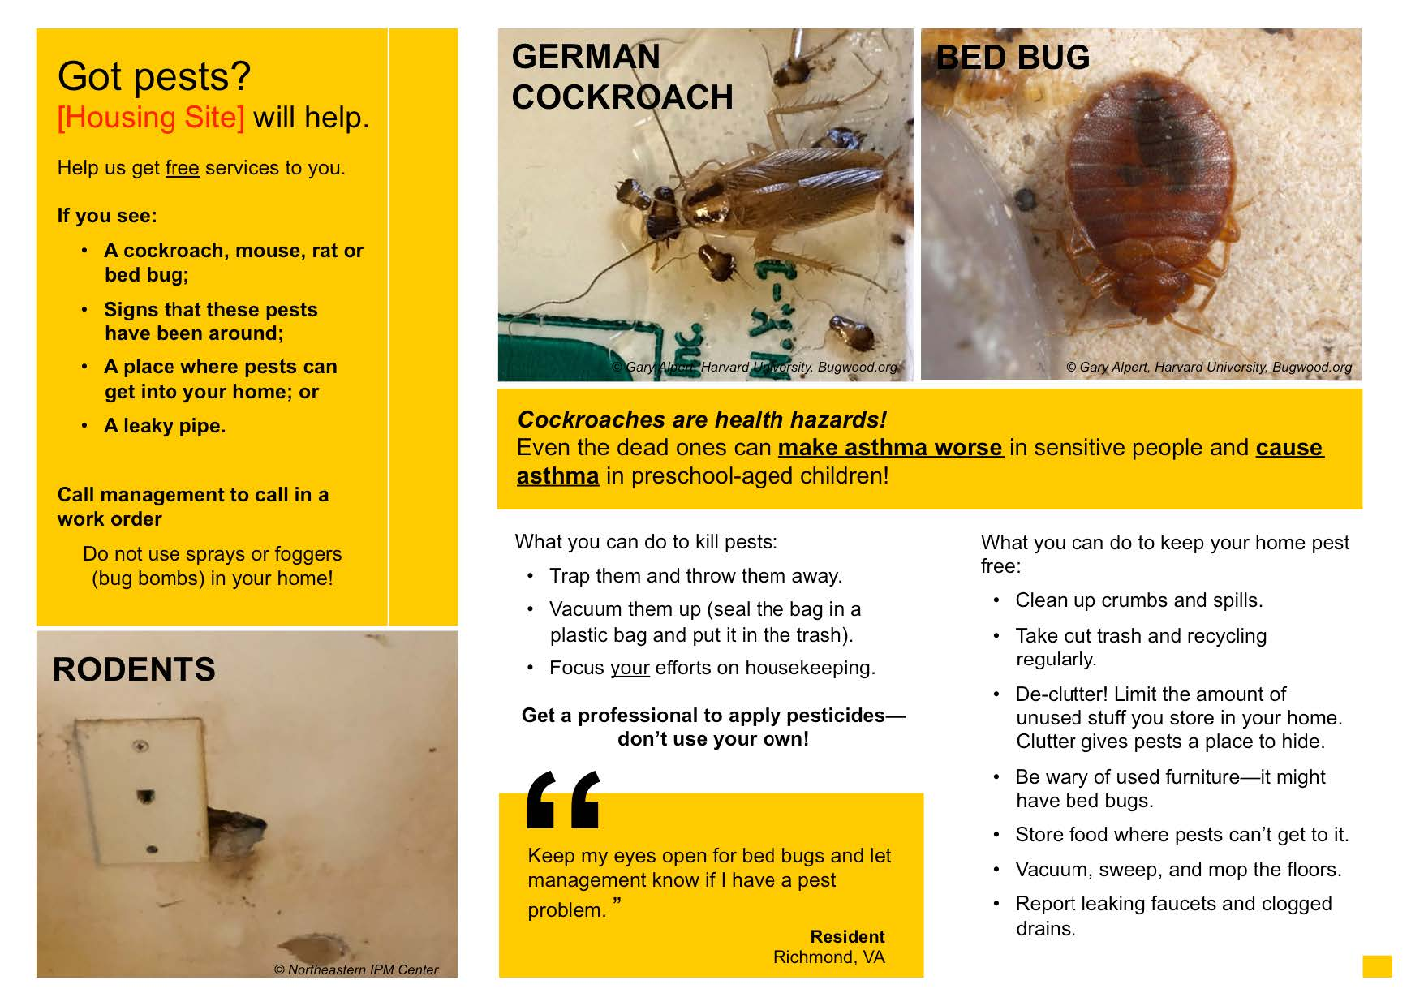
What’s in the IPM log?
  This is the second page of the flyer.
Find sample documents in your handouts or at stoppests.org
Notes:
Here’s the second page of that flyer. It shows some helpful ID pictures. This customizable template is available at stoppests.org.

Slide 52
What’s in the IPM log?
Other forms to include in the IPM Log include:
Service schedule
Applicator licenses
Proof of insurance and business registration
Potential notifications/ preparation instructions
Contract/service agreement (Review regularly!)
Find sample documents at stoppests.org
Notes:
Other forms that should reside in the IPM Log include:
Service schedule, showing when the PMP will visit, and which units will be seen.
Applicator licenses for PMP personnel
Proof of insurance and business registration for the PMP
Potential notifications and preparation instructions for residents regarding PMP visits
Contracts and service agreements between the facility and the PMP. It’s critical that the facility reviews these contracts regularly and understands the provisions contract.

Slide 53
What’s in the IPM log?
Examples of Log Entries include:
Locations of any traps and bait stations that are placed
Notes about resident cooperation for follow up by resident services
Notes about needed repairs for follow up by maintenance staff.
Copies of work orders will need to be filed, as well.
Find sample documents at stoppests.org
Notes:
Examples of Log Entries include:
Locations of any traps and bait stations that are placed
Notes about resident cooperation for follow up by resident services
Notes about needed repairs for follow up by maintenance staff.
Copies of work orders related to IPM should be included, as well.
Reviewing the IPM log will reveal patterns. It will also show the PMP the nature and location of problems so that they can respond appropriately.

Slide 54
Does your organization have an IPM Log?
Yes, contains all of these documents
Yes, contains some of these documents
No
I don’t know
Notes:
Ask the audience

Slide 55
What form is your organization’s IPM Log?
Electronic – all on the computer
Paper
Some electronic, some paper
I don’t know
Notes:
Ask the audience

Slide 56
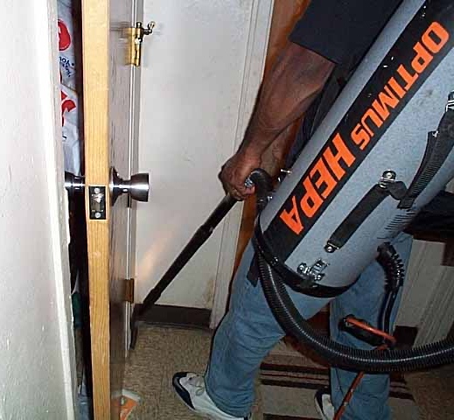
At first more work, but then less
At First
More Education, Repairs, and Monitoring
Increased Work Orders
Pests and pest-friendly conditions that were previously overlooked are reported
Then…
Fewer Complaints
Fewer Pests
A Better Place To Live
Notes:
IPM won’t be successful if it’s implemented half-heartedly. And embracing an IPM program may seem like more work.
Property management will have to invest time and money to get caught up on repairs. But these repairs are essential to IPM and protecting the building from the damaging effects of moisture.
Once fixed, the building must be maintained.
Pest management will be an everyday event, as preventative measures will be taken so that pest levels are reduced and remain low.
At the beginings of their IPM program The Boston Housing Authority had a lot of repair work requested because unreported problems were finally noticed and reported.
<click> But then, as the repairs were made, and pests were controlled, they experienced fewer work orders than before the IPM program began.

Slide 57

What’s a Pesticide?
Any substance or mixture of substances intended for:
  Preventing
  Destroying
  Repelling or
  Mitigating
…any pest
Notes:
In an IPM program, we use pesticides when necessary and appropriate.
Let’s talk about pesticides for a moment.
<click>The EPA defines pesticides as any substance or mixture of substances intended for preventing, destroying, repelling, or mitigating
<click> any pest..
The EPA takes great care to review the uses of pesticides to avoid impacts to people and the environment.
But EPA assumes that people will follow the pesticide label.
Labels are the law, with instructions as to where and how the pesticide can be legally applied.

Slide 58

Pesticides
Pesticides should be applied only by a licensed PMP
The label is the law
EPA does not assess effectiveness, only risk/benefit when used in accordance with the label
Look for the key words Caution, Danger and Poison
Notes:
In an IPM program, when pesticides are necessary, residents and staff should leave their application to the professional.
PMPs take much longer courses to understand each of the pests, and that is why they are needed in any pest management effort. Address any pesticide questions to your PMP. Qualified PMPs should know all the answers or be willing to get them.
<Click>The label is the law; EPA does not assess effectiveness, only risk/benefit when used in accordance with the label
<click>Three key words are used on pesticide labels to define the relative risk to humans. These are Caution, Danger and Poison.
With an IPM program in place, almost all infestations can be managed with a lower-risk pesticide that says, "CAUTION" on the label, as they pose the least risk to humans.
DANGER or POISON means that the pesticide product is more toxic by at least one route of exposure.

Slide 59
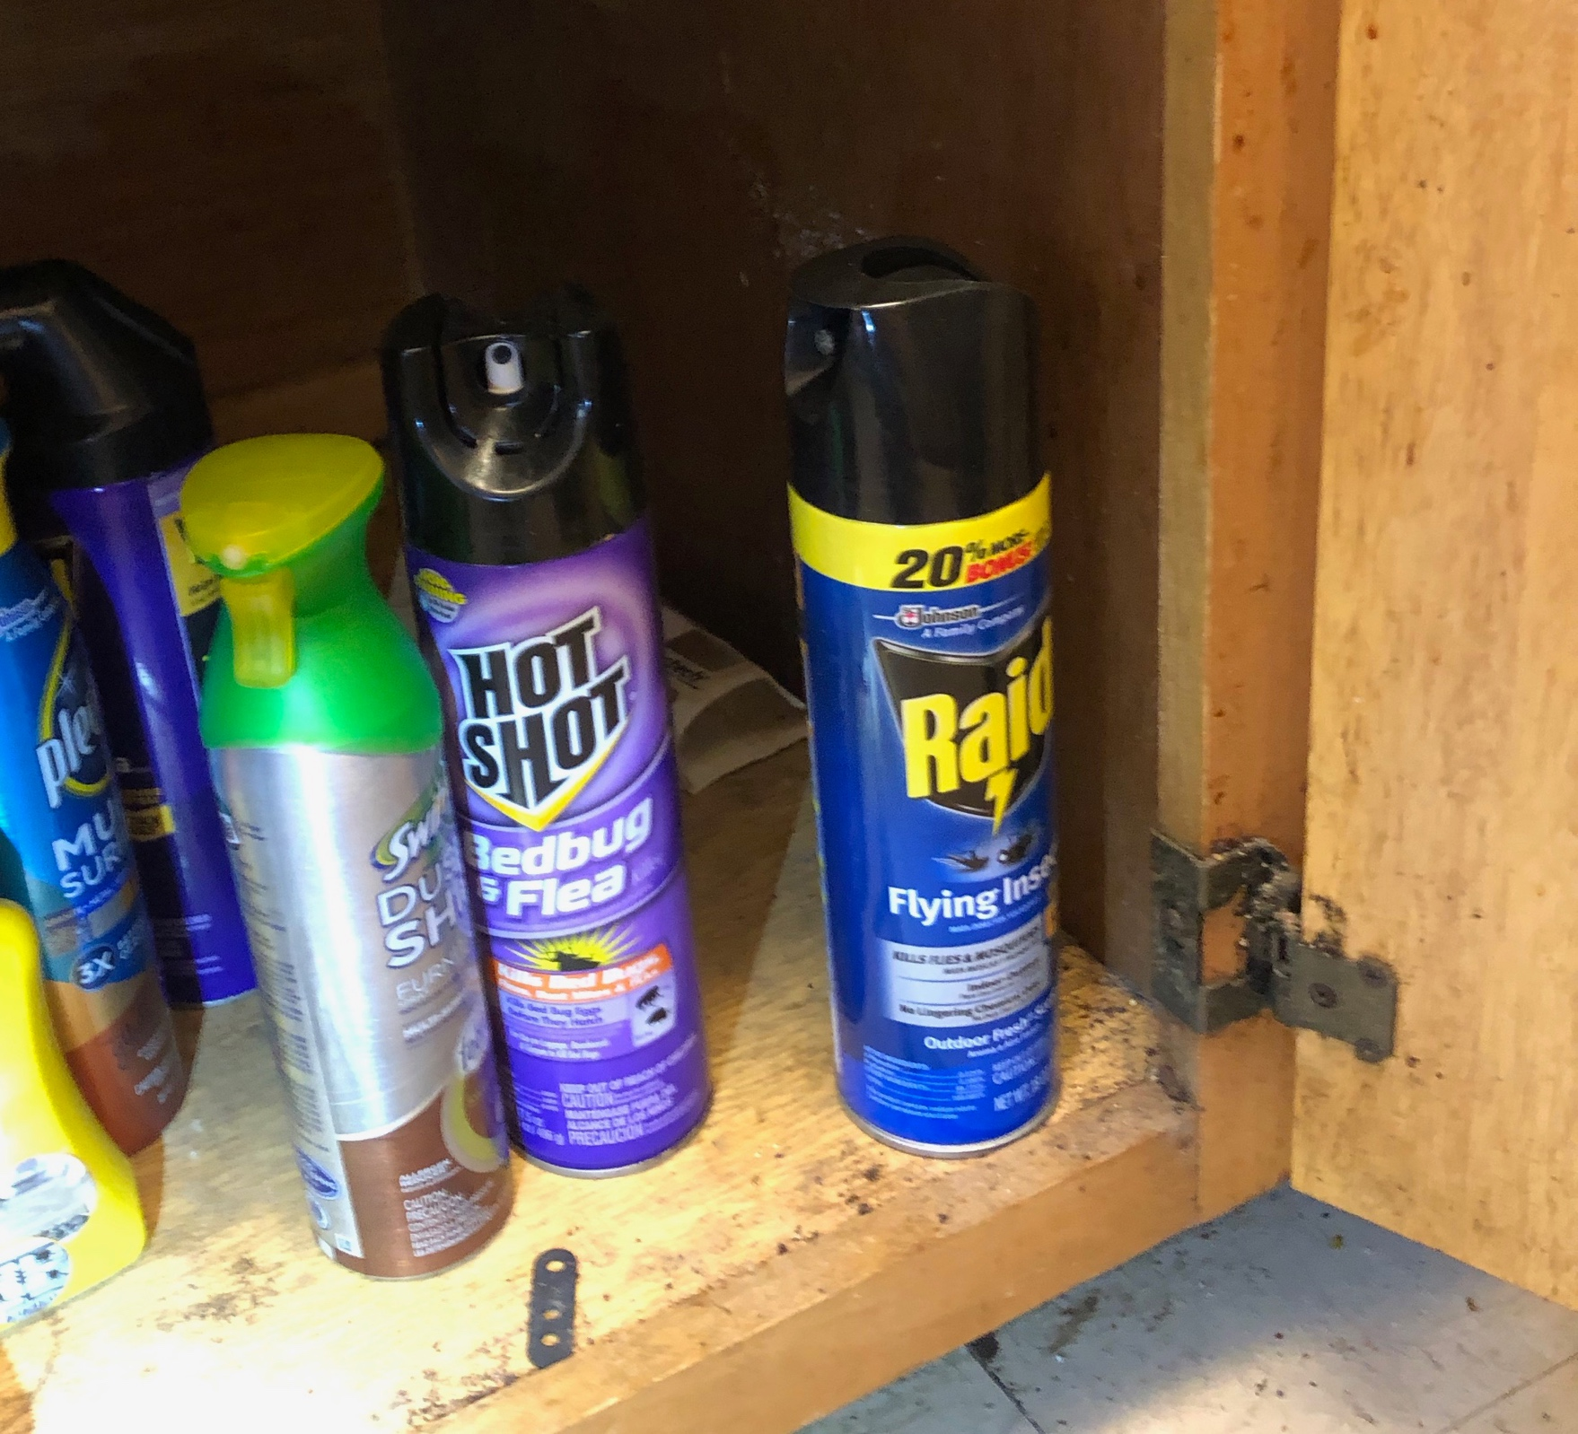
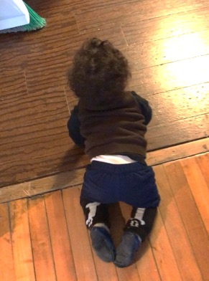
The chemicals that people use to kill pests pose a risk to humans, too
Notes:
By self-treating with pesticides, residents and staff could unnecessarily expose themselves and their families to pesticides and make the pest problem worse.
For these reasons, it it’s best to use reduced-risk practices, to follow label instructions, and to practice prevention-based approaches that reduce reliance on chemical control measures.

Slide 60

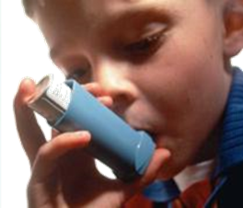
Concerns with Pesticides
Vulnerable populations:
  Elderly, children, pregnant women
  People with breathing or lung disorders such as asthma
  People with chemical sensitivities
Notes:
60
The elderly, pregnant women, and young children are at greater risk for adverse health effects associated with exposure to pesticides. Children are more vulnerable than adults because they are closer to the floor, do not have high tolerance for toxins, and put many things in their mouths. Pregnant women also are more vulnerable to pesticides. In addition, when exposed to pesticides, people with chemical sensitivities experience adverse reactions and will not be able to participate in daily activities.
Under the Fair Housing Act, chemical sensitivities can constitute a handicap.
Special attention must be given to people with chemical sensitivities so that they receive pest management services that meet their needs. Conventional pesticides should not be used in the units occupied by people with chemical sensitivities, or in adjacent or neighboring units, or in common areas such as the halls, lobbies, laundry rooms, elevators, or stairs, or along paths of travel for disability access.
Property managers and maintenance crews must identify residents who are especially vulnerable to chemical exposure. Some residents may not be able to tolerate the presence of chemicals in their units, or they may feel that admitting a PMP to their unit may expose them to the pesticides present on the PMP’s clothing.
Working with residents is an important part of the property manager’s responsibilities.

Slide 61
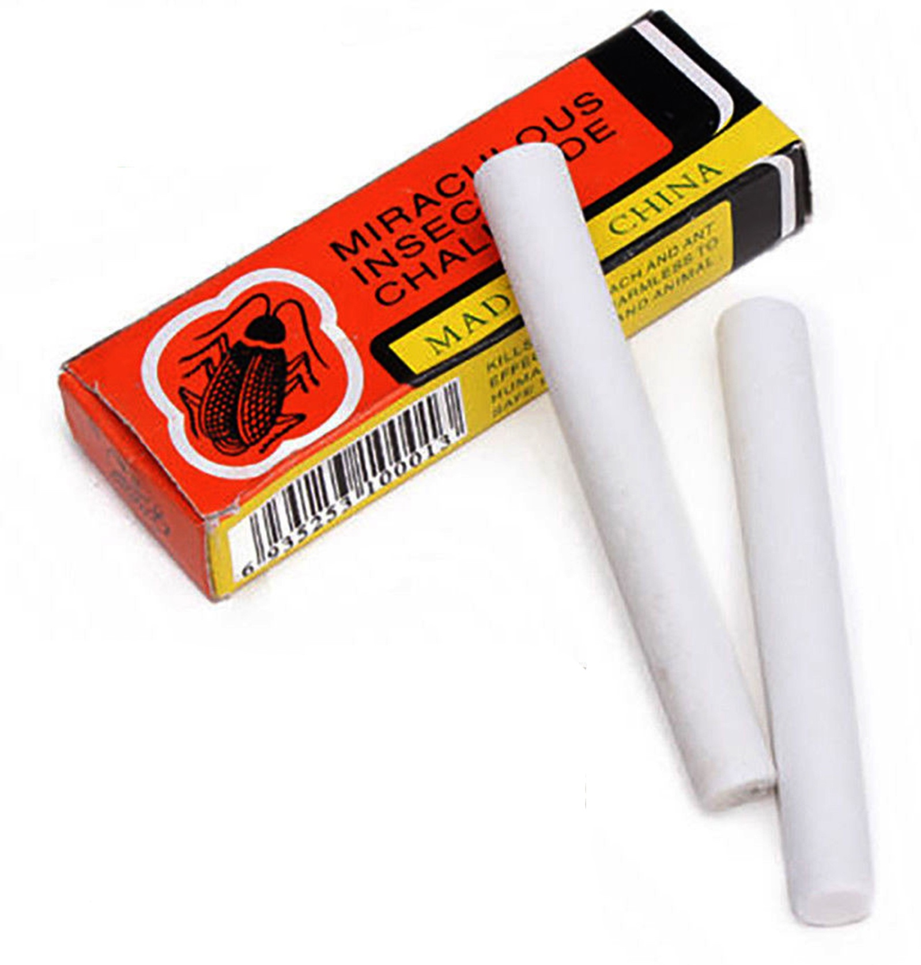
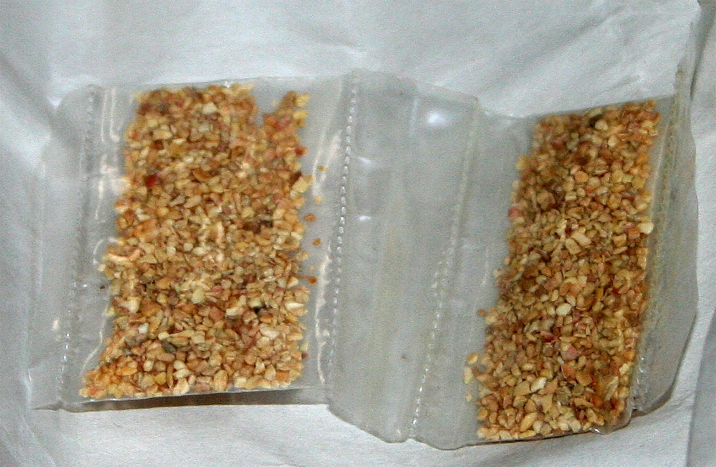
Concerns with Pesticides
Residents use of “illegal” pesticides
Notes:
There are a number of concerns related to illegal pesticide use.
Pesticides are considered illegal when they are not registered by the EPA or the state where they are used, or when they are used against the label.
Illegal pesticides may be stronger than ones that are legal, or approved, for residential use. People may be tempted to purchase and use illegal pesticides because they are fast-acting. These products, commonly sold by street vendors, at markets, or through the internet, are harmful to people and pets, and should not be purchased or used.
Pictured are two examples of illegal pesticides, Chinese chalk and tres pasitos.

Slide 62
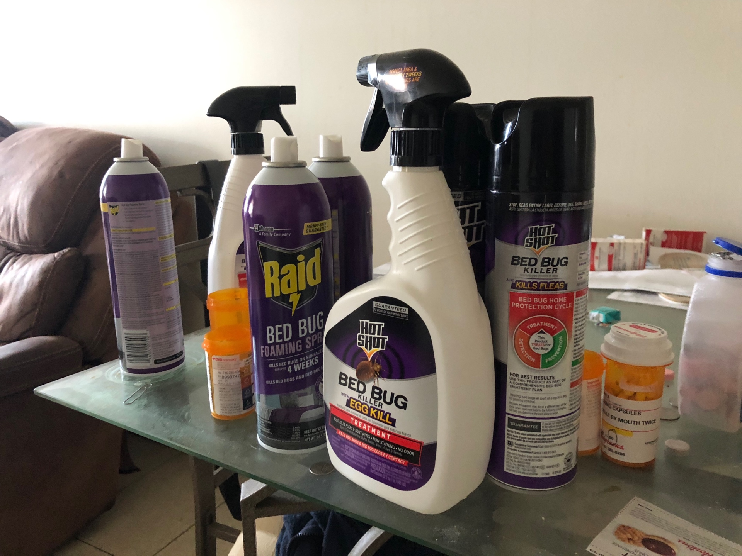
Concerns with Pesticides
Residents use of “illegal” pesticides
Pests become tolerant/avoid
Exposure risk may outweigh benefit
Possible harm to pets and wildlife
Notes:
Pests often develop resistance to pesticides, or develop an aversion, or avoidance, to some chemicals.
Over the counter sprays act as repellants, pushing the pests further into hiding, making them harder to treat.
The risk from Exposure may outweigh benefit
Possible harm to people, pets and wildlife
Consider instituting a pesticide “buy-back”, where residents can turn in the pesticides they have in their home, and receive something of value. Could your agency provide cleaning kits or gift cards in return?

Slide 63
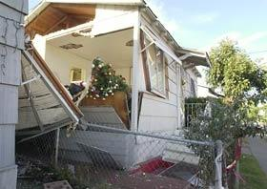
Total Release Foggers or “bug bombs”
Chemicals fail to reach places where pests congregate
San Diego, CA, July 1992
Notes:
63
The products commonly known as “bug bombs” are officially called “total release foggers.”
In the hands of a consumer, they are prone to dangerous misuse. The propellant that spreads the insecticide through the air is flammable and can create an explosion.
<click>These photos show houses and apartments destroyed by “bug bombs” that were used incorrectly.

Slide 64
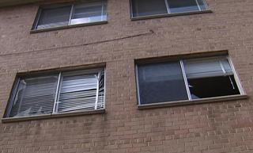
Total Release Foggers “bug bombs”
Chemicals fail to reach places where pests congregate
Nasty toxic residue in… areas pests generally avoid but which are heavily used by humans and pets
Washington, DC,
August 2008
Notes:
64
They release a very fine mist of pesticides into the air from pressurized cans, and pose a risk of exposure similar to sprays.
In a study from North Carolina State University, they found total release foggers were ineffective at eliminating cockroaches. Researchers say bug-bomb chemicals fail to reach places where cockroaches congregate the most – on the underside of surfaces and behind counters and cabinets and wall voids.
Besides leaving behind numerous cockroaches, bug bombs also leave behind pesticide residue in the middle of floors and on countertops, These are areas cockroaches generally avoid, but which are heavily used by humans and pets.

Slide 65
Pesticide Risk
Notes:
Pesticides are harmful to pests, and they aren’t good for people, either.
The total risk associated with any pesticide is determined by both the toxicity of the chemicals it contains, and the risk of a person being exposed to the product.

Slide 66
Pesticide risk of exposure by application method
Less risk of exposure
More risk of exposure
Tamper- resistant station
Gel bait
in a crevice
Total release fogger
Notes:
Exposure increases the risk of a pesticide.

Slide 67
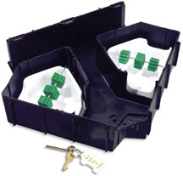
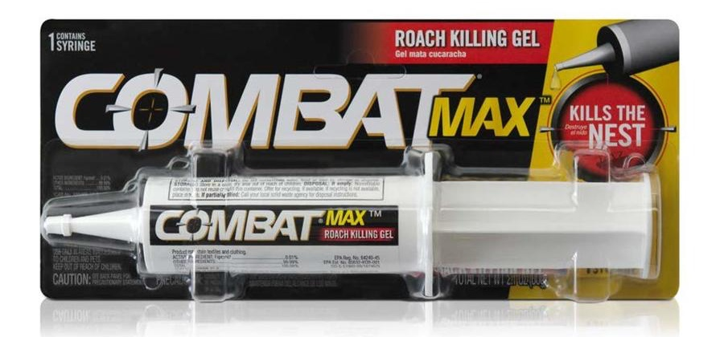
Pesticide risk of exposure by application method
Less risk of exposure
More risk of exposure
Notes:
Pesticides that are concealed in tamper-resistant packaging or bait stations, pose less risk to humans. Rodenticides are some of the most toxic pesticides, they are made to kill mammals. But because they are placed in a tamper-resistant bait station, there’s very little risk that human will be exposed to them. This makes them safer than an insecticide spray or bug bomb that covers all of the surfaces in our homes.

Slide 68
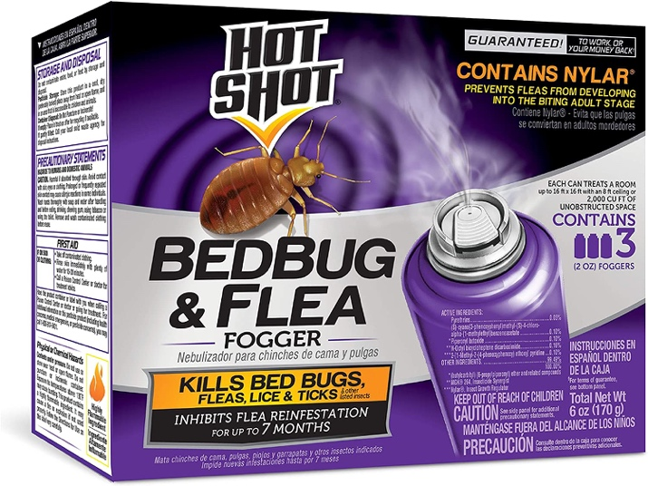
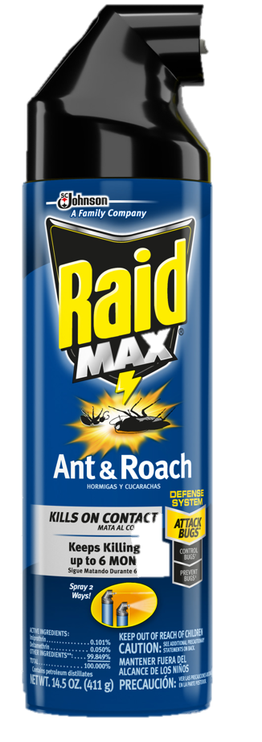
Pesticide risk of exposure by application method
Less risk of exposure
More risk of exposure
Notes:
touching a pesticide that can be seen is not the only way we can be exposed to pesticides.
Consider that pesticides can get into the air and remain on surfaces we touch, even when they can’t be seen or smelled.
An insecticide spray or bug bomb that covers all of the surfaces in our homes is much riskier.

Slide 69
Pesticide risk of exposure by application method
Less risk of exposure
More risk of exposure
Notes:
Another risk to consider is that someone could misuse a pesticide by applying it incorrectly., either for the wrong pest, or using more product than the label prescribes.

Slide 70


How to Read a Label
Notes:
Here’s a graphic from the National Pesticide Information Center on reading pesticide labels.

Slide 71


How to Read a Label
EPA Registration number
Notes:
All pesticides registered with the EPA will have this information on the label: The EPA Registration number, which shows that the product was submitted to the EPA for evaluation.

Slide 72

How to Read a Label
EPA Registration number
Precautionary Statements
Notes:
Precautionary Statements, which list particular hazards to humans and pets, and in general, how the product can be used safely.

Slide 73


How to Read a Label
Directions for: Use, Storage and Disposal
Notes:
and Directions for Use, Storage, and Disposal. It is not only dangerous to ignore these instructions, it is against the law.

Slide 74

Signal Words on the Label
Signal words:
CAUTION = slightly toxic
WARNING = moderately toxic
DANGER = severe skin or eye irritation
DANGER-POISON = highly toxic
Notes:
Remember, with an IPM program in place, almost all infestations can be managed with a pesticide that says, "CAUTION" on the label.
DANGER means that the pesticide product is highly toxic by at least one route of exposure. It may be corrosive, causing irreversible damage to the skin or eyes. Alternatively, it may be highly toxic if eaten, absorbed through the skin, or inhaled. If this is the case, then the word “POISON” must also be included in red letters on the front panel of the product label.
Pesticides (other than tamper resistant stations containing bait) should be applied only by a licensed PMP.

Slide 75

Notes:
Residents, and even maintenance staff, can become complacent about the dangers of pesticides.
But remember, just because they’re available in many stores, does not mean they’re safe, or even effective.
This photo shows the pesticide section in the grocery store – right next to the gift wrap and the Barbie display.

Slide 76
Do your residents apply pesticides on their own?
Yes, without restrictions
Sometimes, although we have a policy against it
Never
I don’t know
Notes:
Ask the audience

Slide 77
If they’re so bad, why do people tolerate exposure to pests and pesticides?
Low standards for pest control and maintenance
Other priorities
Not aware of the problems
Accustomed to living with problems, and cannot envision a better way
Notes:
77
So why do people tolerate exposure to pests and pesticides?
<click>Residents may have low expectations for pest control and maintenance, or feel their complaints won’t be acted upon.
<click>They may have other priorities
<click>Sometimes, residents are not even aware of the problems. They may not recognize the signs of infestation, or be aware that pesticides are harmful to humans.
<click>And sometimes, they’ve been accustomed to living with problems, and simply cannot envision a better way.
But there is a better way to manage pests than just using conventional pesticides.
As we move into the pest-specific modules, you will learn solutions for dealing with the three priority pests that are more effective and safer for everyone who lives and works in housing.

Slide 78
Inspect & Monitor
IPM
Program
Lifecycle
Evaluate Success
Identify
Use Multiple Tools
Scale the Response
Notes:
What have we learned? IPM is a decision-making process that emphasizes prevention, knowledge of pest biology, and the use of least-disruptive control tactics, with pesticides saved as a last resort.
In a structural setting, an IPM program consists of:
Inspection & monitoring
Identification
Scaling the response to the level of infestation
Employment of two or more control measures (which may be, mechanical, biological, chemical, or a behavior change), and
Evaluation of effectiveness , which has us circle back to inspection & monitoring

Slide 79
The IPM Team
Property
Manager
Pest
Management
Professional
Resident
IPM
Coordinator
Landscaping
Services
Maintenance
crew
Resident
Support
Services
Procurement
Specialist
Janitorial/
Custodial
Notes:
As a review – Successful IPM programs are the Results of a Team Approach
An inspection and monitoring system that finds pests
A reporting system that identifies areas for improvement
Units that are prepared to receive effective treatment
Communication that empowers everyone involved
and, Fewer pests and a healthier environment

Slide 80
Questions
?
Notes:
Are there any questions?

Slide 81
Homework:
Find your IPM log
Remembering our suggested list of contents, is yours complete?
What should you add?

Slide 82

Stoppests.org
Notes:
Please remember that many of the resources that we’ve mentioned are available on our website, stoppests.org.
Click>Prerecorded webs,<click> request training, click>find materials, click>using IPM templates, policies,
click> resources for residents, click>handouts at online course <click> subscribe to our blog

